Slide 1

Parks Asset Management Journey
City of Lethbridge

Slide 2
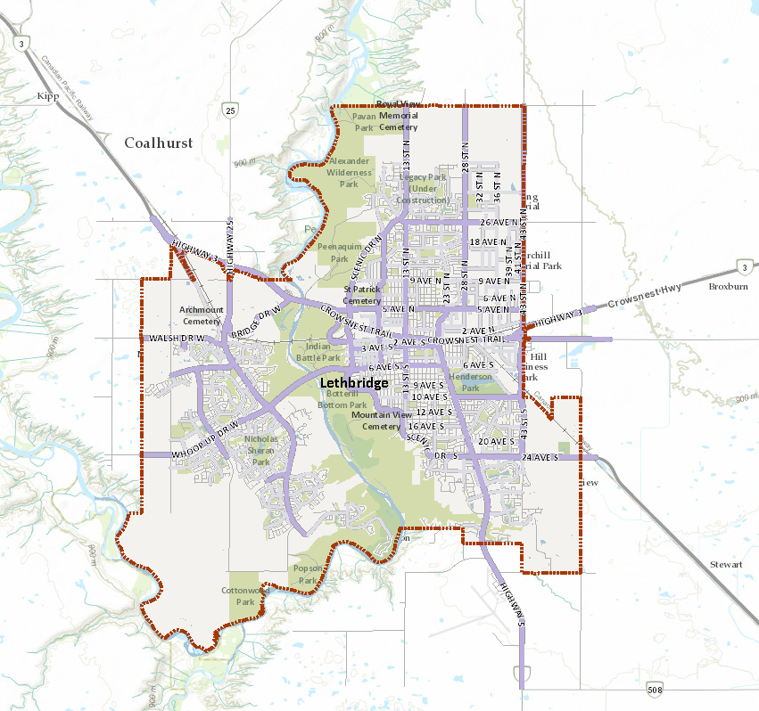
The City of Lethbridge
2017 census: 98,198
2712 ha of parkland and public green space
- 868 ha of maintained parks and green space
- 1844 ha of river valley parkland and natural areas

Slide 3
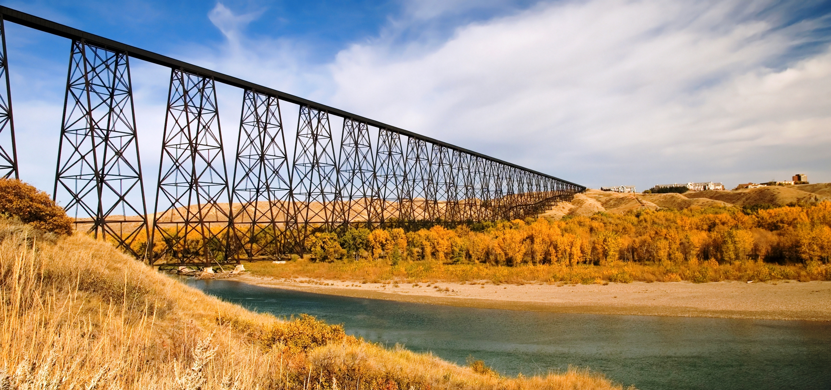

Slide 4
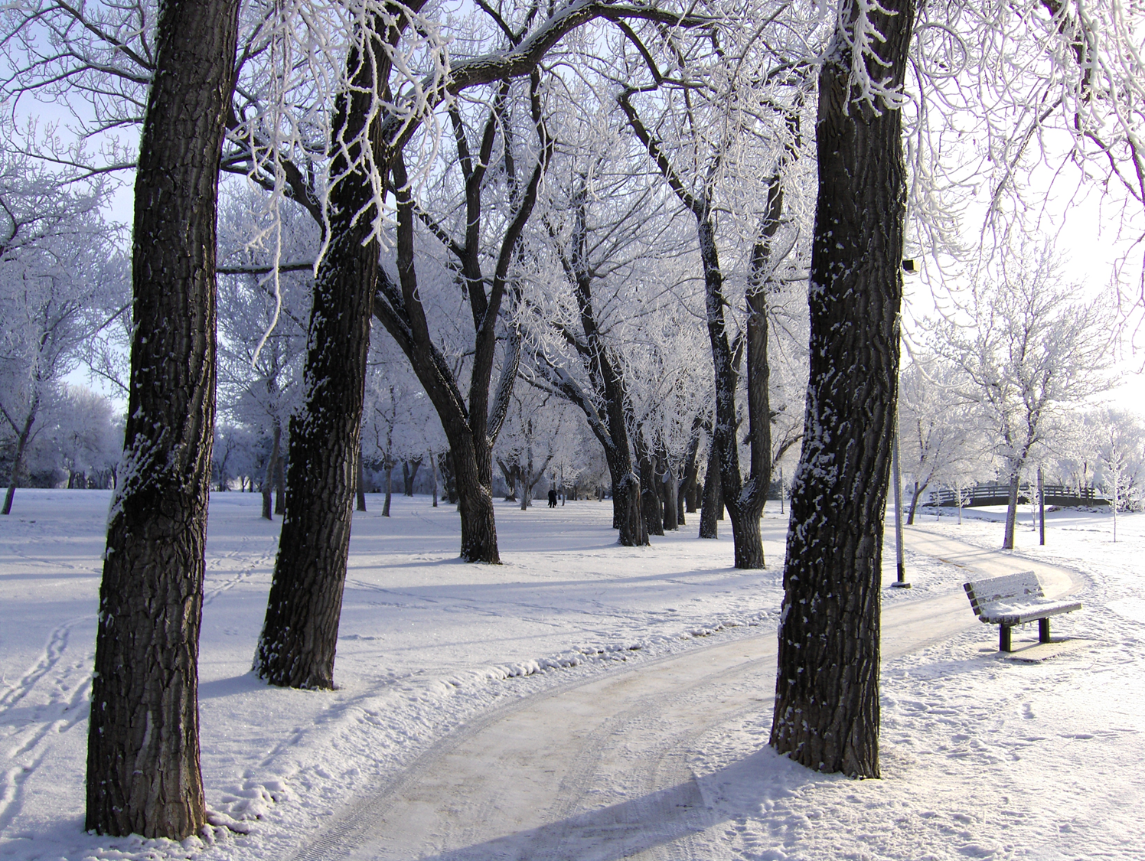
Lethbridge Parks
AM Journey
2006 Corporate CAMP
2009 Parks asset inventory initiated
2010 Levels of service (LOS) standards & Parks asset conditions descriptions
2013 Parks condition audit
2015 LOS updated
2016 Cityworks
2017 Asset Planner

Slide 5
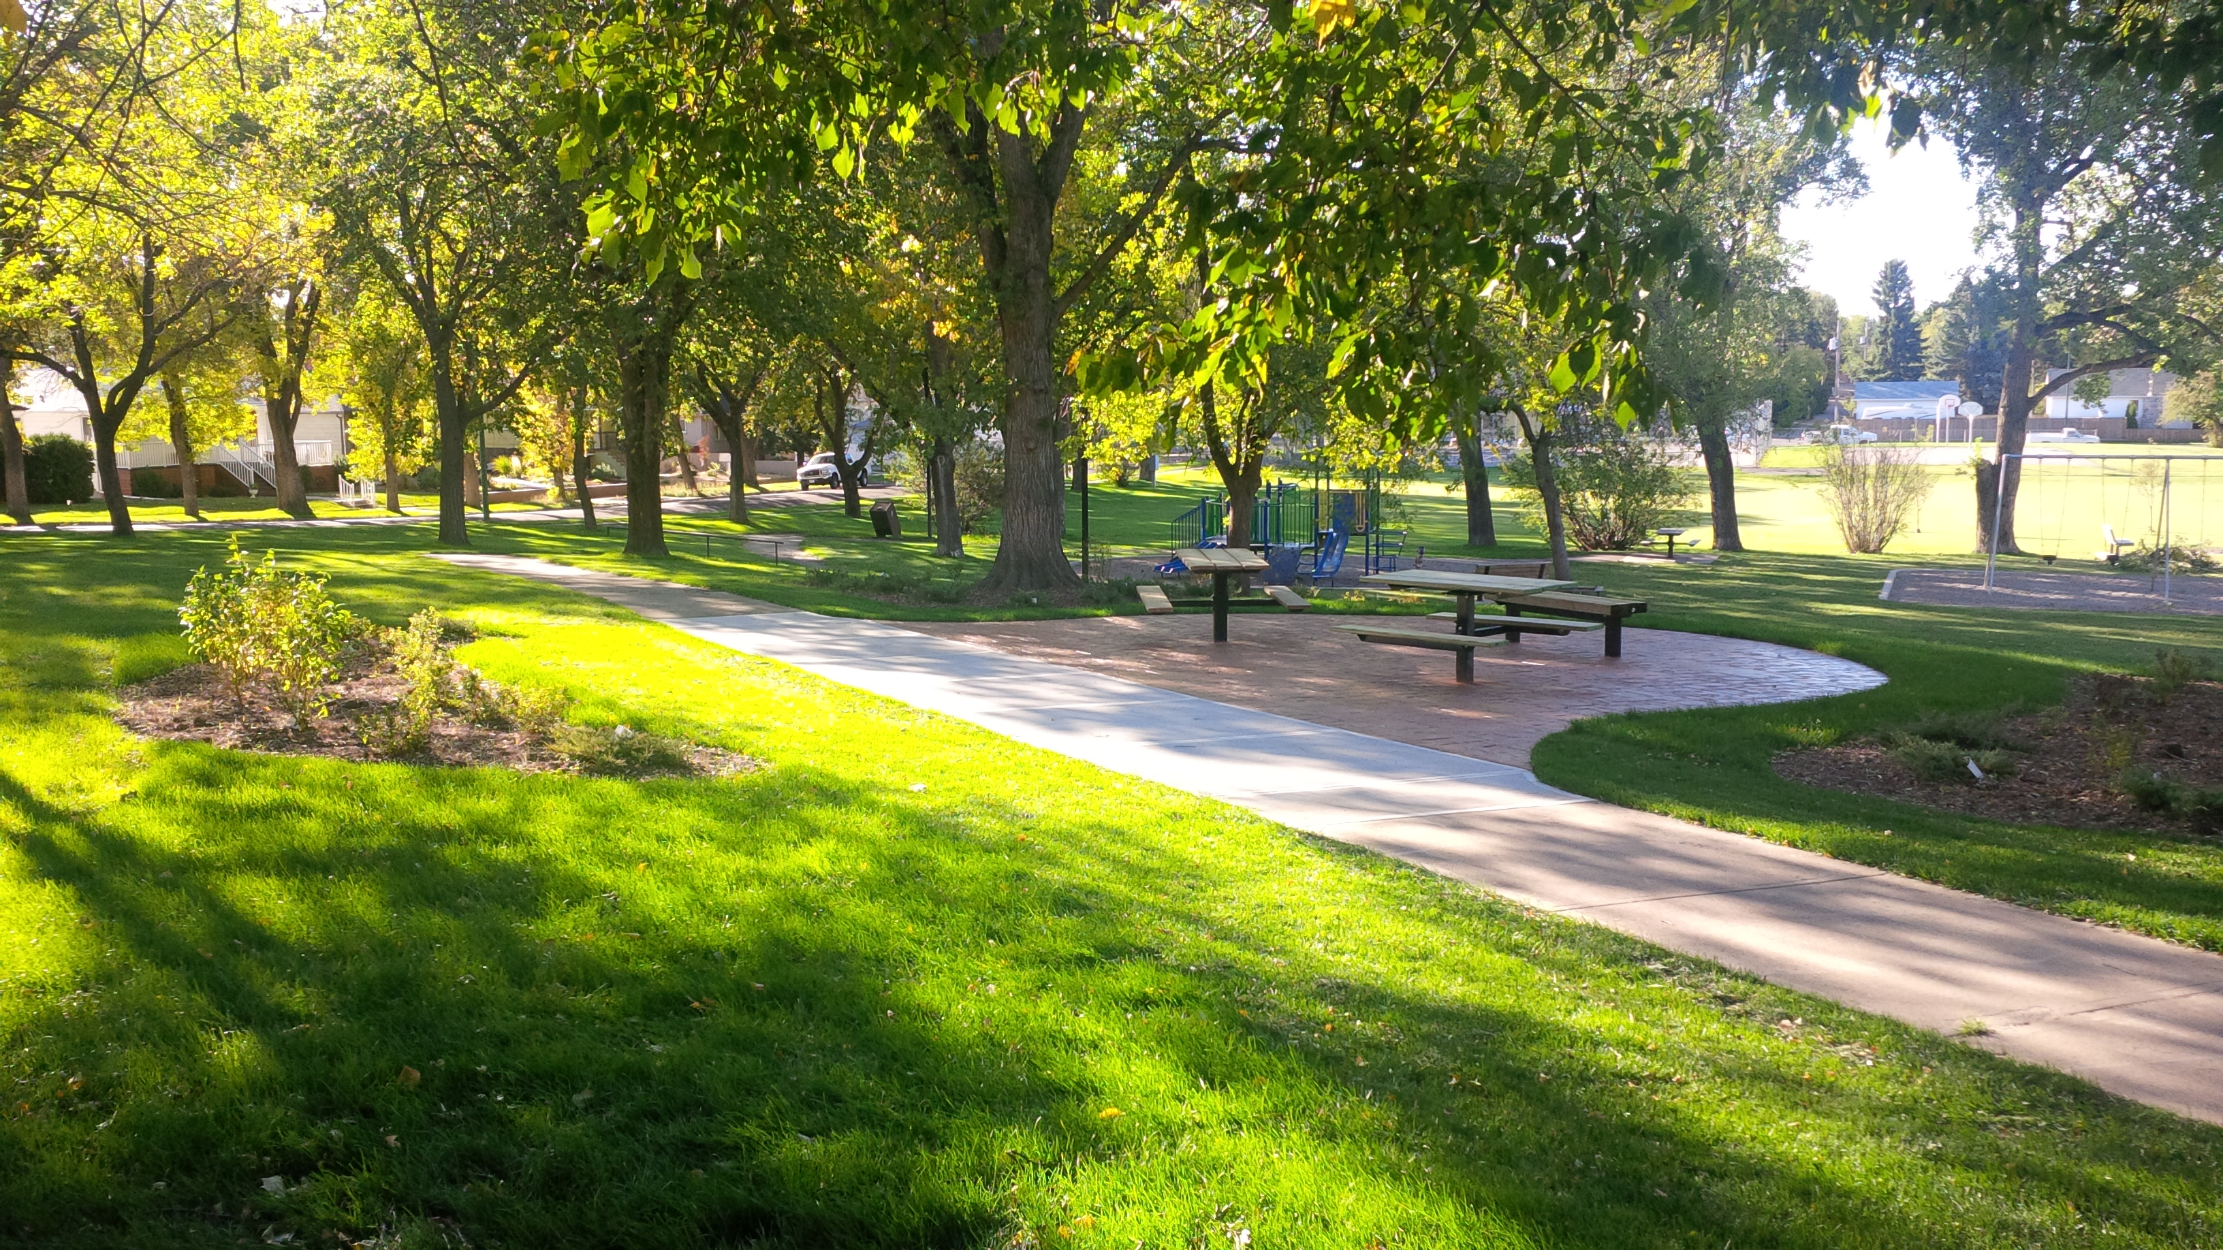

Slide 6
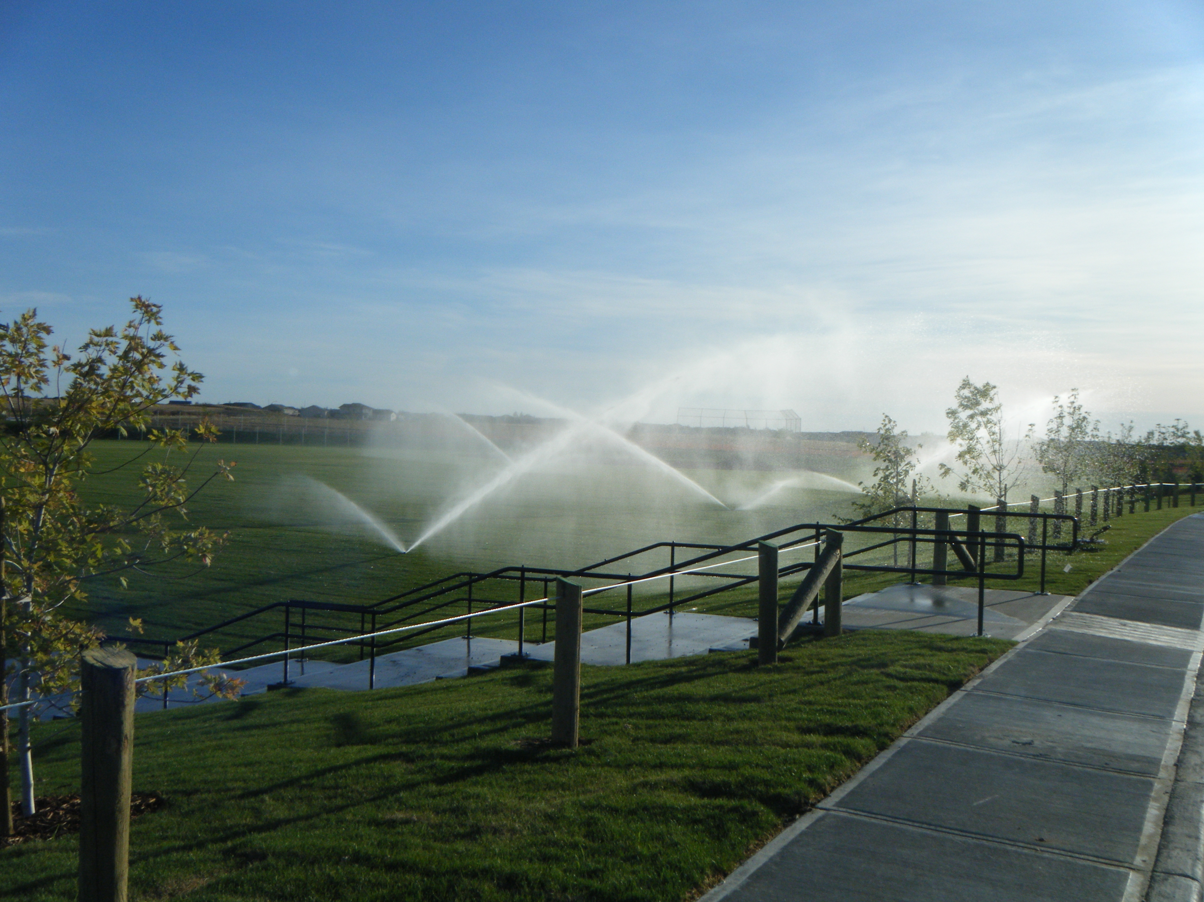

Slide 7
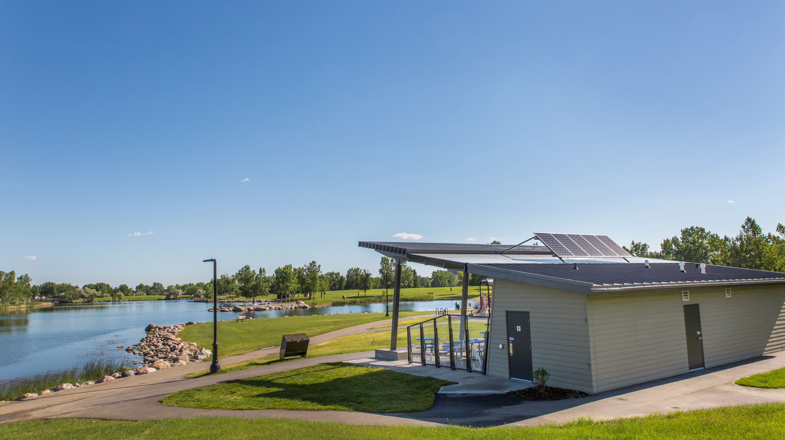

Slide 8
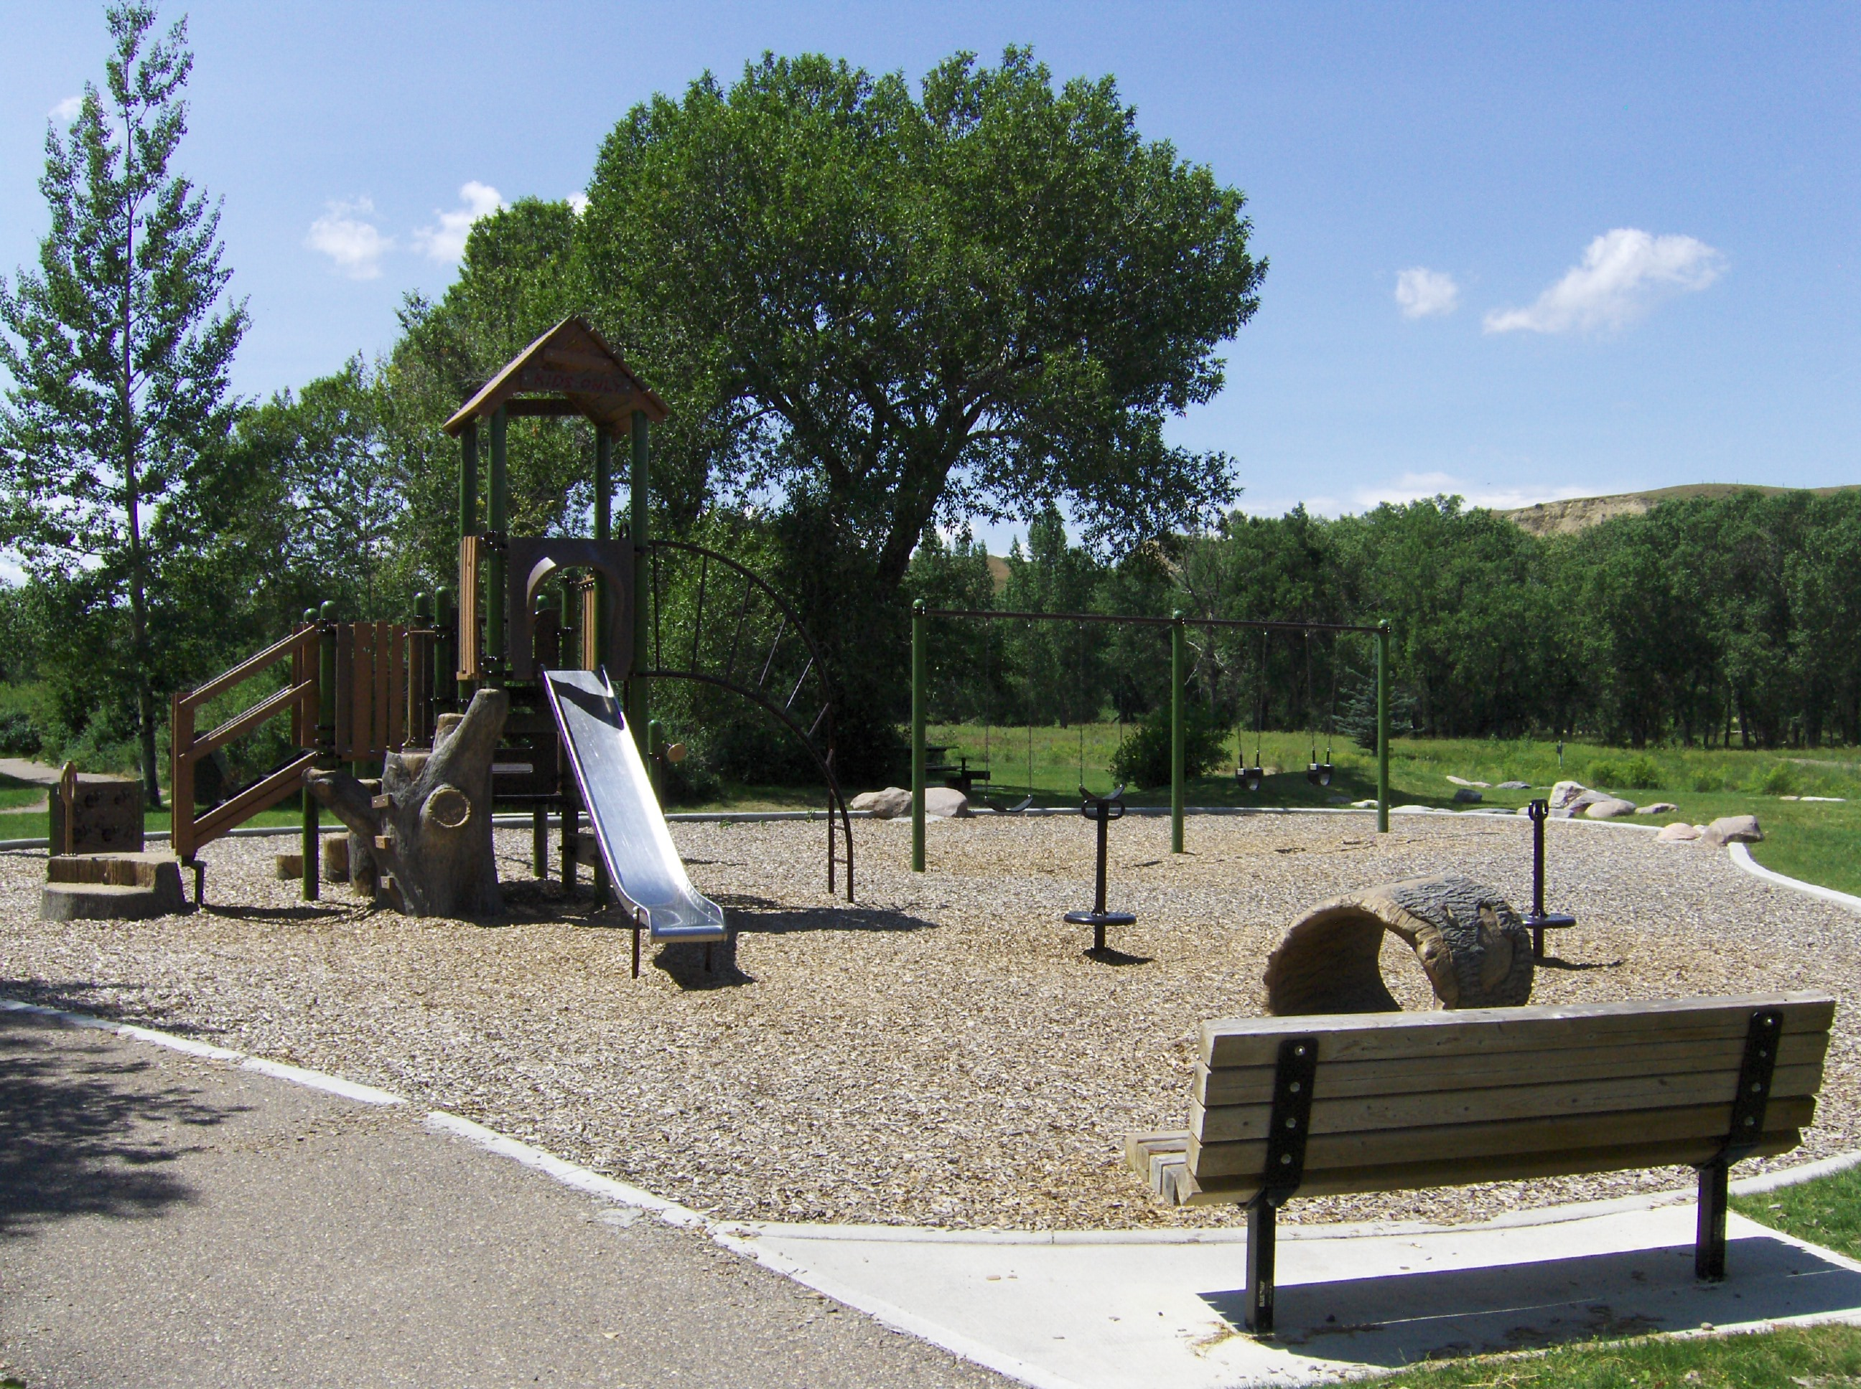

Slide 9
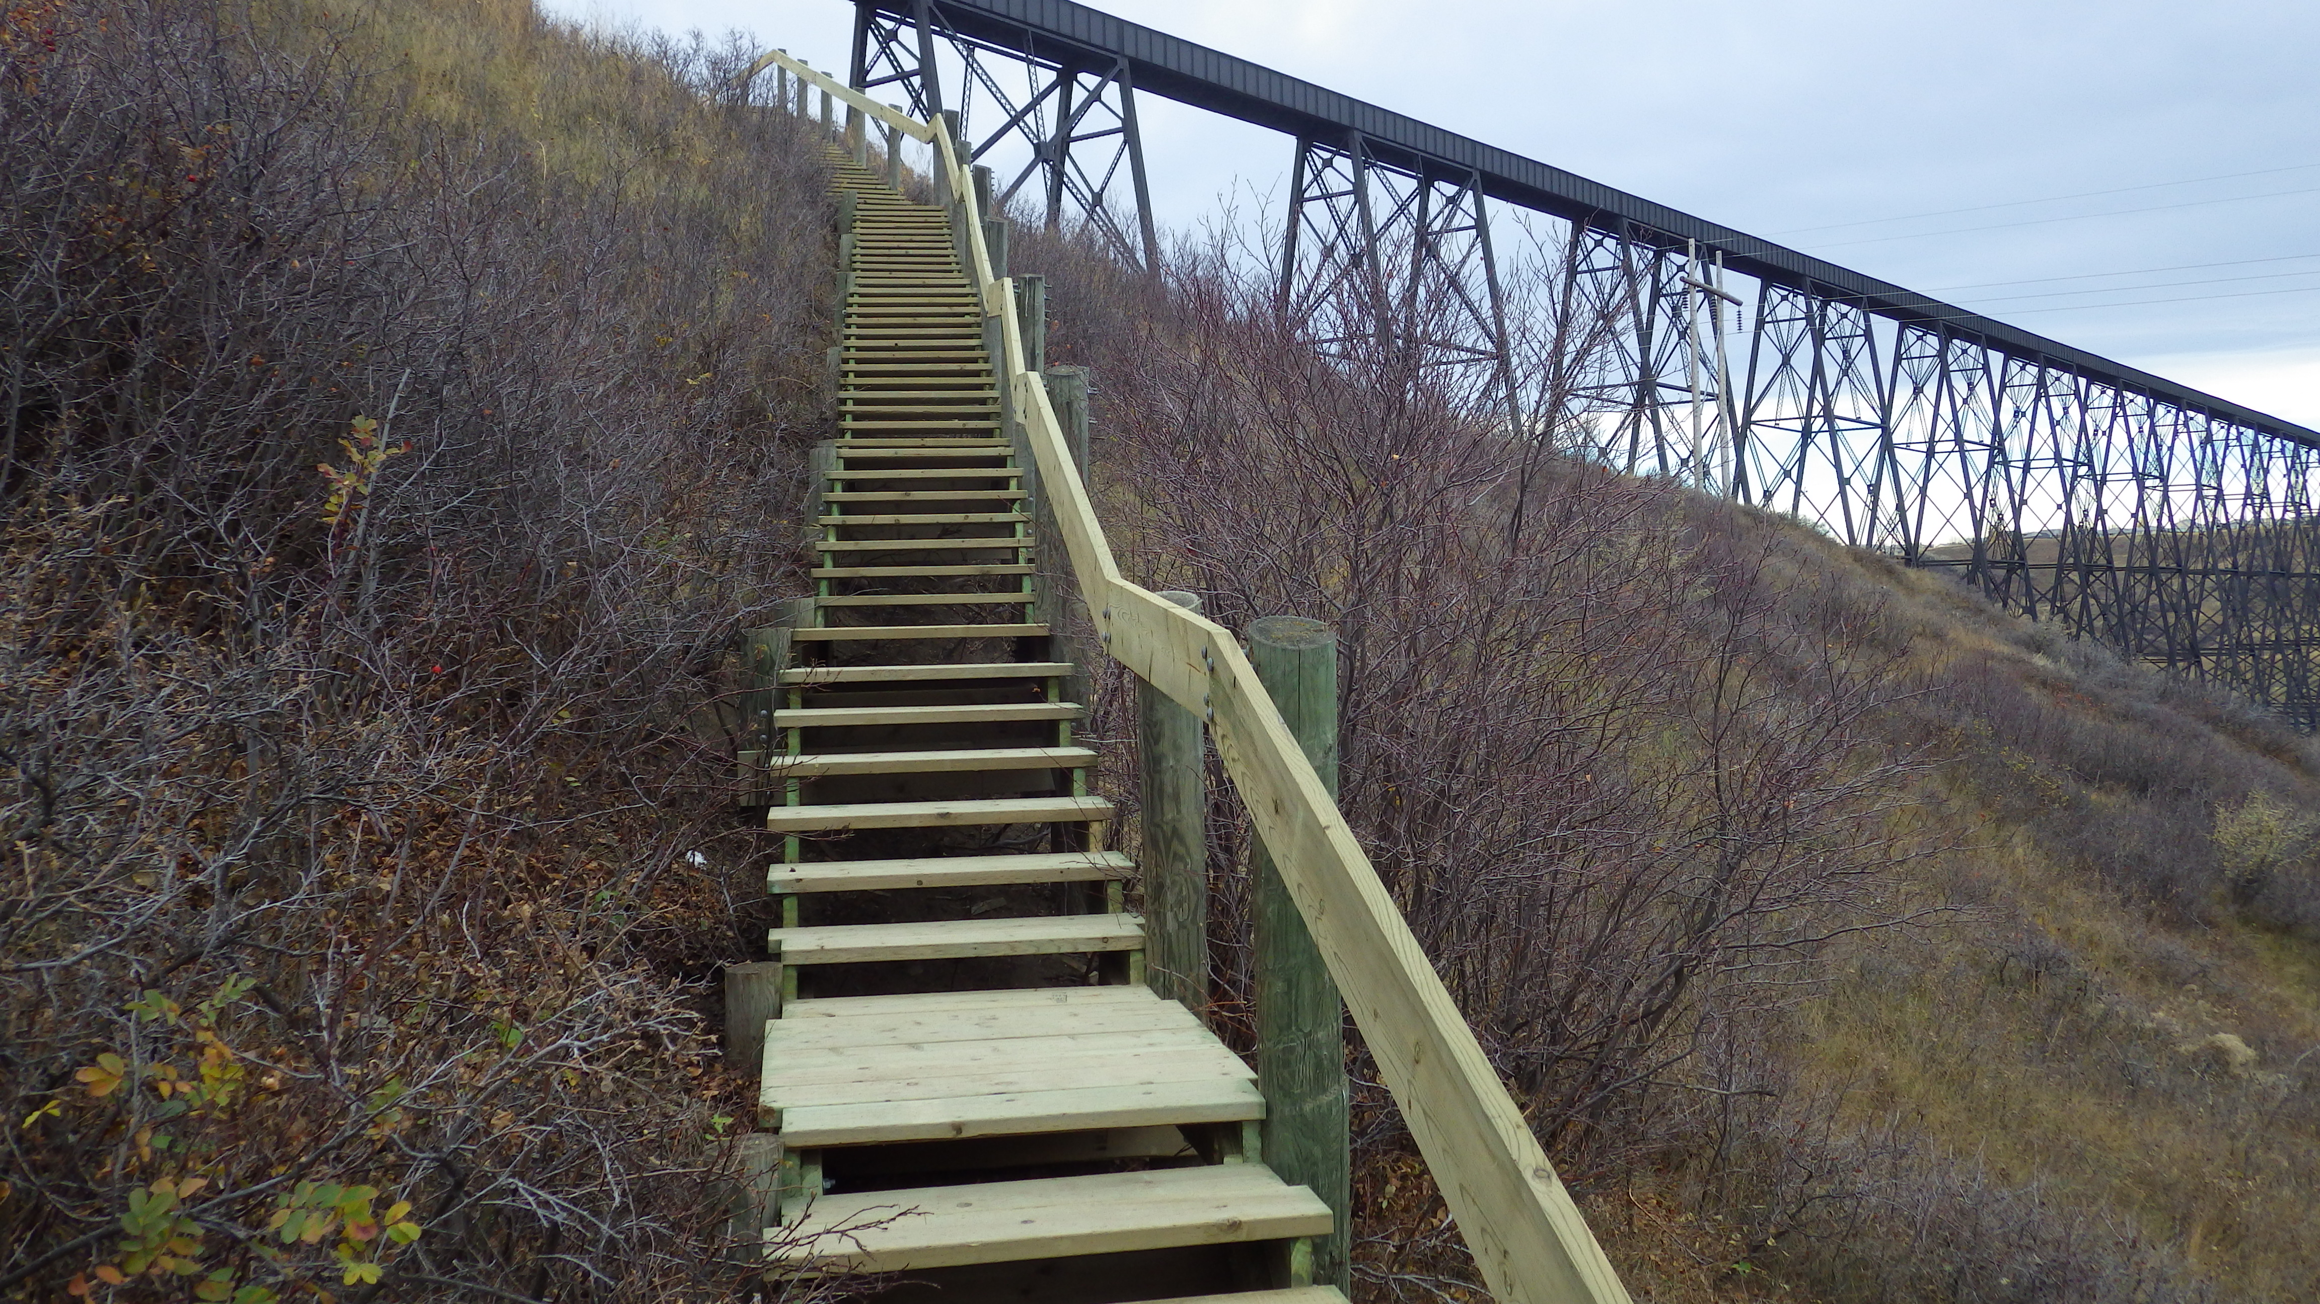

Slide 10
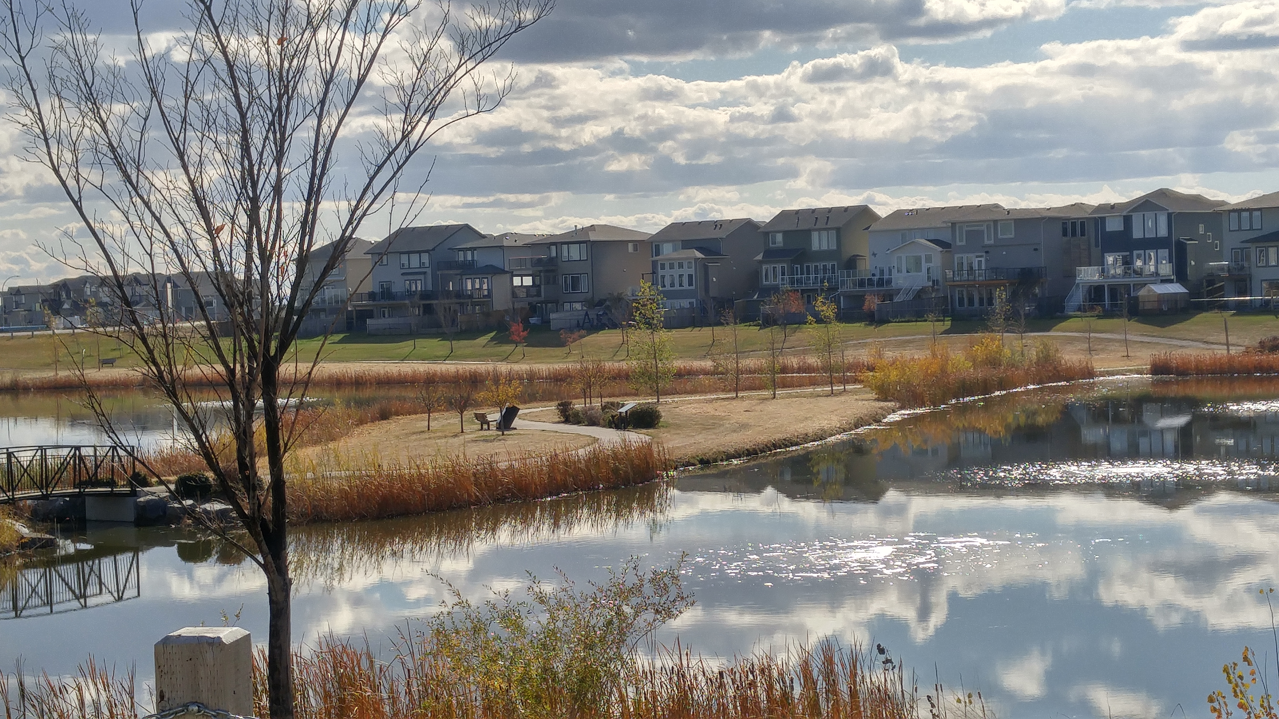

Slide 11
Parks Asset Management: Early days
Current Parks Assets
What does Parks own?
What Condition is it in?
How long will it last
GIS inventory survey
Levels of service defined
Parks asset condition rating descriptions
Lifecycle and replacement cost determined
  Excel spreadsheet management

Slide 12
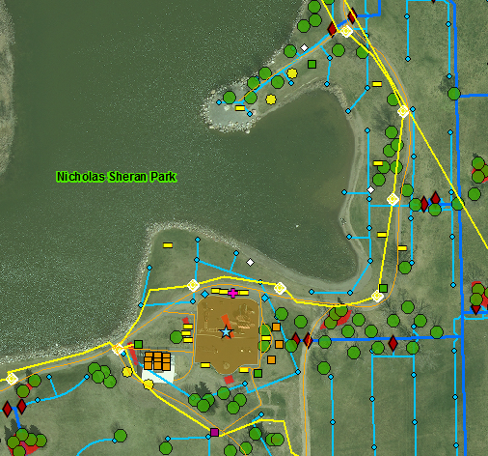
Parks GIS Inventory
Furniture
Irrigation components
Landscaping elements
Pathways & Trails
Play Equipment
Sports & Recreation amenities
Trees
Water Quality infrastructure
Other
Data Coordination is critical
for Parks Management!

Slide 13



Work Order Management
& Service Request Tracking
- Public Operations
Long Range Planning
AM system
- Parks Management
GIS
Published Elements
Interactive WebMAPs
Open Data Catalogue
Parks App
- Public
JDE
Corporate Finance/Assets

Slide 14
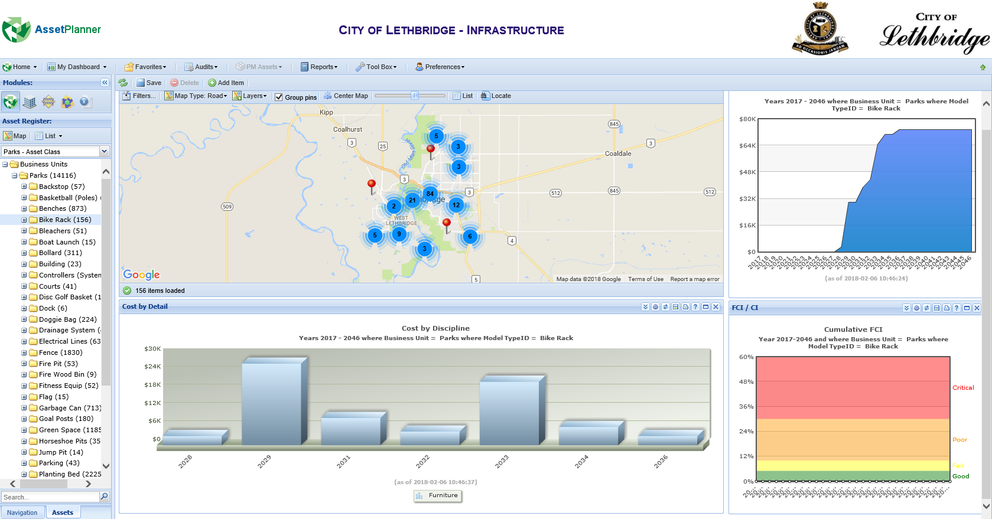

Slide 15
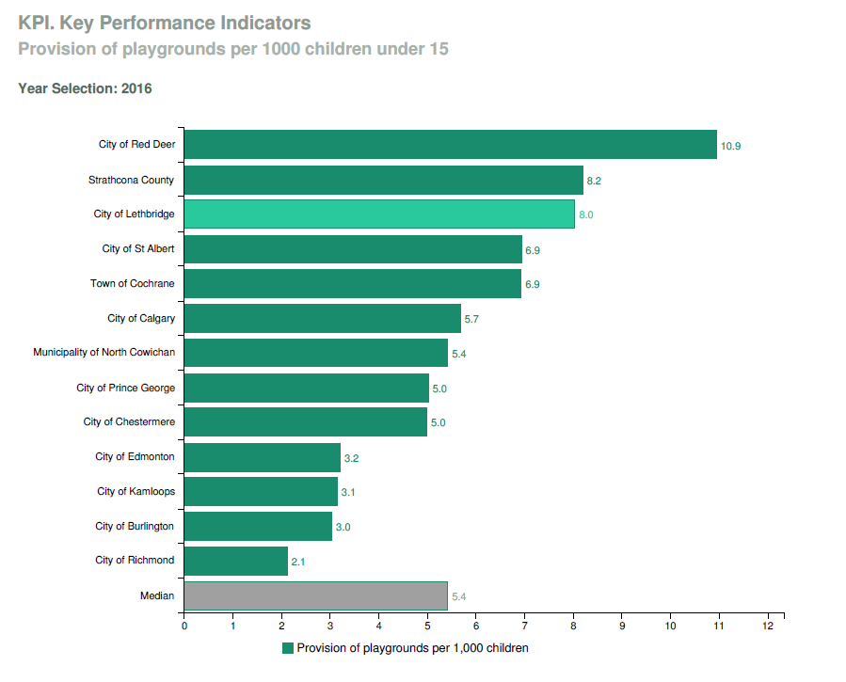

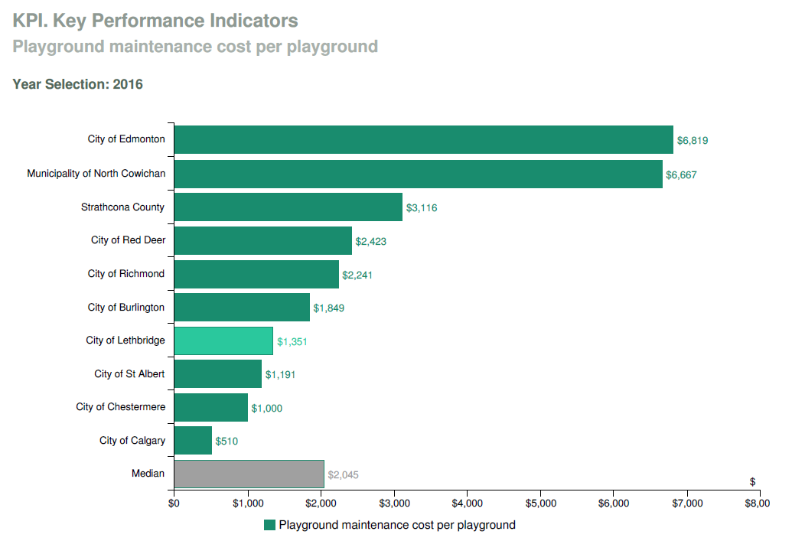
Benchmarking
Provision
vs
Expenditure

Slide 16

Pressures
Budget & resource constraints
Increased Parks use
Community demographic shifts
Climate change and environmental pressures
Technology systems

Slide 17
Parks Asset Management: Parks Value Forecast
Parks Value
Who are Parks Users?
How are Parks being used?
How could Parks be used?
Parks Assets
GIS inventory remains current
Lifecycle & budget forecasting
Parks user satisfaction surveys
Park use analysis
Community engagement

Slide 18

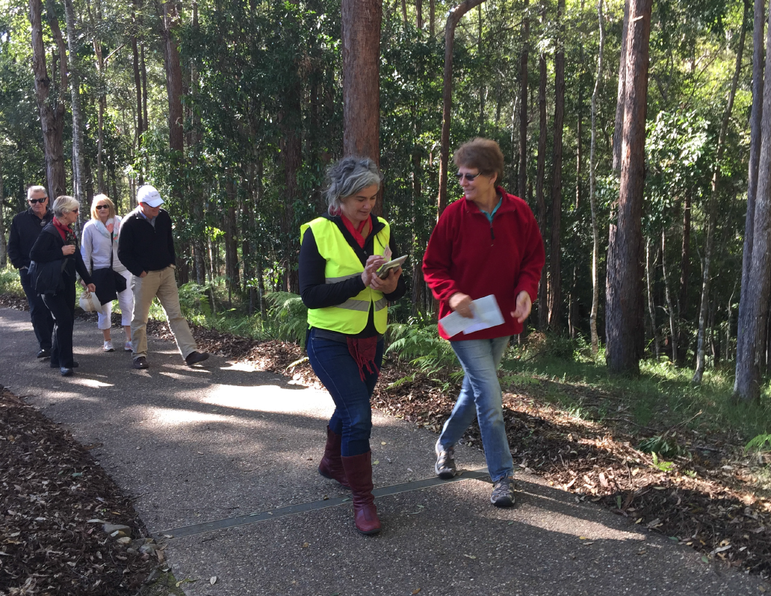

Parks User Survey

Slide 19
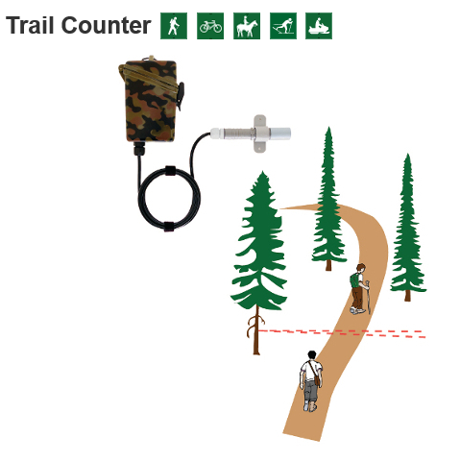
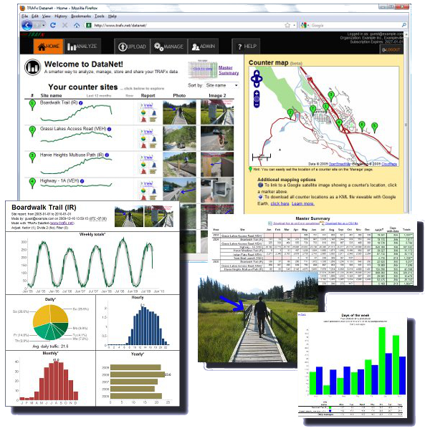

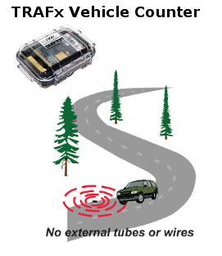
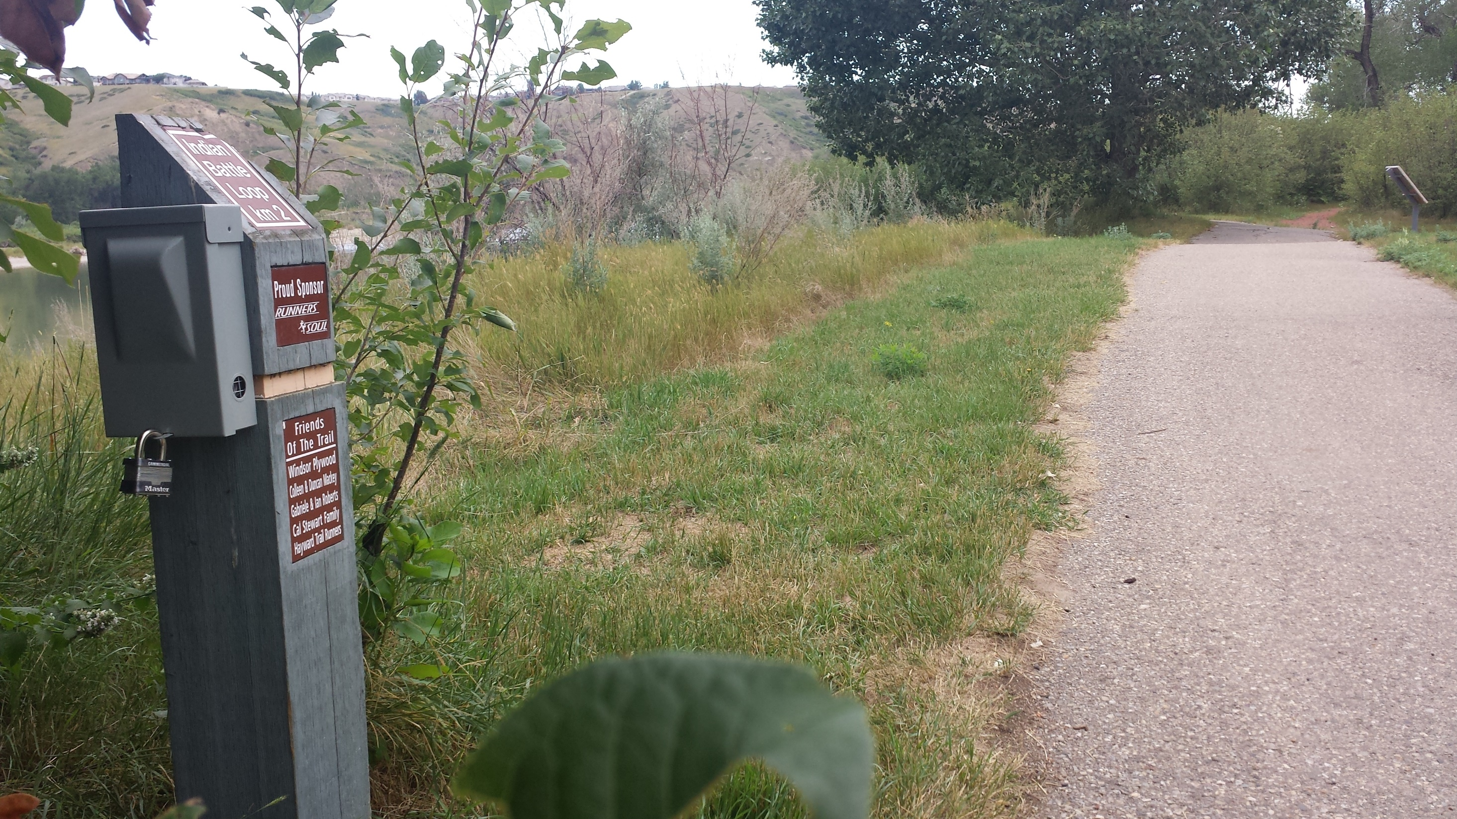
Determining Park Visits & Use
Images courtesy of TRAFx.net

Slide 20
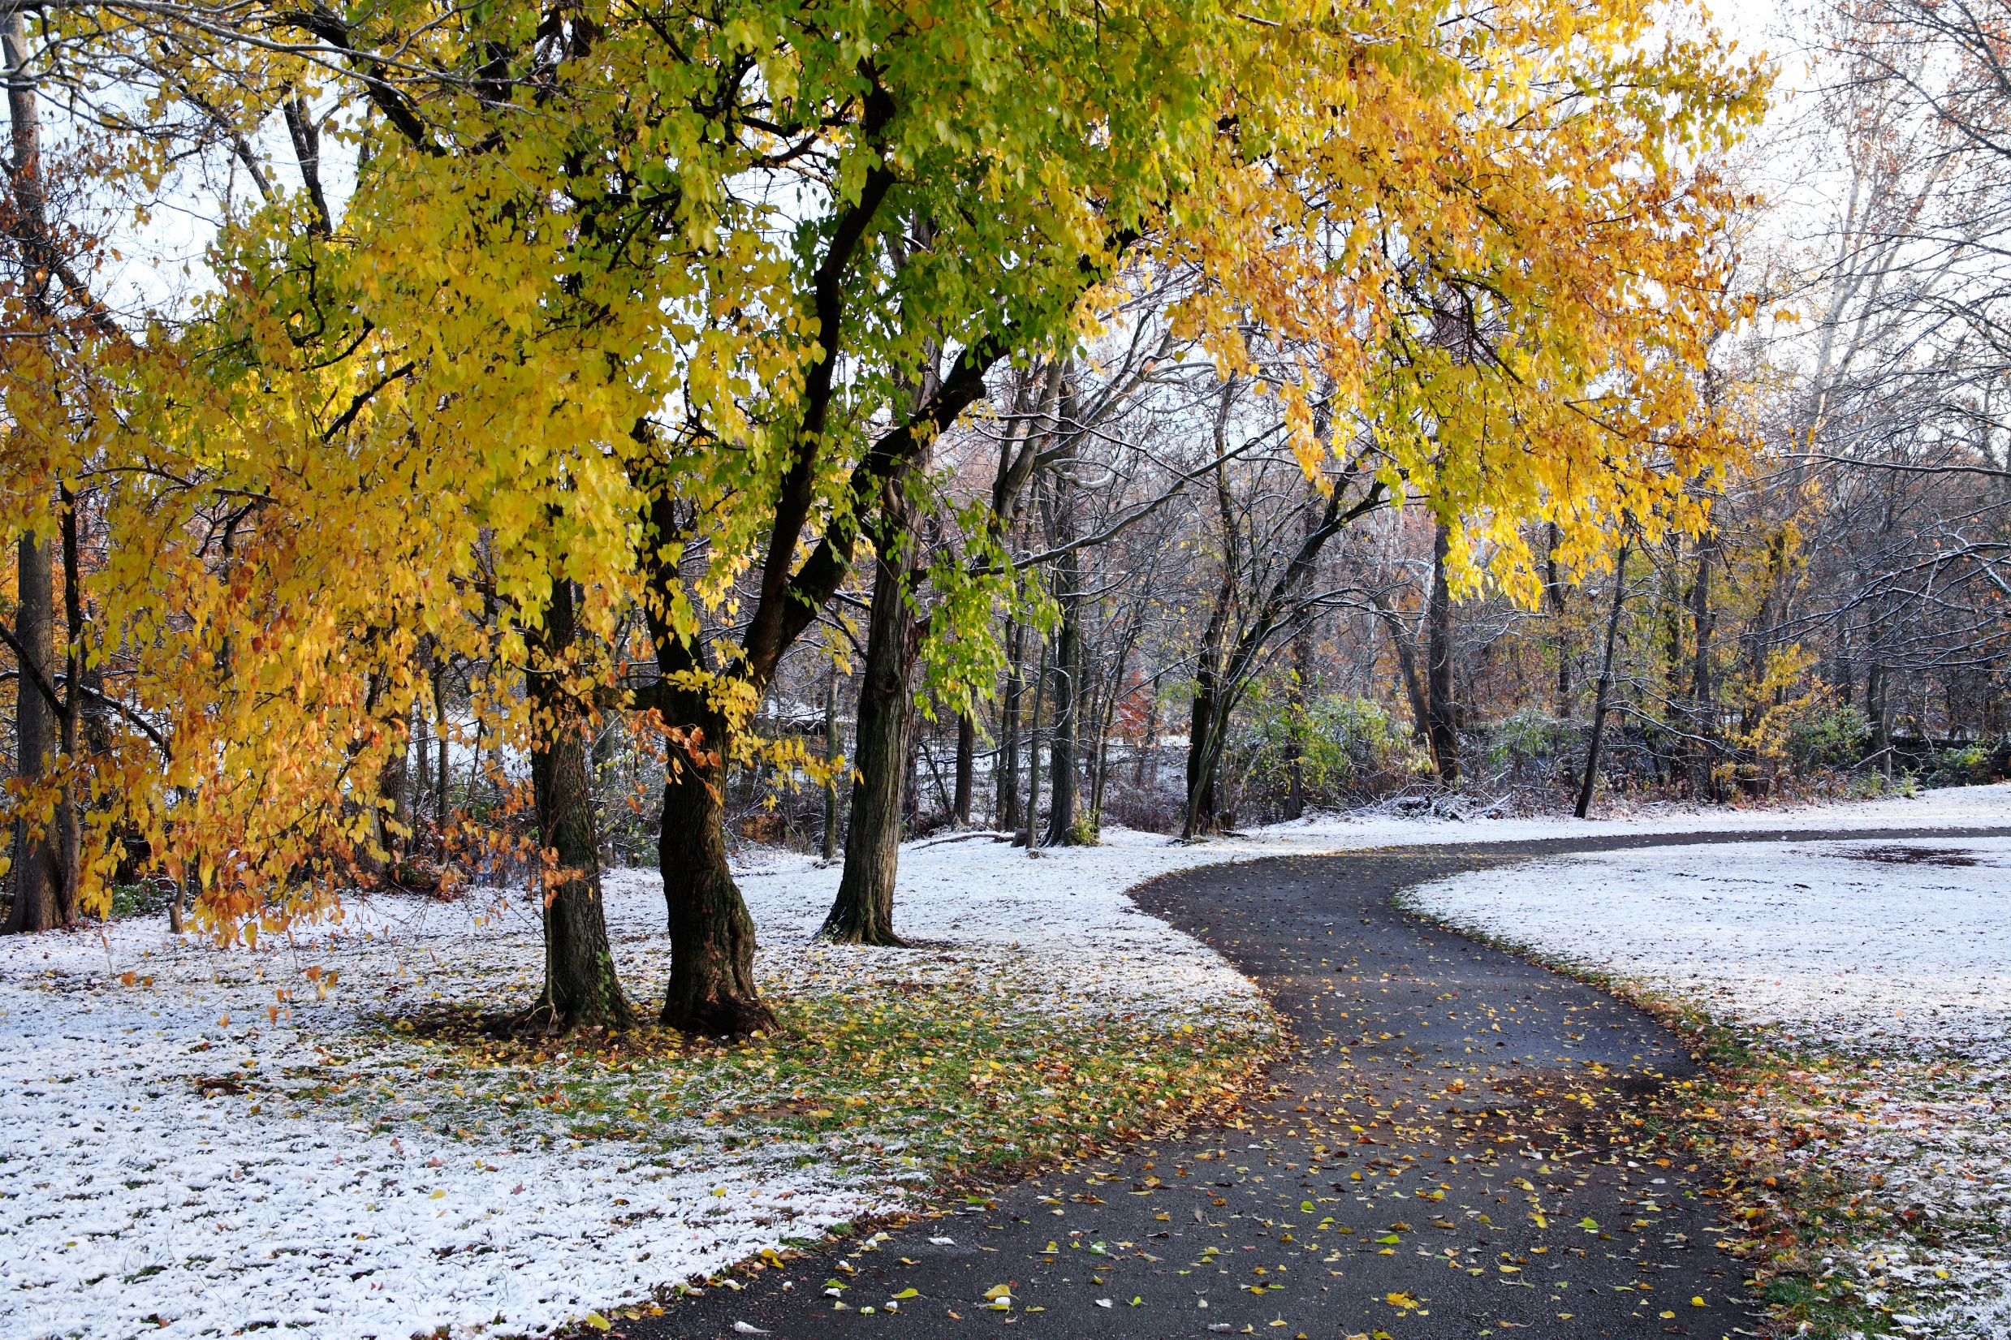
The Parks
Journey Continues…
Refine and customize systems
Coordinate existing and future systems
Improve efficiencies
Define metrics to report
Data driven decision making
Lead & Innovate
- Smart Parks within a Smart City

Slide 21
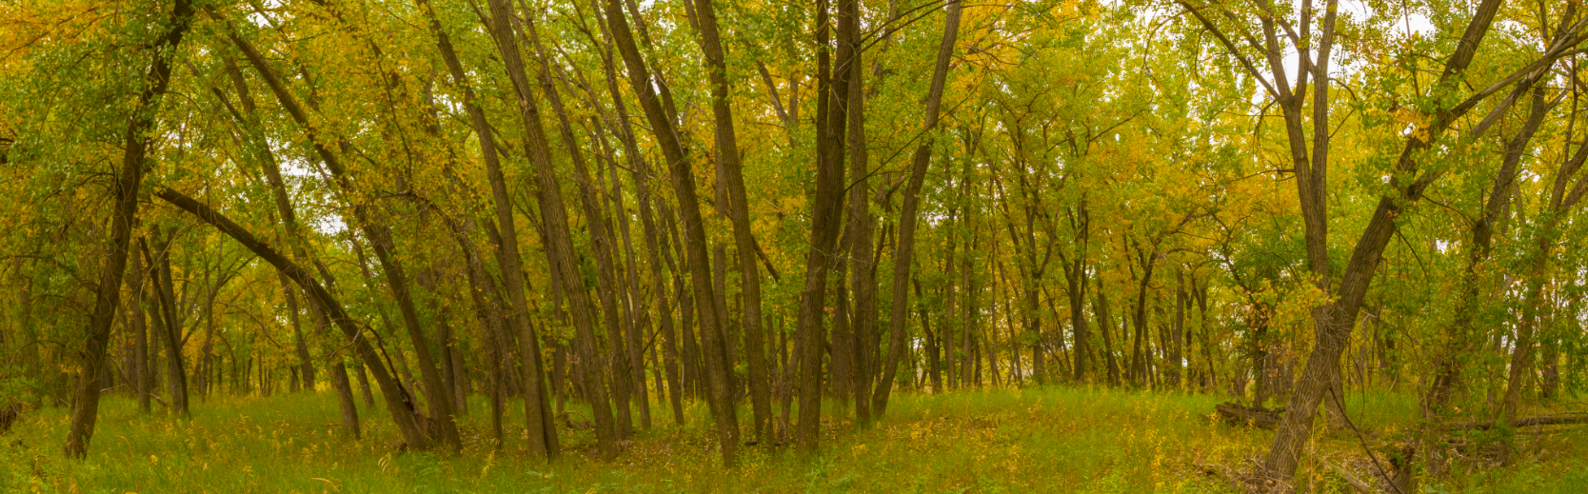
Thank You!
Andrew Sommerville
Parks Infrastructure Coordinator
City of Lethbridge

