Slide 1
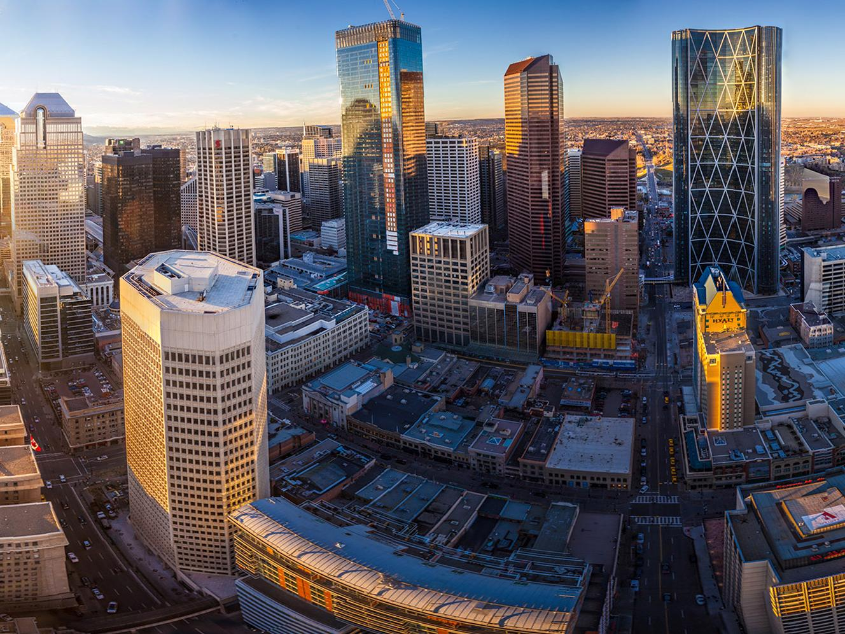
Managing Assets vs. Asset Management
The City of Calgary’s Approach
Steve Wyton, P.Eng., MBA, FIAM
Manager, Corporate Project & Asset Management

Slide 2

Managing Assets versus Asset Management
The Goal of Asset Management:
To provide a systematic, holistic, cost effective and integrated approach to planning and the management of assets to achieve agreed upon service levels with acceptable risk levels and at the lowest lifecycle costs.
Notes:
People and organizations have been caring for assets since mankind first invented tools. Over the years, we have derived entire disciplines to help define the best ways to care for those assets through their lives and as such we have been Managing Assets for ever. With the advent of the formal discipline of Asset Management some 20 years ago, there has been a development of structured approaches that span engineering, finance and business practices to assure stakeholders have derrived value from the organization.¹
The City of Calgary is an early adopter and world-class leader in the practice of municipal asset management. Now, more than ever, Asset management is relevant and necessary: given the fact that our organization is being asked to “do more with less” and that our stakeholders are demanding transparency and accountability in how we invest in infrastructure and provide service.

Slide 3
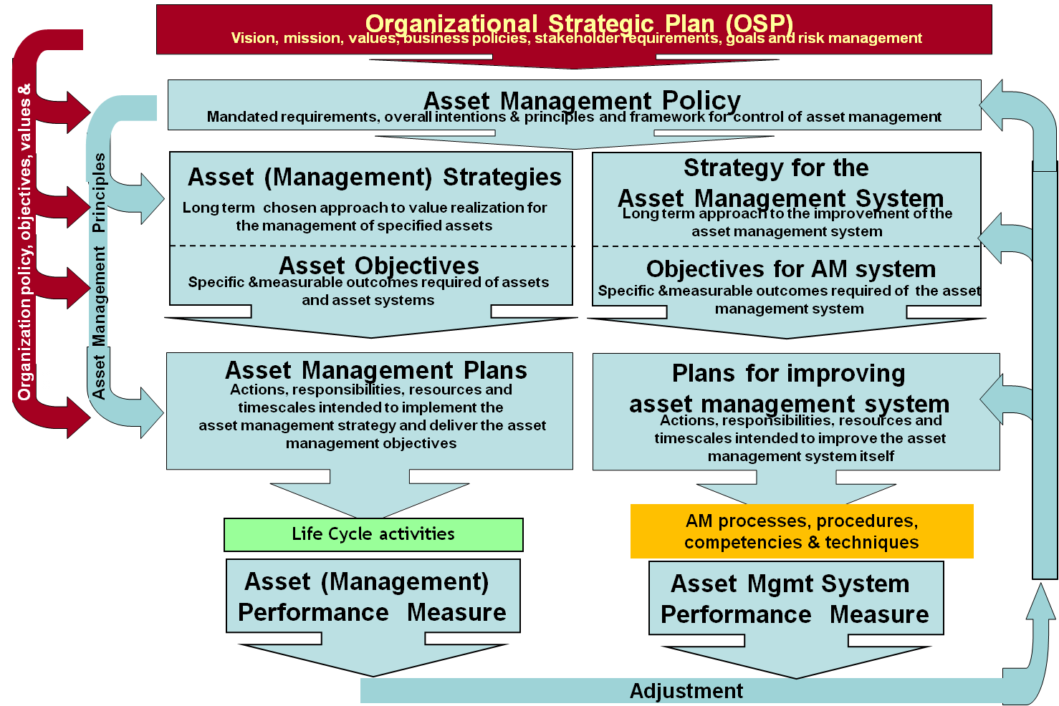
ISO55000 Framework

Slide 4
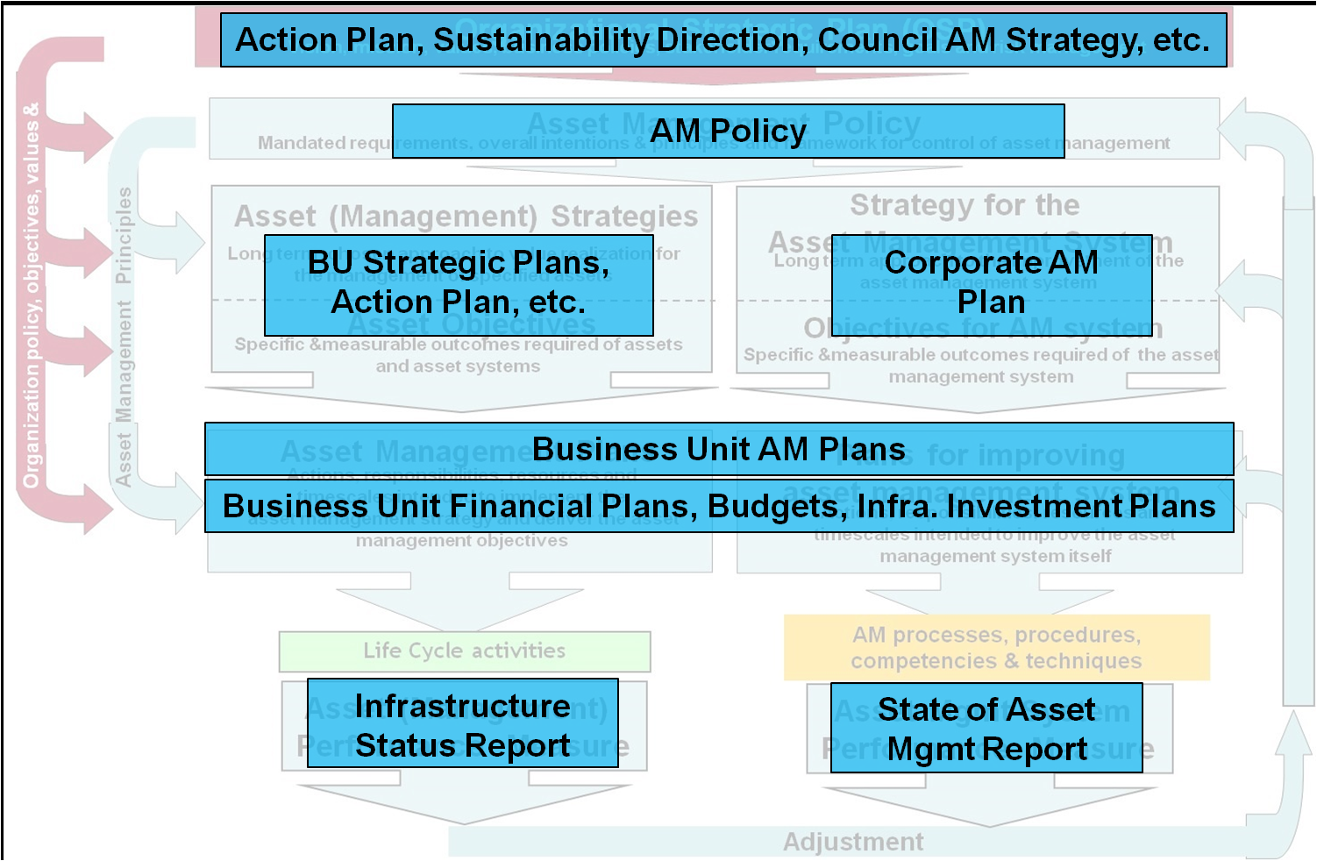
Calgary’s AM Framework

Slide 5
Calgary’s Asset Management Policy - 2016
Further defines asset management and The City of Calgary’s guiding principles:
  Aligns the corporation to ISO55000 (international asset management standard)
  Identifies the need for the asset management business system and governance
  Identifies the “plan-do-check-act” cycle and key documents/principles:
    Asset Management Plans, Infrastructure Investment Plans, Infrastructure Status Report, corrective action, etc.
  Legitimizes the City’s asset management strategy and guidelines:
    Level of Service Framework, Infrastructure Risk Management Framework, Infrastructure Investment Planning guidelines, Infrastructure Investment Strategy (Infrastructure Calgary)
Page 5

Slide 6
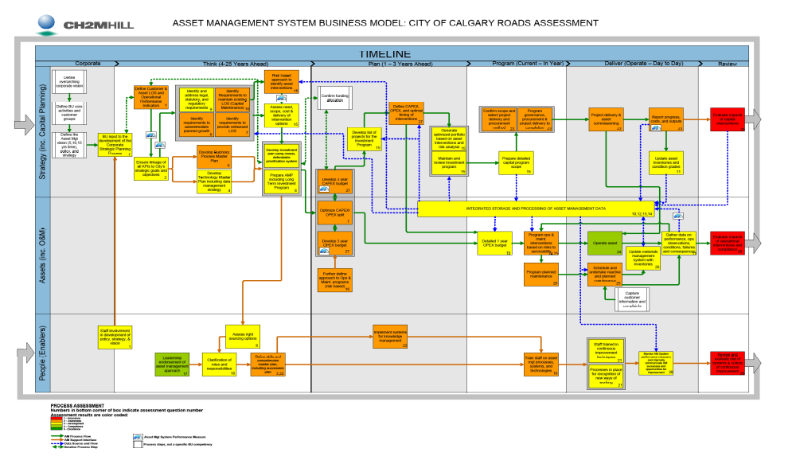
Calgary’s Asset Management Business System

Slide 7
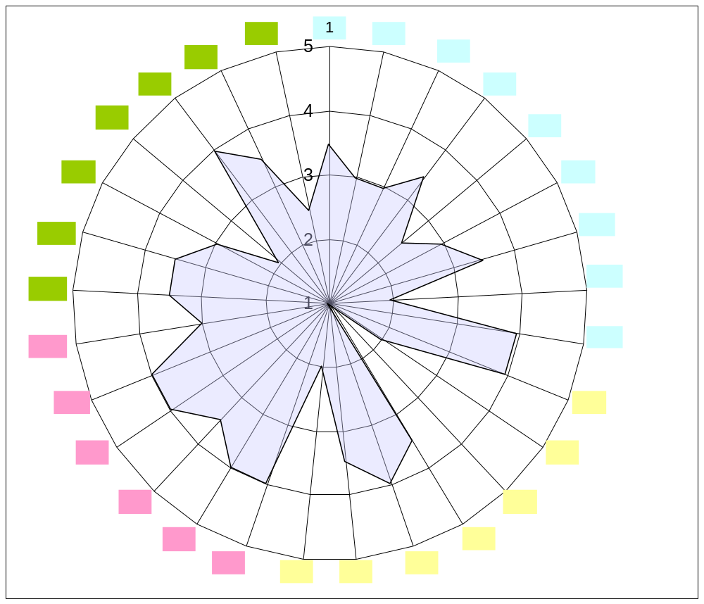
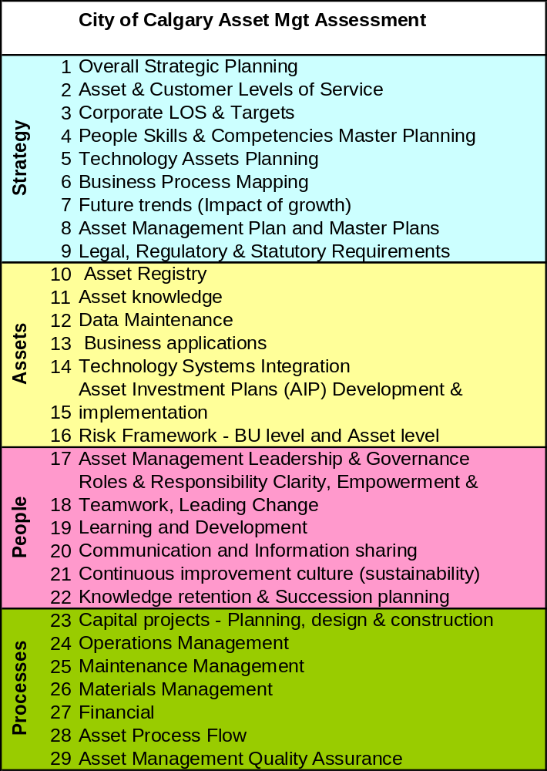
Measuring AM Maturity

Slide 8
The Asset Management Plan
EXECUTIVE SUMMARY
  SERVICE & INFRASTRUCTURE STATUS
INTRODUCTION & BACKGROUND
LEVELS OF SERVICE (LOS)
DEMAND MANAGEMENT (CURRENT & FUTURE)
ASSET LIFECYCLE PLANS
  SERVICE & ASSET RISK
  OPERATIONS & MAINTENANCE
  RENEWAL & DISPOSAL
FINANCIAL & FUNDING FORECASTS
ASSET MANAGEMENT PRACTICES
PLAN IMPROVEMENT & MONITORING
APPENDICES
$
Risk
Service Level
Page 8

Slide 9
The Concept of Level of Service (LOS)
Results Based Accountability (RBA)
Corporate LOS
Customer LOS
A great place to make a living, a great place to make a life
Community Safety and Well Being
100% reliability in fire fleet
100% Fire Response within X minutes
24 hour fire staff availability
Min. X km to any community from firehall
Efficient, Reliable, Affordable Transportation
New Fire Hall A
Existing Fire Hall B
Roof
Time to clear snow and ice
Community LOS (how is the community better off)
Homeowner Insurance Affordability
Asset LOS
(CAPEX)
Impact of fire minimized
Operational LOS
(OPEX)
Perception of public safety
*for illustrative purpose only
Page 9

Slide 10
Level of Service and “Star Rating”
LOS Rating
Mobility
Pavement/Bridges
Pavement
Comfort
Pavements
Signals
Driving Environment
Aesthetics
Safety
Responsiveness
Seasonal
Signals
No. of lane hours lost per km per year due to maintenance
Signals
No. of failed pedestrian signal hours per intersection per year
Pavements
Streetlights
Signs
Signs
Lines
Bridges
Streetlights
Signals
All
Pavement
Streetlights
Signals
Signs
Winter
Spring
Average PQI rating for segment
% of signs in segment in poor or worse condition
% of Streetlights in segment with "Good" condition rating
% of Signals in segment with "Good" condition rating
% of valid pothole reports in segment resolved with 14 days of complaint
% compliance with snow and ice removal policy

Slide 11
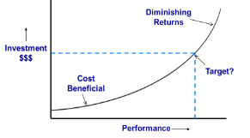

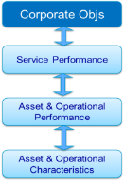
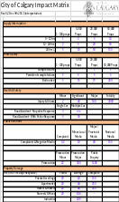
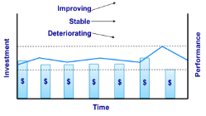
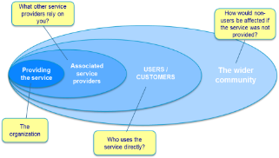


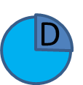
AM Planning
Step 1: Identify Customers & Services Provided
Identify the customers of the Business Unit and the Outcomes the customers seek
Step 2: Define Service Outcomes
Identify and define Level of Service that the business unit delivers to its customers and prepare outcome statements of intent that link the Business Unit’s objectives to the City’s Organizational Strategic Objectives.
Step 3: Develop Measures
Develop customer and technical performance measures and rating system. Develop the methodology for data collection, & validation, analysis, monitoring and reporting.
Step 4: Understand Linkages
Link service measures and risk indicators (failure modes) to customer satisfaction and higher level objectives..
Step 5: Establish Baseline
Benchmark the performance measures and customer satisfaction
Step 6: Financial Relationship
Assess the financial and risk implications of levels of service
Step 7: Set Targets
Assess affordability and make decision regarding changes in LoS and set targets
Step 8: Engage Stakeholders
Consult with customers over Level of Service. Review demand for any changes in LoS and debate LoS options
Plan
Do
D
P
A
Act
C
Step 11: Monitor & Review
Monitor customer satisfaction
Monitor Performance
Review risk impact of strategy.
Review cost of Strategy
Step 10: Deliver Strategy
Deliver the agreed Strategy
Step 9: Evaluate Strategies
Review Strategic options for achieving LoS targets. Review options for impacts on other Business Unit or Organizational Objectives.
Check
Step 12: Investigate & Improve
Investigate deviations from objectives to understand root cause.
Identify improvement actions
Feedback
Phase 1
Phase 2
Develop Infrastructure Investment Plans
Phase 3
Evaluate Cost Benefit (IIRMF)
Existing Process
Project Management
IIRMF
Key

Slide 12
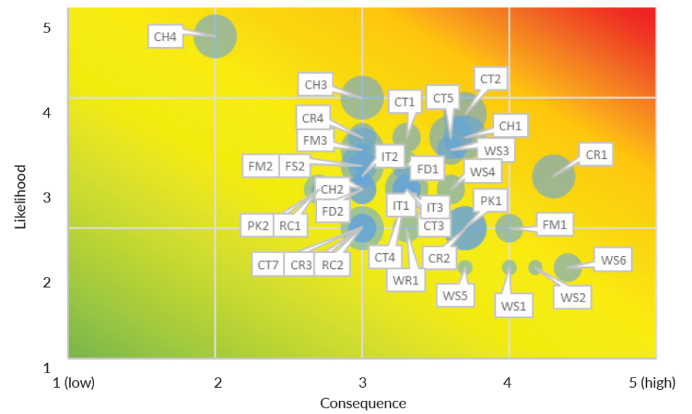
Asset and Service Risk Management
Page 12

Slide 13

Linking AM Plans to Business Decisions
Levels Of
Service
Risk
Financial
Forecast
Economics
Lifecycle
Cost
Growth
Projection
Infra
Performance
Taxpayers
Asset Management Plans
Other
Levels
Of
Gov’t
10 year Infrastructure Investment
Plans
4 year Business Plan & Budget
Land Use & Growth
Mgmt Plans
Industry
Long Range Financial Plans

Slide 14
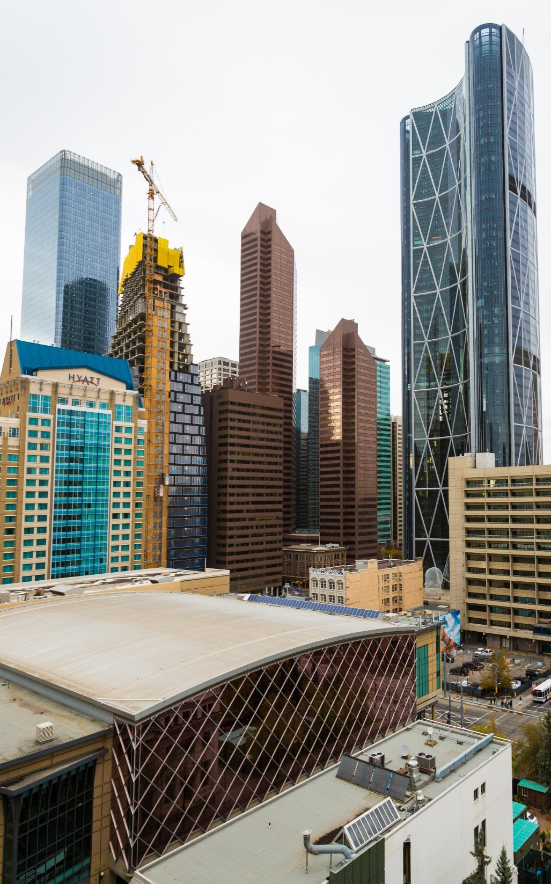
“Calgary: A great place to make a living, a great place to make a life.”
Infrastructure Calgary
Respond to the service needs of Calgarians in light of changes in the community.
Deliver value to Calgarians through strategic capital investment.
Develop an infrastructure investment plan and resiliency framework for Calgary based on foundation of social, economic and environment drivers.
Provide short and long term value while responsibly managing debt.
Foster and practice good government that supports public trust and confidence.

Slide 15
Asset Management and Infrastructure Investment Planning
Service Planning
Service Execution
Key Touch Points for Council
Citizen Priorities
The City’s Strategic Plan Principles
Approve Service Plans and budget 2019-2022
Approve mid cycle & annual adjustments
Council Directives
Capital Infrastructure Investment Principles
Receive Infrastructure Status Report for Information
Capital Investment Plan
Infrastructure Calgary (Enterprise Management)
Capital Investment Process
Investment Need
Investment Planning
Investment
Optimization
Investment Delivery
Investment
Results
Key Activities
Community service need
Inform service planning
Prioritize & coordinate
investments
Execute capital investments to support service delivery
Monitor & report on investments & risks
Identify and mitigate risk
Create business cases within common repository
Allocate funding according to capacity
Continuous improvement through best practices
Evaluate &
adjust to
maximize value
Evaluate service
needs & costs
Build Infrastructure Investment Plans
Recommend
capital
investments by service
Performance Monitoring and Reporting
Risk Management

Slide 16
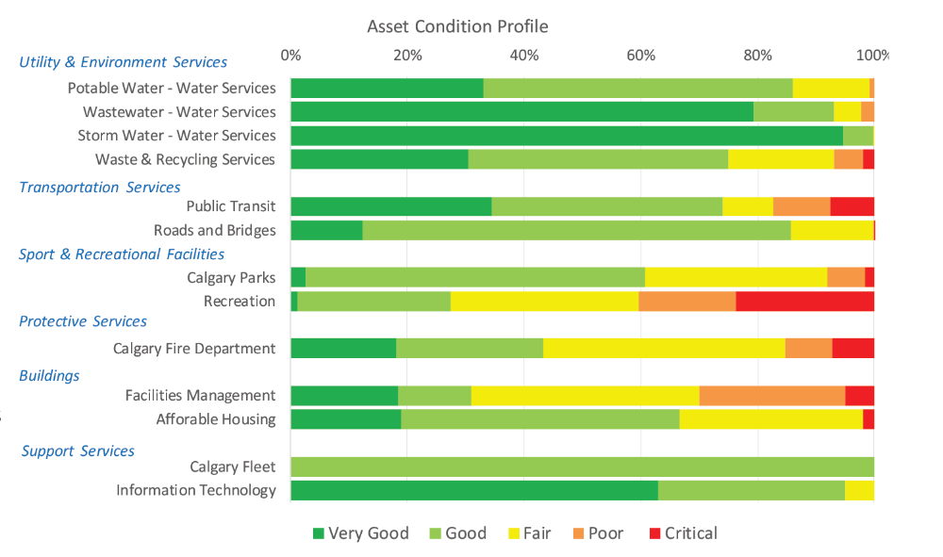
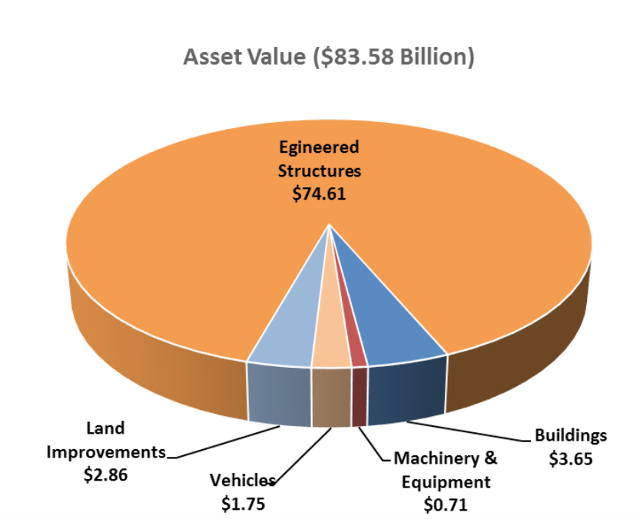
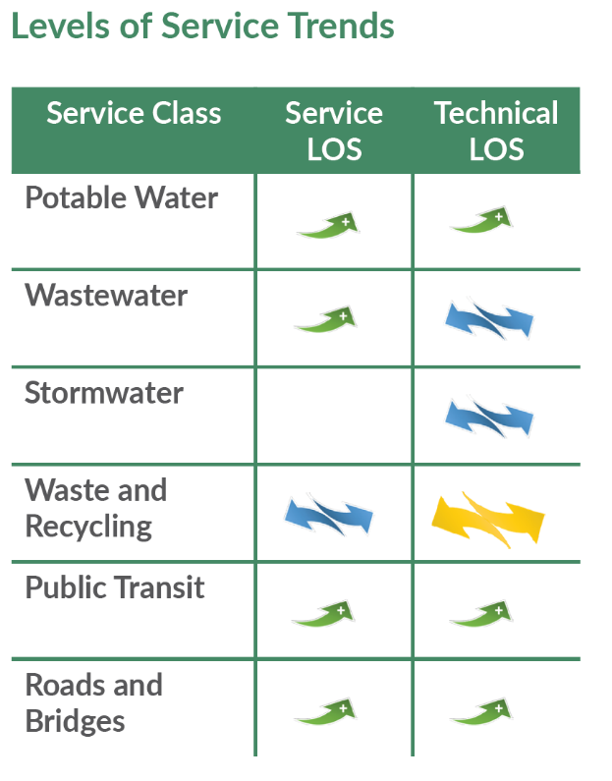
Use AM to Engage, Demonstrate Accountability & Transparency

Slide 17
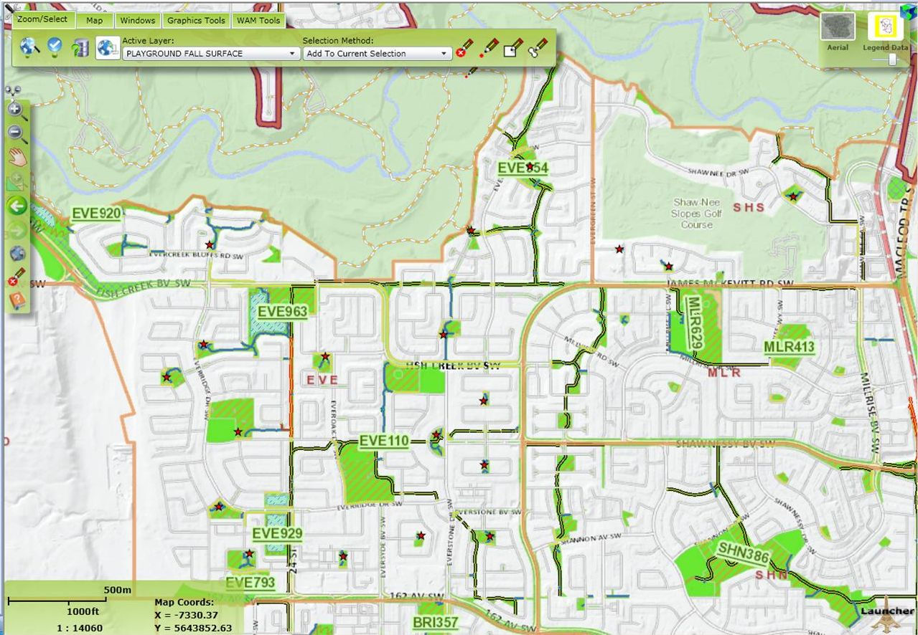
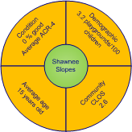
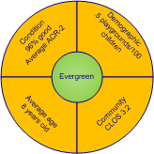
Recent Calgary Stresses and Shocks
Optimizing Asset Strategy
Integrating Levels of Service & Risk
17

Slide 18
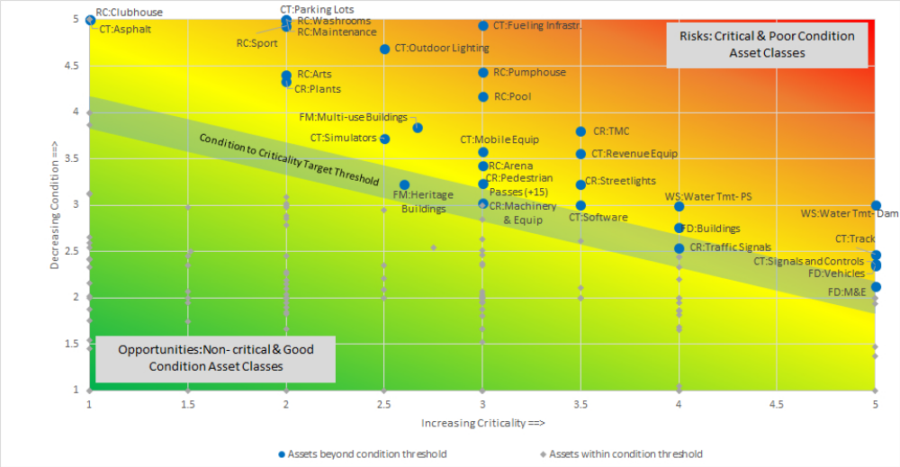
AM Outputs - Business Intelligence

Slide 19
The Future of Asset Management
Strengthen service and risk management capabilities;
Improve asset data availability and accuracy;
Citizen engagement on service levels, value and integration across service lines;
Start to consider other means of delivering service, including non-asset based solutions;
Consider asset divestiture or service elimination;
Link to resiliency, energy management, climate change; etc.
Develop practices on measuring benefits realization and adjust LOS/risk/$.

Slide 20
What’s the Value?
  Shell (oil platforms and export pipelines)
    Production uptime increased by 17% over 4 years
    Simultaneous opex savings over $250 million (50%)
    Safety and integrity indices improved
  Scottish Water:
    Reduced opex by 40% (4 years), exceeded service targets
    Delivered capital program for $1 billion less
  City of Calgary
    AM reporting resulted in $3.3 billion contribution from provincial government and justified increase capex for maintenance of $234 million (50%)
    Prioritized $2 billion of potential corporate investment and deferred $1.4b
    Efficiency gains and capital deferrals in most operating business units, citizen engagement on service levels.

Slide 21
AM Implementation Challenges
Unwavering support of “Top Management”
Change management & fatigue
Technology and data requirements
Prioritization of objectives between corporate directions
Duration of implementation – succession and knowledge management
Time before value realization
“Herding cats” – setting and moving in a common direction

Slide 22
Thank You!
Steve Wyton, P.Eng., MBA, FIAM
Manager, Corp. Project & Asset Management
The City of Calgary
steve.wyton@calgary.ca
(403) 268-5746

Slide 23
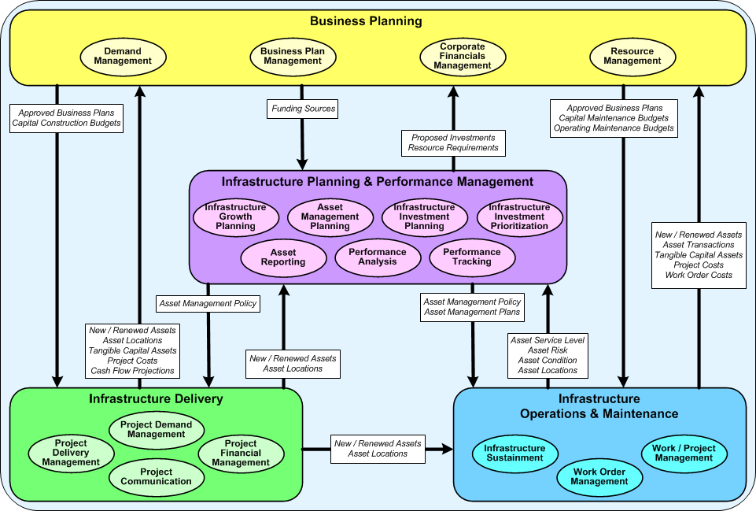
Corporate Asset and Project Management

