Slide 1

Asset Management Policy

Slide 2
Asset Management Policy
Themes:
Evolving Issues
Working Group & Value Of Communication
Asset management: A Governance Piece
Policy As A High Level Document

Slide 3
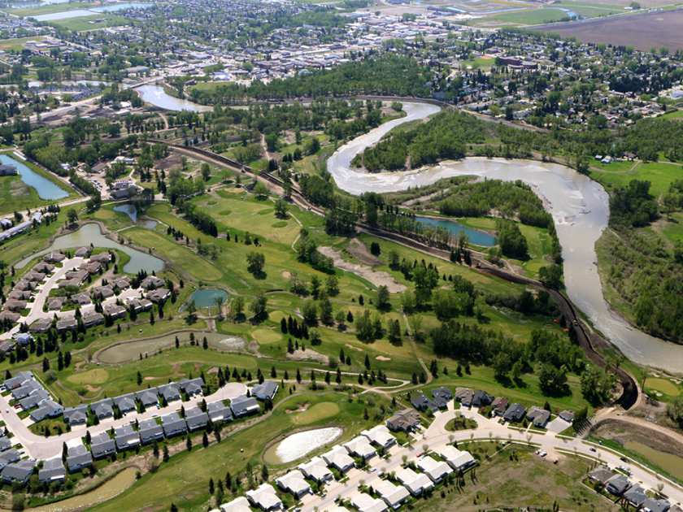
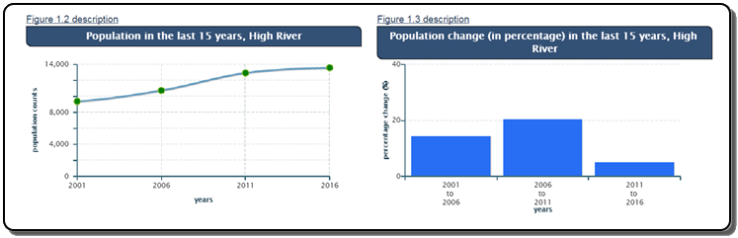
Asset Management Policy

Slide 4
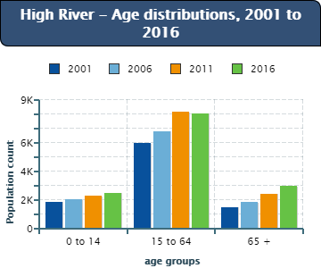
Asset Management Policy

Slide 5

Asset Management Policy
Sewer
Water
85 Km
100 Km
Storm
Roads
52 Km
92.6 Km

Slide 6
Asset Management Policy
Issue:
We Need
Asset Management.

Slide 7
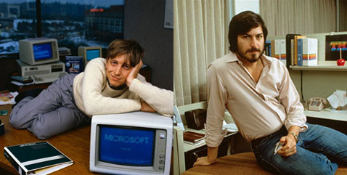
Asset Management Policy
Asset Management: A Software Issue

Slide 8




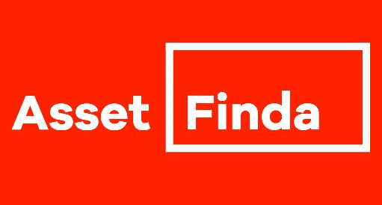




Asset Management Policy
Asset Management: A Software Issue

Slide 9

Asset Management Policy
Asset Management: A Software Issue

Slide 10
Asset Management Policy
Asset Management: A Software Issue

Slide 11

Asset Management Policy
Asset Management: A Software Issue

Slide 12
Asset Management Policy
Asset Management: A Software Issue
?
?
?
?

Slide 13
Asset Management Policy
Asset Management: A Software Issue

Slide 14


Asset Management Policy
Asset Management: A Software Issue

Slide 15
Asset Management Policy
Asset Management: A Software Issue
?
?
?
?

Slide 16
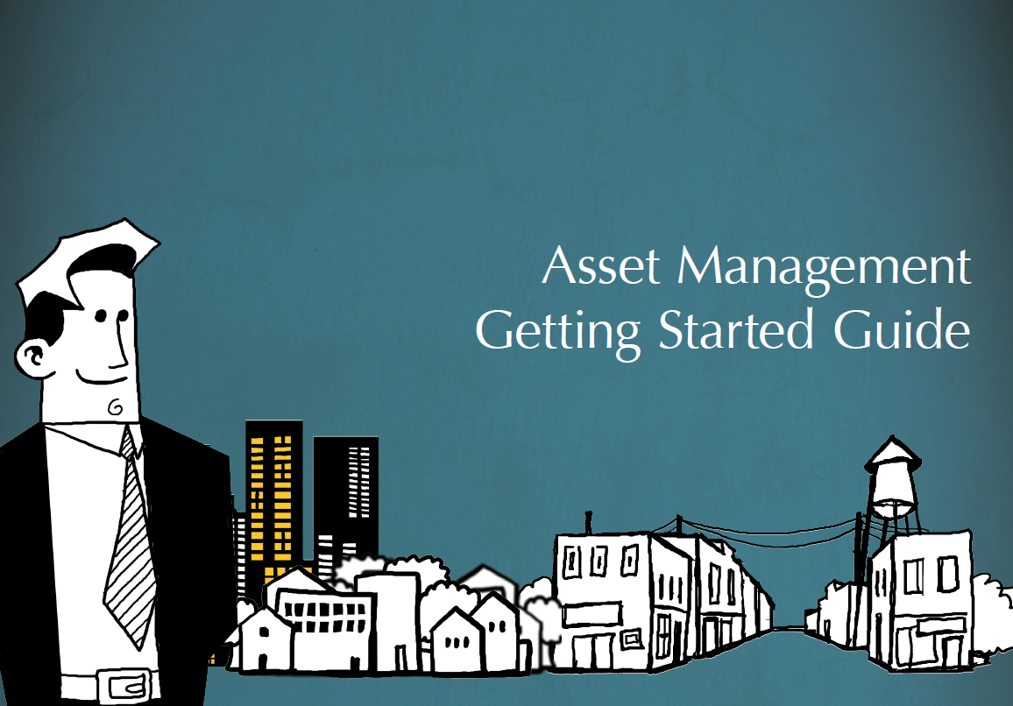
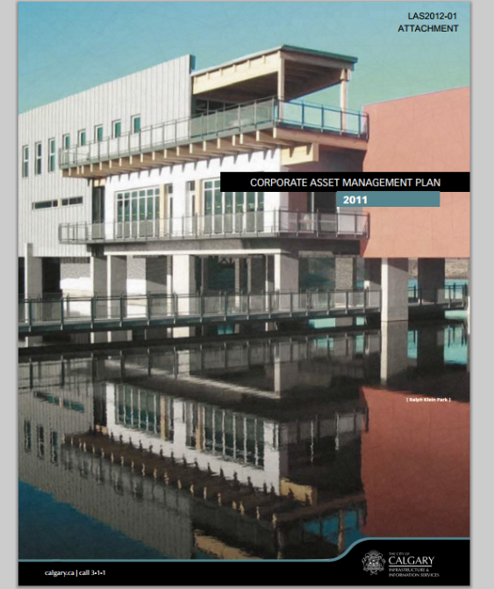

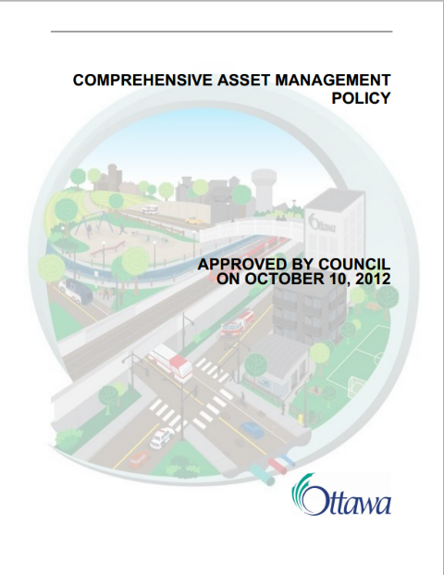
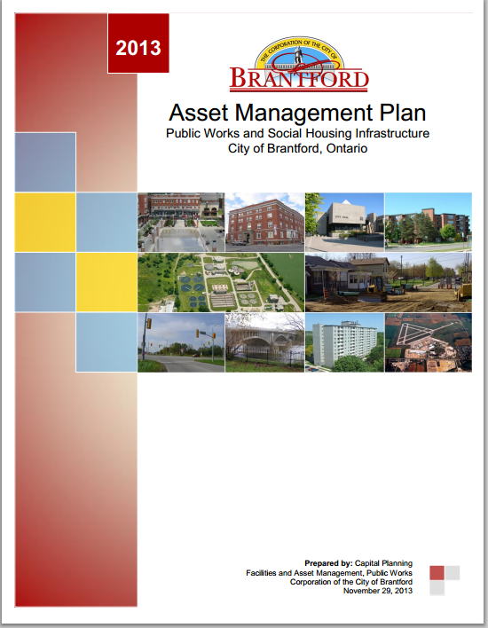
Asset Management Policy
Asset Management: A Software Issue

Slide 17
Asset Management Policy
Asset Management: A Software Issue

Slide 18
Asset Management Policy
Asset Management: A Policy Issue

Slide 19
Asset Management Policy
Issue:
We Need
Asset Management.

Slide 20

Asset Management Policy
Issue:
We Need
Asset Management.

Slide 21
Asset Management Policy
“Policy making is, in large measure, about trying to solve problems, and so the nature of those problems -- how they are defined -- is central to the entire process. But defining problems is not merely a technical exercise; it entails political and strategic manoeuvers, insofar as problem definition sets the tone for successive stages in the process.”
Leslie A. Pal

Slide 22
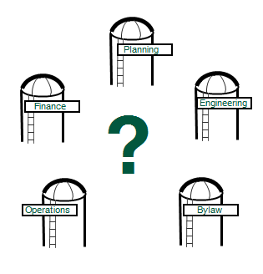
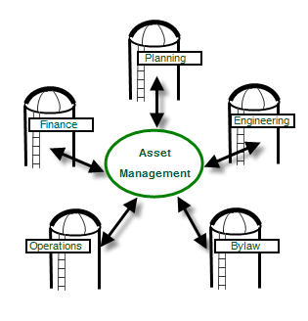

Slide 23
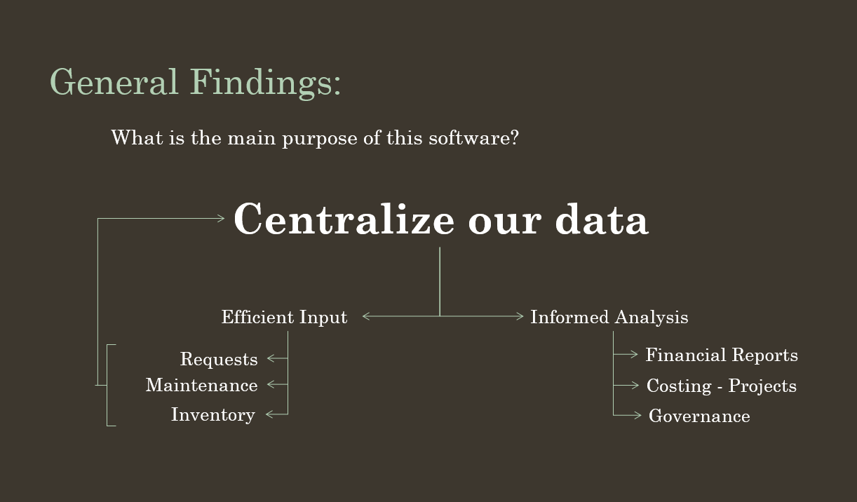

Slide 24
Asset Management Policy
Issue:
We Need
Asset Management.

Slide 25

Asset Management Policy

Slide 26
Asset Management Policy
Ways to Frame Asset Management – Policy Issues
Efficiency
Grants
Safety
Modernizing
Financial Administration
Accounting
Engineering

Slide 27
Asset Management Policy
Saving The Town Money
Making Informed Decisions
Responsible Spending

Slide 28
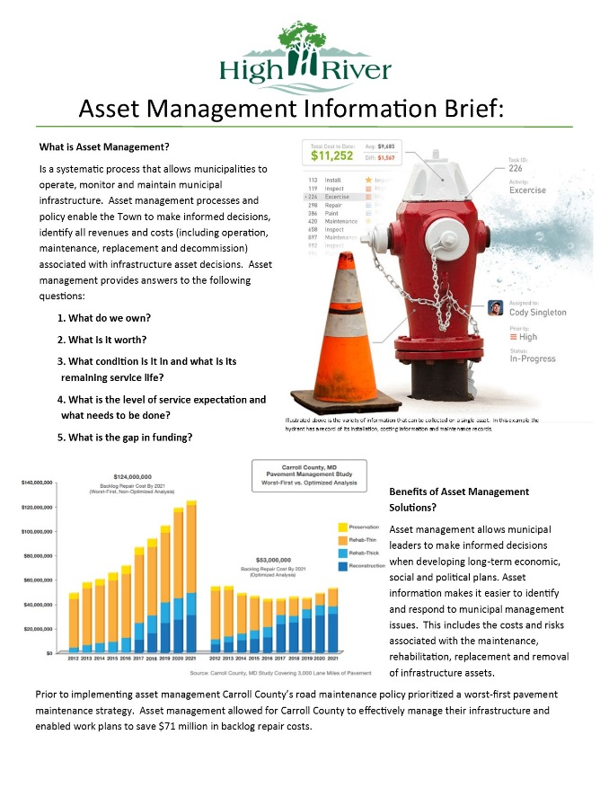
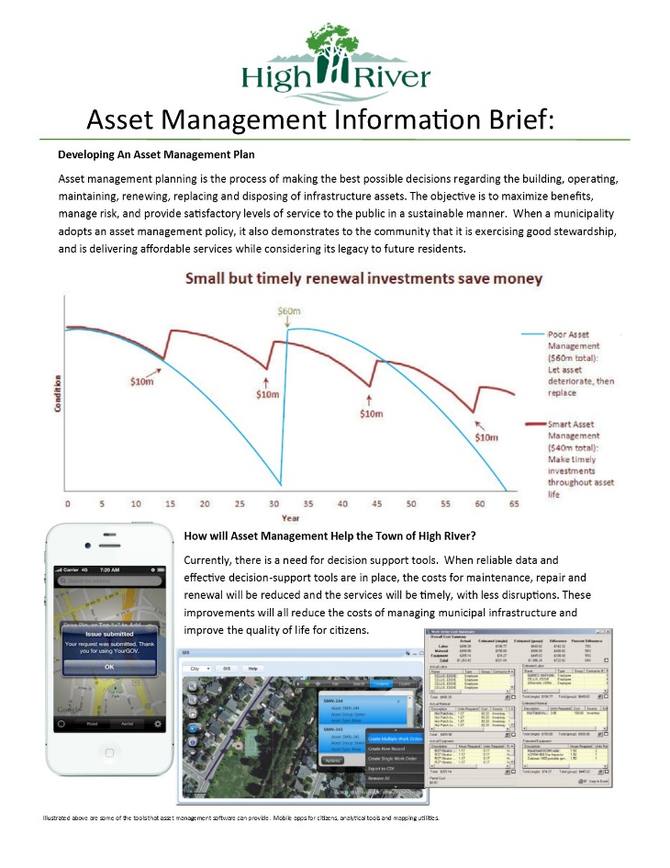
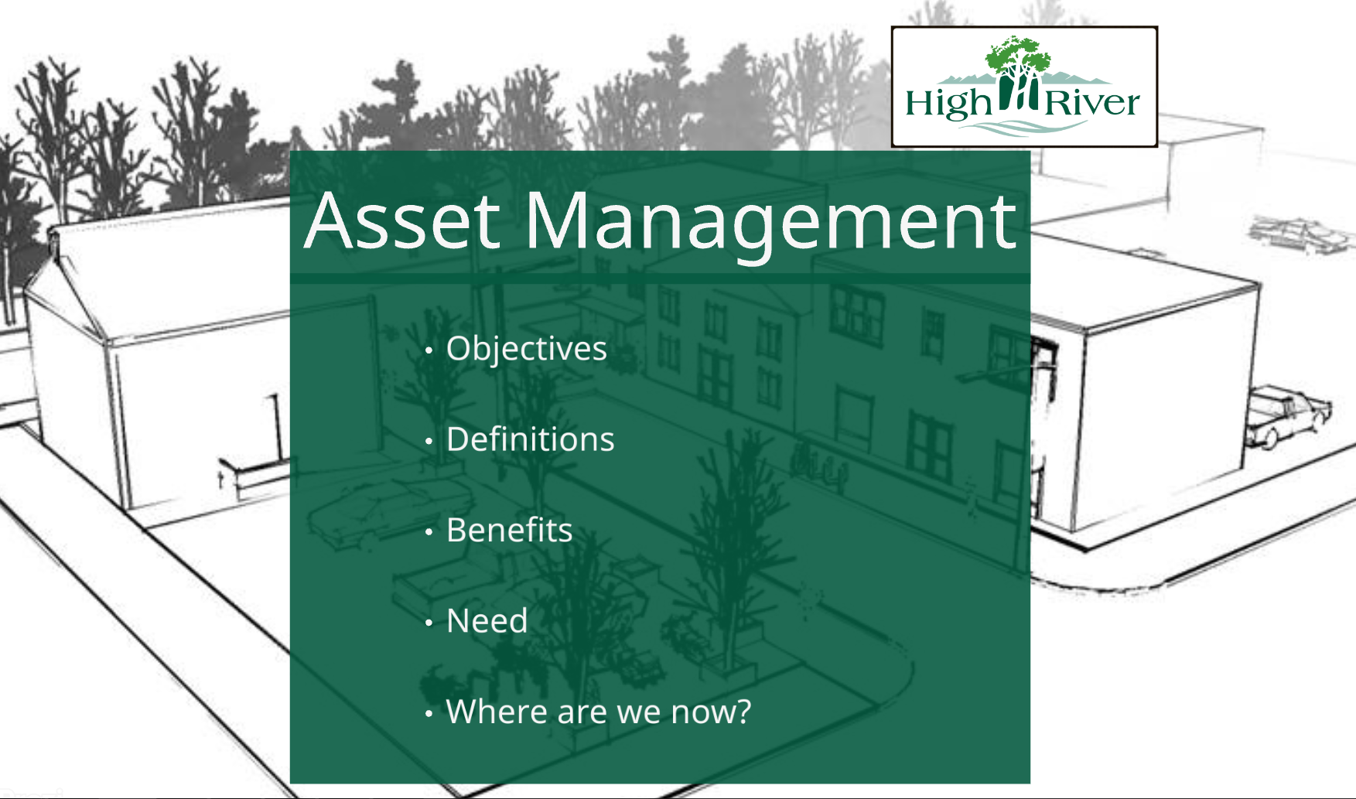
Asset Management Policy

Slide 29
Asset Management Policy
What to include within the policy?

Slide 30
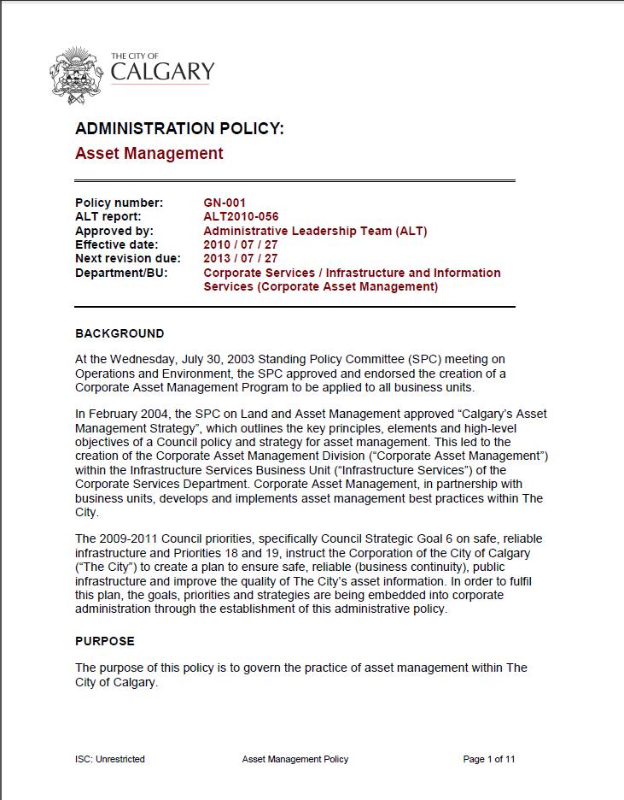

Asset Management Policy

Slide 31
Asset Management Policy
High River’s Asset Management Policy Included:
Policy Statement
Purpose
Definitions
Related Information (Policies)
Scope
Guiding Principles
Responsibilities

Slide 32
Asset Management Policy
High River’s Asset Management Policy Included:
Policy Statement
Purpose
Definitions
Related Information (Policies)
Scope
Guiding Principles
Responsibilities
Additional Topics:
Program Details
Flow Charts and Diagrams
Application
Procedures
Components
Objectives

Slide 33
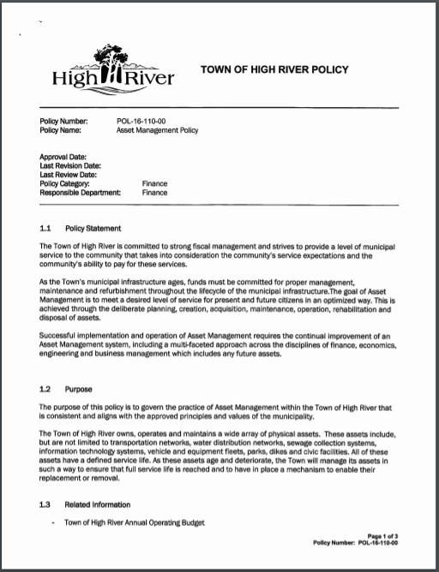
Asset Management Policy

Slide 34
Asset Management Policy
Thank You

