Slide 1
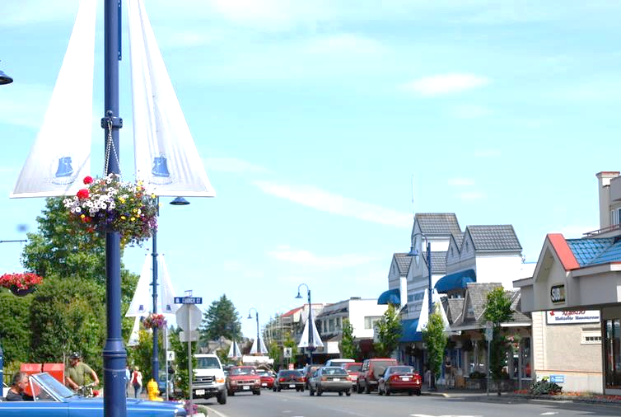



How To Bridge Your
Asset Funding Gap
Presentation By:
Clive Freundlich – Town of Comox
Brittany Stark – Municipal 360
Cory Sivell - YourCity
Notes:
Speaker: Cory
Hi, my name is Cory from YourCity & we have Clive from Town of Comox & Brittany from Municipal 360.
Introduce Clive, Brit & Myself
We appreciate you taking time to meet with us today.
So before we get started, just had a quick question before we started;
How many of you are finance ? | How many are engineering? | How many of your are administration? | How many of you came here to learn something new? | How many people here came here to get a day off work ?
How many of you have an asset management plan?
How many of you have identified a Funding Gap
3) How many of you Long-term financial strategy for asset replacement ?
4) How many people would like to build their AM Plan & financial strategy in the near term?
Well hopefully today we are able to provide you some key insights
Well we are hear today to share with you the Town of Comox Journey, share some of the common challenges faced as well how they are working to bridge their asset funding gap in realistic & approachable manner.

Slide 2
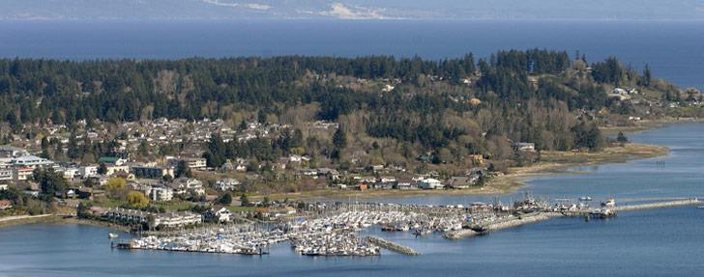
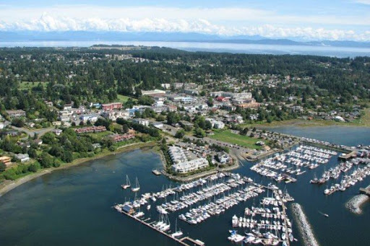
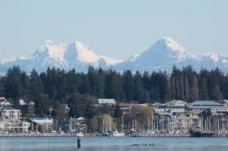
Notes:
Speaker: Cory
The town of comox was eager to set out on their asset management & long-term financial planning journey to help move their community into a financially sustainable future

Slide 3
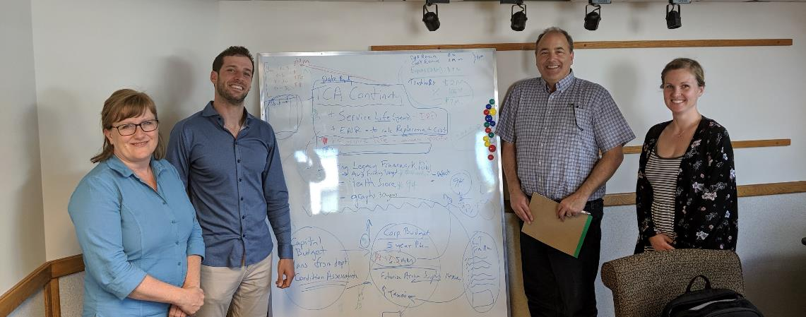
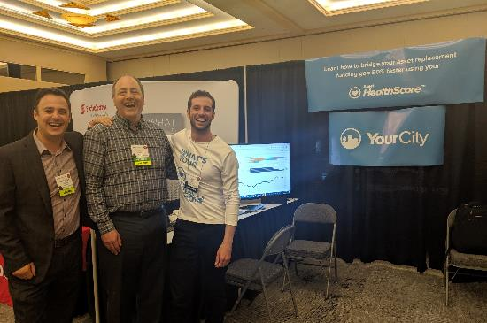
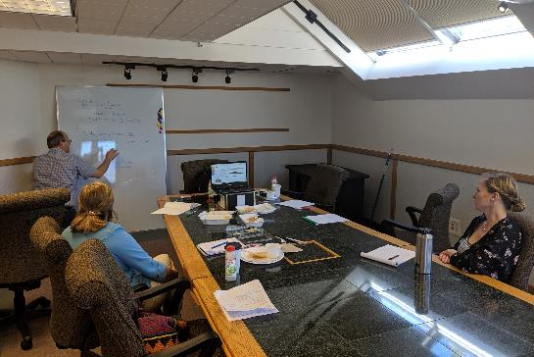
Notes:
Speaker: Clive
Fist Phase: Build Awareness with council & get buy in
Now the Town has AM as a #1 strategic priority
Second Phase: Refine funding target to a more realistic level & develop financial strategy.
Say something about Cory & Britney….

Slide 4
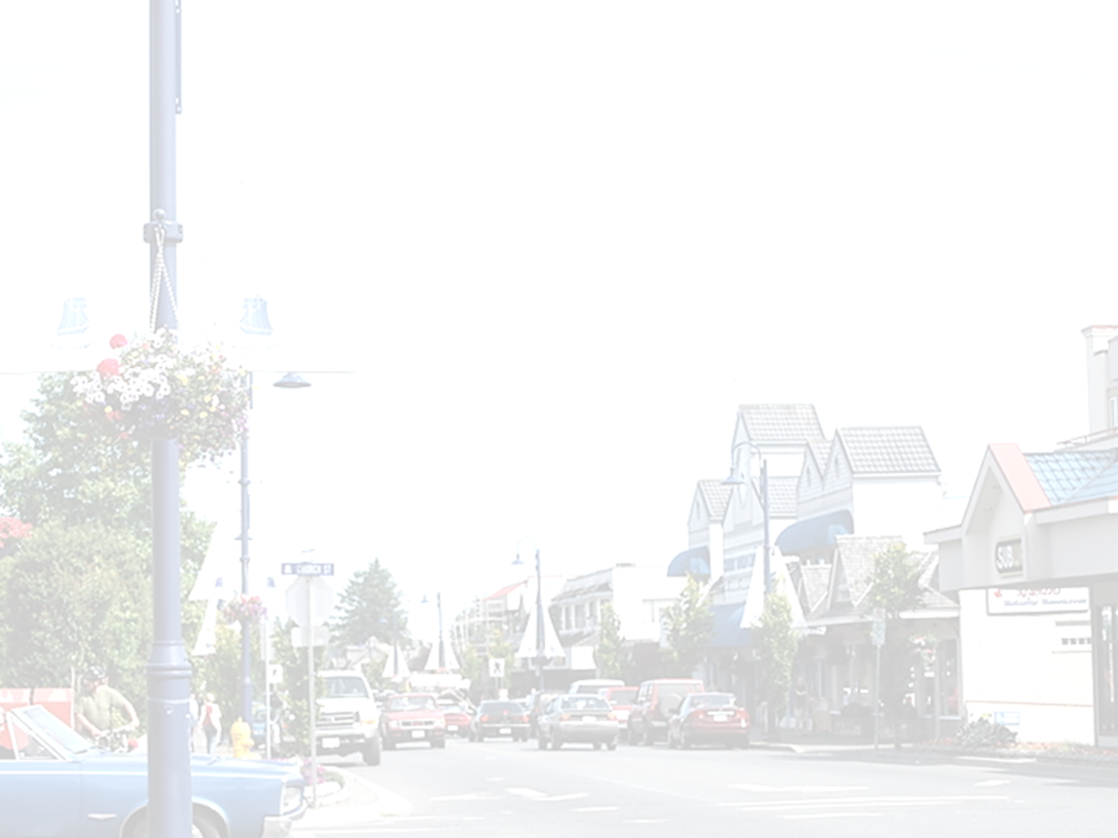

Challenges
Unrealistic Replacement Budgets
Notes:
Speaker: Cory
Along this journey, Comox bumped up against some common challenges
The 1st challenge & the biggest of them all.
The town first identified their asset replacement budget using life cycle funding forecasts which suggested the Town needed to increase their asset replacement budget from $2.5 million to $7 million. In order to bridge the funding gap, the town would have had to increase taxes 52%. ($4.5 million or 280% into asset replacement investments). This was unrealistic & not financially feasible.

Slide 5
Challenges
Asset Management Plans Remain Unfunded
Notes:
Speaker 1: Cory? | Clive
The life cycle funding target were presented but there was no consideration on how we were going to fund it. There was no consideration to the impact on taxation, debt, reserves etc….
Cory to Pause & ask clive if he has anything to add….
Clive: Without a long-term financial plan, its still an awareness thing & no plan…..

Slide 6
Challenges
Difficult To Show Trade-off’s B/W Risk, Level Of Service & Funding Levels
Notes:
Speaker: Cory | Clive
It was difficult to predict how risk & level of service would change into the future based the identified replacement budget. This made it difficult for staff & council to set budgets with confidence & understand the impact their decisions today have on their future.
Speaker: Clive
Comox Example: Roads department came in & just finish a road condition assessment. They said they needed $X million & our entire general capital fund budget was $X million. But we had no systematic way to show them trade-off between investing the entire budget into roads & what that would mean for the rest of the asset categories & how that aligned with future level of service needs.

Slide 7
Challenges
Councils Are Not Compelled to Think Long Term
Notes:
Speaker: Clive
Comox Example: One councillor said we are going to lower taxes, build a new building & put bike lanes but by doing the presentation on AM we have been able to show them the wave of costs coming to the Town. If we miss the opportunity to share AM we miss the opportunity to get them to think about long-term…….

Slide 8
Challenges
Require Complex Data Collection Exercises
Notes:
Speaker: Clive
Comox Example: Comox had a GIS system with some attribute data but not all required to support asset management, spreadsheets with data. We had a TCA inventory but wasn’t sure which direction to go & what sources to use? How do we keep data up to date? What data would be the most reliable plan & there was some thought that we needed to go collect a bunch of new data to build our plan.

Slide 9

Check-In
Notes:
Speaker: Cory
Of those challenges have any of you bumped up against them?

Slide 10
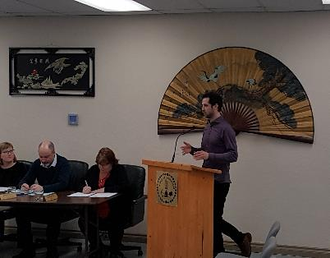
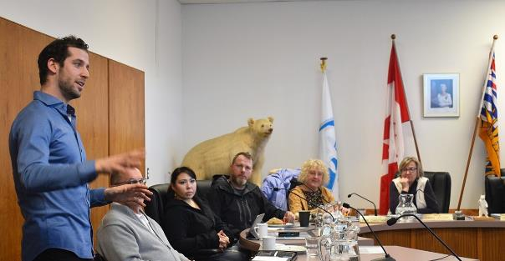
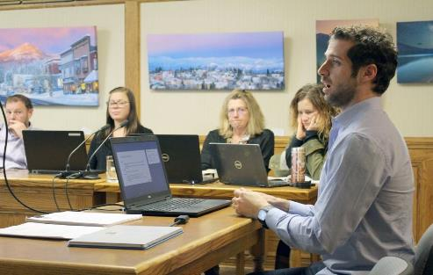

70+ Local Government Leaders & Counting…
Notes:
Speaker: Cory
Not only did I face those challenges with Comox, it also happened with the 70 + other local government leaders I had worked with. This encouraged our team to set out on a journey to develop a new way to think about this

Slide 11
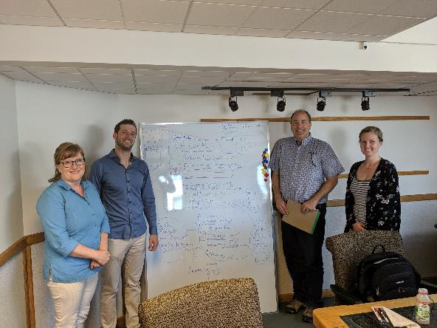
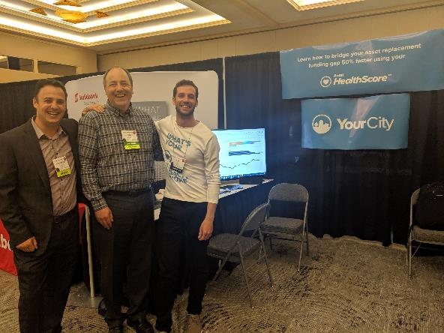
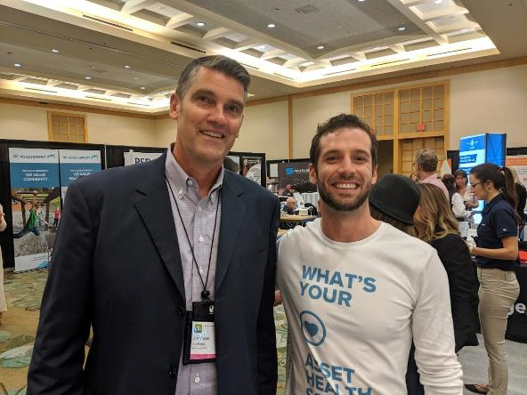
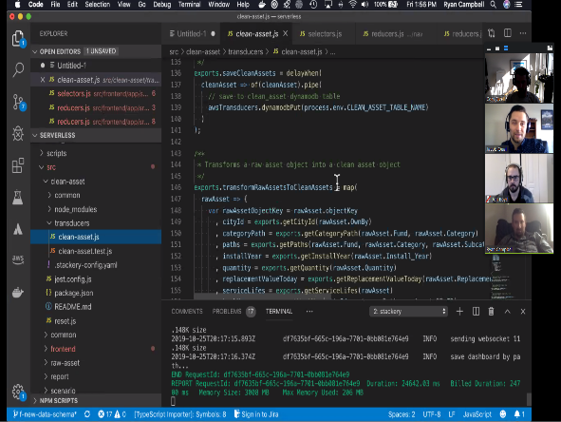
Notes:
Speaker: Cory
Our team & the client advisory board worked day in & out trying to figure out a way to eliminate these common challenges for other local governments.

Slide 12
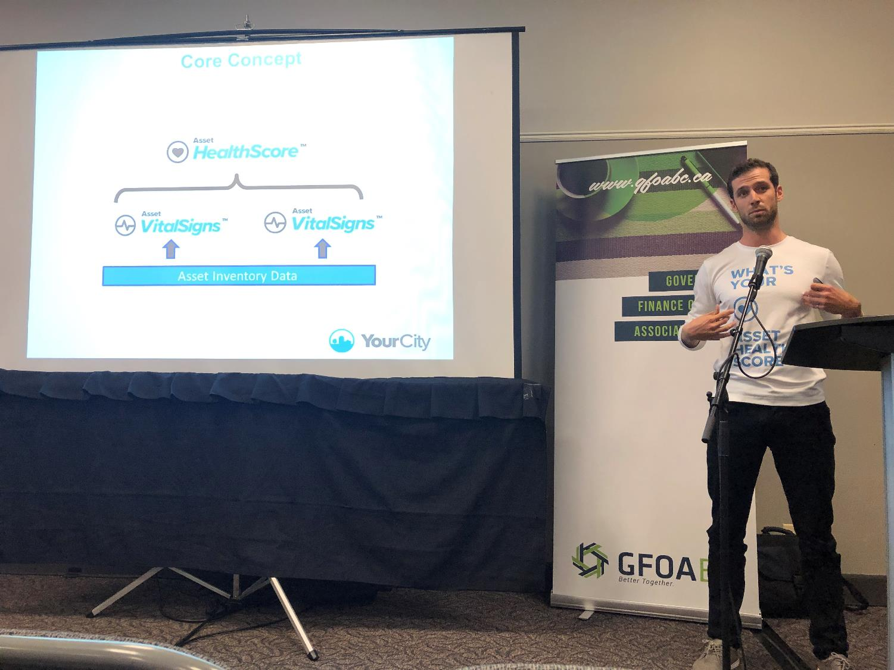
Notes:
But the great news is that the hard work has paid off & that we have found a solution that successfully eliminates each of the challenges & we now have the opportunity to share this with others.
After seeing the impact this approach has had on our clients, we have now made it our sole mission to share our knowledge & tools with as many local governments as possible which is why we appreciate you taking time to chat with us today.
We know that we cannot do this alone & that it requires the support of our current clients to share our message & future clients to provide us the opportunity to share how we can help

Slide 13
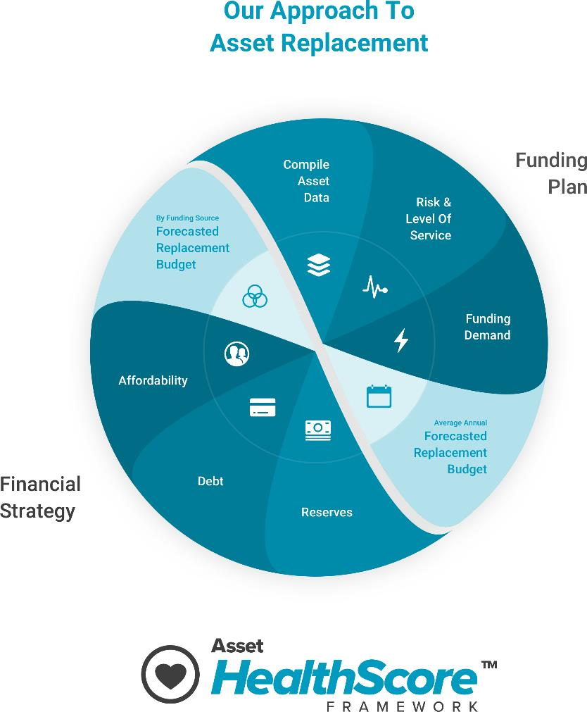
Notes:
Speaker: Cory
The New approach that we have developed that eliminates these challenges is the asset healthscore framework

Slide 14
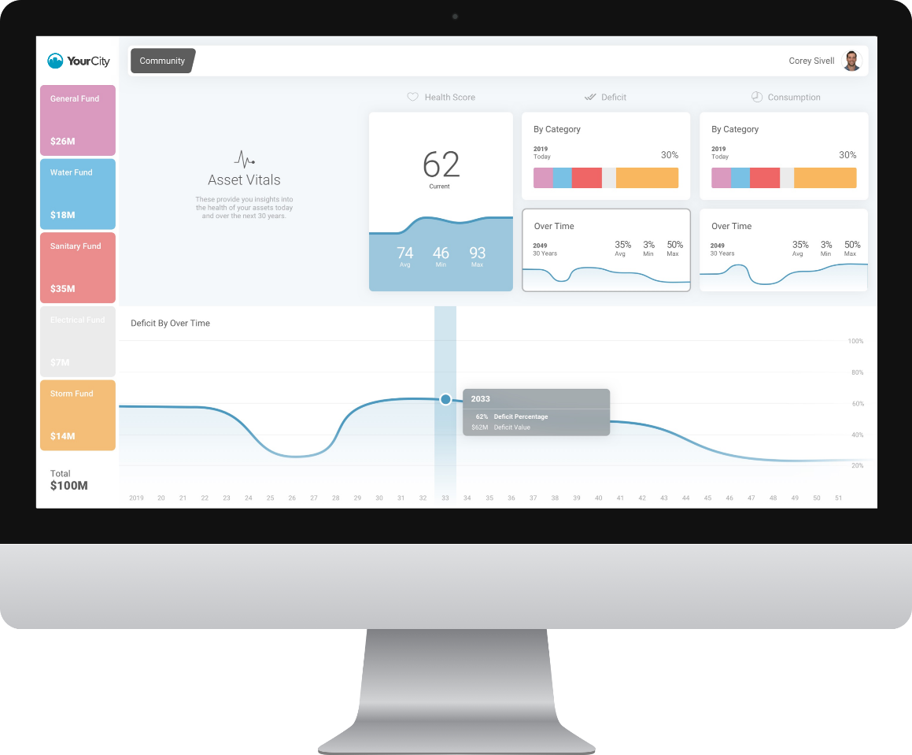
Notes:
Speaker: Cory
We also are developing tools & technologies to help automate the framework & visualize it.

Slide 15

Compile Asset Data
Notes:
Speaker: Cory
Frustration: We don’t have enough data to build our plan & to collect data takes time & money which often delays time between results etc…

Slide 16

Compile Asset Data
Notes:
Speaker: Cory
Want: Perfect data that can be managed & updated easily

Slide 17
Compile Asset Data
How to Identify Your Best Data Sources?
Audit
Rate
Select
Notes:
Speaker: Cory
Audit: Do a data download, GIS, TCA, Spreadsheet, Master Plan etc….
Rate: You need a way to rate inventories. I typically like to rate it in three ways:
Staff time to improve
Time to keep up to date
Usability for AM & long-term financial planning
Tools – do we need to purchase any new tools to manage the data
The Town of Comox has many data sources including:
Spreadsheets
TCA inventory
GIS data with some attributes but missing lots
Etc…..
We ended up using the TCA inventory data, insurance values & roads condition data

Slide 18

Compile Asset Data
Notes:
Speaker: Cory
Lots of trust issues with TCA data. Its not accurate enough, its missing some assets etc… I have used both types of data, bottom up & top down data & in the early stages of AM I would suggest using readily available data.
Quick Story: One client working with…..

Slide 19
Compile Asset Data
Benefits Of Using TCA Inventory
Data was already available (get started right away)
Build on top of an existing process
Same data source for financial statements & asset management/LTFP
Check-In
Audited & annually updated
Get you 80% to 90% of the way there
Notes:
Speaker: Clive
Speak the bullet points.

Slide 20
Compile Asset Data
Selected TCA Data
TCA Data
Asset Management
Notes:
Speaker: Clive
Comox Experience:
Re-tooling TCA & what was done there.
Didn’t have work orders that provided sub-asset categories & getting it to work with Chart of accounts
Create sub-asset categories & done through new work order system that lined up with asset management & provided in TCA

Slide 21
Compile Asset Data
How to update the TCA
General Ledger
TCA Continuity Schedule
Chart of Accounts (TCA Categories):
2 – 2xx – 1* Land
2 – 2xx – 2* Land Improvement
2 – 2xx – 3* Buildings
2 – 2xx – 4* Engineered Structures
2 – 2xx – 5* Machinery & Equipment
2 – 2xx – 6* Vehicles
Work Orders (Asset Sub-Categories):
General Ledger
2–218–31101– Community Centre
Work Orders
  313001 Roof
  315001 Electrical
  321001 Landscaping
Notes:
Speaker: Brittany
One of the biggest challenges with updating the TCA Schedule, is collecting and organizing your Capital Expenditure costs. Typically the level of detail in your TCA (and detail required by AM programs) is not captured in your GL accounts, which can make this a very manual and time-intensive process.
As a solution, we build in the TCA categories into the Chart of Accounts and Work Order.

Slide 22
Compile Asset Data
Benefits of using the COA with Work Orders
Provide Fund, Category, and Sub-Categories detail for AM program
Add asset specific service lives
Easy for staff to code invoices
Easily extract TCA detail & costs
General Ledgar:
2-218-31101- Community Centre
Work Orders:
  2020 - 313001 Comm Centre, Roof
  2020 - 315001 Comm Centre, Electrical
  2020 - 321001 Comm Centre, Landscaping
TCA Continuity Schedule
Notes:
Speaker: Brittany
Benefits &
At the end of the year, you can pull out a list of your work orders to easily copy into the TCA Schedule.

Slide 23
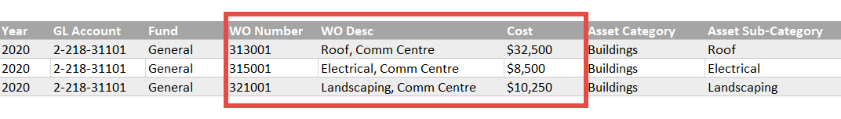
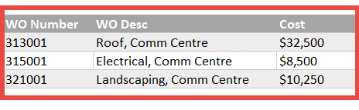
Compile Asset Data
Sample TCA Continuity Schedule
Notes:
Speaker: Brittany

Slide 24
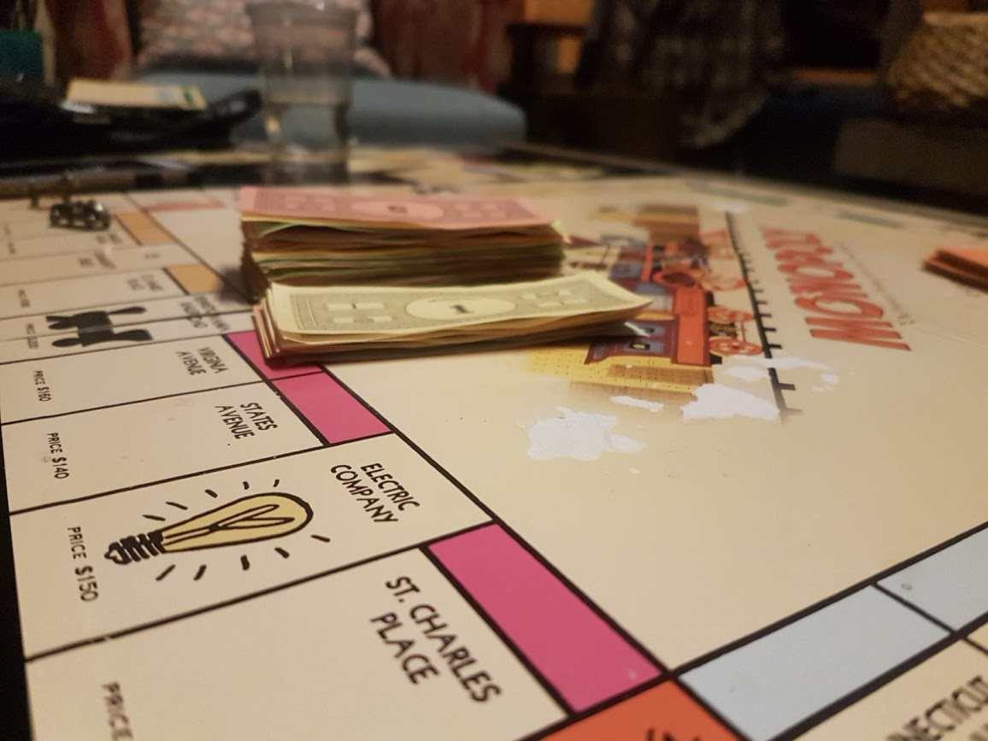
Forecasted Asset Replacement Budget
Notes:
Speaker: Cory
The Frustration with most forecasted asset replacement budgets is their more money available than you have.

Slide 25

Forecasted Asset Replacement Budget
Notes:
Speaker: Cory
The Want is that every budget needs to be balanced properly & that funding targets are realistic & that you have confidence in the financial future.

Slide 26
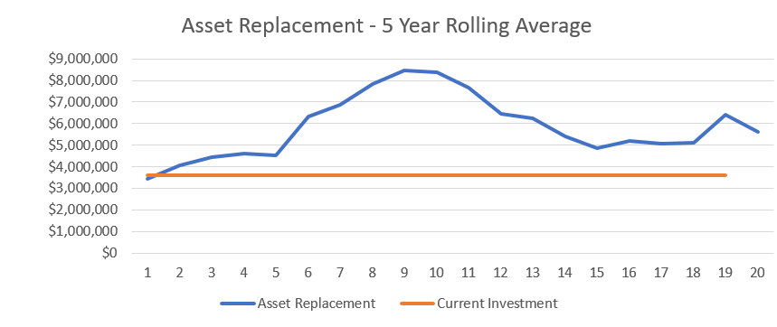
Forecasted Asset Replacement Budget
2020
2025
2030
2035
2040
Notes:
Speaker: Clive

Slide 27
Forecasted Asset Replacement Budget
$
Life Cycle
Risk & Level of Service
Current Funding
Time
Notes:
Speaker: Cory
How did Comox do it?
Life Cycle Funding is $7M
Current Funding was $2.5 million to bridge funding gap, taxes needed to increase by 52%.

Slide 28
Forecasted Asset Replacement Budget
Trade Offs
Risk
Level of Service
Cost
Notes:
Speaker: Cory

Slide 29
Forecasted Asset Replacement Budget
Asset HealthScore™
Risk
LOS
Spending Target
=
=
=
=
=
=
Notes:
Speaker: Cory
The core concept is that the healthier assets are, the less risk, the righer the level of service, the more you have to spend & viceversa.
There is a set of asset vital signs that inform the healthscore which we don’t have time to get into today b/c of time but more than happy to share more about that offline.
But the overall goal is we wanted to crease a single metric that provides insights into risk & level of service & try to move the conversation from from saying keep taxes low to saying keep assets healthy.
The asset health score if a function of % of assets past their life, how far into the asset life span, condition etc… it’s a rolled up metric….

Slide 30
Forecasted Asset Replacement Budget
Scenario 1: Consistent HealthScore
Category | Current Health Score | Future HealthSore | HealthScore Forecast | Life Cycle Forecast
General Capital Fund | 90% | 86% | $2.3M | $3.3M
Notes:
Speaker: Cory
You can see we looked at developing various scanrios.
Scenario 1 was based around keeping the asset which means same level of service & risk
Sceanrio 2 was based around reducing level of service & increasing risk.
If you remember cCve talking about the roads department coming forward with a large budget, well with this approach we can show them that maybe you cannot afford to keep the health of roads the same so what other asset categories need to give?

Slide 31
Forecasted Asset Replacement Budget
Scenario 1: Consistent HealthScore
Category | Current Health Score | Future HealthSore | HealhScore Forecast | Life Cycle Forecast
Buildings | 96% | 94% | $500K | $840K
Drainage | 96% | 95% | $470K | $590K
Equipment | 10% | 10% | $560K | $1.1M
Land Improvements | 72% | 70% | $320K | $330K
Transportation | 88% | 88% | $400K | $434K
Total | 90% | 86% | $2.3M | $3.3M
Notes:
Speaker: Cory
You can see we looked at developing various scanrios.
Scenario 1 was based around keeping the asset which means same level of service & risk
Scenario 2 was based around reducing level of service & increasing risk.
If you remember cCve talking about the roads department coming forward with a large budget, well with this approach we can show them that maybe you cannot afford to keep the health of roads the same so what other asset categories need to give?

Slide 32
Forecasted Asset Replacement Budget
Scenario 1: Consistent HealthScore
Notes:
Speaker: Cory
You can see we looked at developing various scanrios.
Scenario 1 was based around keeping the asset which means same level of service & risk
Sceanrio 2 was based around reducing level of service & increasing risk.
If you remember cCve talking about the roads department coming forward with a large budget, well with this approach we can show them that maybe you cannot afford to keep the health of roads the same so what other asset categories need to give?

Slide 33
Forecasted Asset Replacement Budget
Scenario 2: Reduce HealthScore
Category | Current Health Score | Future HealthSore | HealthScore Forecast | Life Cycle Forecast
General Capital Fund | 90% | 72% | $1.7M | $3.3M
Notes:
Speaker: Cory
You can see we looked at developing various scanrios.
Scenario 1 was based around keeping the asset which means same level of service & risk
Sceanrio 2 was based around reducing level of service & increasing risk.
If you remember cCve talking about the roads department coming forward with a large budget, well with this approach we can show them that maybe you cannot afford to keep the health of roads the same so what other asset categories need to give?

Slide 34
Forecasted Asset Replacement Budget
Benefits Asset HealthScore Forecast
Show the impact funding decisions today have on your future
Easily mange the trade-off’s between investment decisions, risk & level of service
Set more manageable & realistic funding targets
Check-In
Notes:
Speaker: Cory
You can see we looked at developing various scanrios.
Scenario 1 was based around keeping the asset which means same level of service & risk
Sceanrio 2 was based around reducing level of service & increasing risk.

Slide 35
Long-Term Financial Strategy For Asset Replacement
$
Life Cycle
Risk & Level of Service
Current Funding
Time
Notes:
Speaker: Cory
Frustration: How do you move from the current funding level to the new funding level in a realistic & affordable manner.
This is where we directly linked the outputs of the asset management plan to the long-term financial strategy for asset replacement.
This is where questions come up such as;
how much do we budget a transfer into & out of reserves.
What is our minimum reserve level,
how much debt do we use & is this within the provincial maximum etc….
Is this plan affordable?

Slide 36

Long-Term Financial Strategy For Asset Replacement
Notes:
Speaker: Cory
Do you have decided where you want to go from a funding perspective but you don’t know if you can get there.
In other words, what you want is the most cost efficient & affordable way to move from one side to the other.
I like to think that completing your asset management plan with out a long-term financial strategy is like saying you want to go from that side of the river to the other but not sure where that bridge will go, if you can afford it, how do we manage that project over time. Etc….
So the core message here is that you need to create a financial strategy to bridge your funding gap otherwise you could be missing a core piece.
Speaker: Clive
- The Town has celebrated being debt free but may need to rethink that over time & weaving in the reality of this.

Slide 37
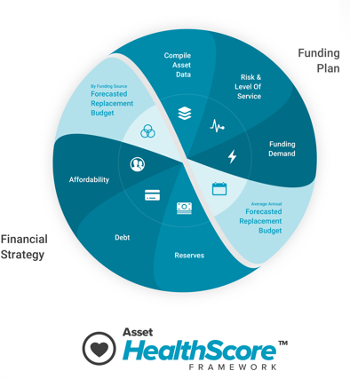
Long-Term Financial Strategy For Asset Replacement
Notes:
Speaker: Cory
So how do you do this?
We need to consider:
Reserves. Need to look at current budgeted transfers into reserves, budget transfers out, minimum reserve levels based on mitigrating risk & creating what we call a financial buffer
Debt. We need to consider how much
Affordability. Can our citizens afford this.
There is often some back & forth here. For example: if we want to keep our healthscore the same, what is the impact to reserves, debt & affordability? If it doesn’t work, then you know you need to reduce your healthscore or in other words adjust risk & level of service.
There
Going back to the Comox example: that is why we created a varitety of different scenarios. One might not be desired but not financially possible. By connecting them both it will prevent lots of back & forth.

Slide 38

Compelling Councils to Think Long-Term
Notes:
Speaker: Cory
Frustration with trying to communicate results in a way that resonate with everyone

Slide 39

Compelling Councils to Think Long-Term
Notes:
Speaker: Cory
Eveyrone wants to communicate the results crystal clear, get everyone on the same page & not have to convince, convince, convince
Also wanted to move away from telling councils this is what you should do, to telling them this is the impact of your decision

Slide 40
Compelling Councils to Think Long-Term
Notes:
Speaker: Cory
Eveyrone wants to communicate the results crystal clear, get everyone on the same page & not have to convince, convince, convince

Slide 41
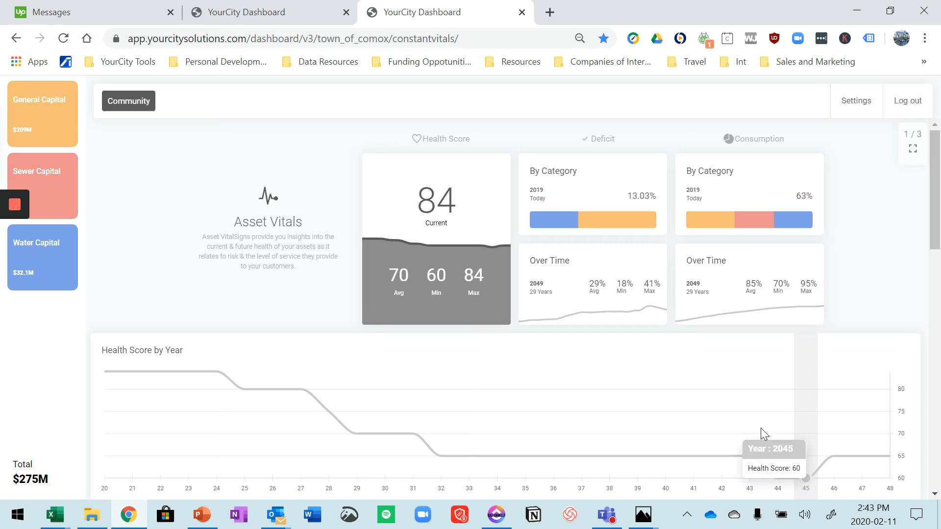
Communicating Results
Notes:
Speaker: Cory
Eveyrone wants to communicate the results crystal clear, get everyone on the same page & not have to convince, convince, convince

Slide 42

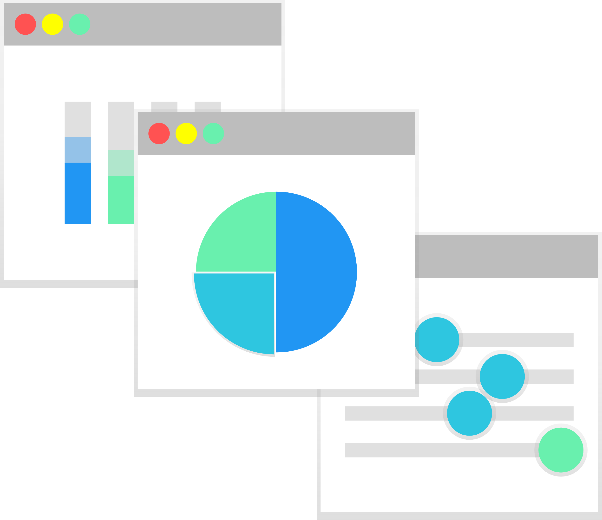



Key Takeaways
You can get started using existing data (TCA)
Check-In
Chart of account & WO streamline updating TCA & AM Plan
Refine funding target using risk & level of service
Connect AM plan directly to a long-term financial strategy
Communicate results clearly & compelling manner
Notes:
Cost Side
- Indexing cost

Slide 43
Cory Sivell, CEO
cory@yourcity.co
778-222-3282
Brittany Star, COO brittany.stark@municipal360.ca
Notes:
Cost Side
- Indexing cost

Slide 44
BONUS SLIDES
Notes:
Cost Side
- Indexing cost

Slide 45


Asset HealthScore
Consumption
Past Life Assets
ASSET DATA
Notes:
Definitions
Past Life Assets: % of the asset portfolio that is past it estimated service life
Consumption: How far into the estimated asset life span?
HealthScore: Measure of the assets likelihood to deliver service without disruption. The higher the healthscore, the more likely the asset can deliver services with a lower likelihood of service disruption.

Slide 46
Bucket Analogy
Rate of Investment
Consumption
HealthScore
Past Life Asset
Rate of Deterioration

Slide 47
Bucket Analogy
Rate of Investment
Rate of Investment
Rate of Deterioration
Rate of Deterioration

Slide 48
Bucket Analogy
Rate of Investment
Rate of Investment
Rate of Deterioration
Rate of Deterioration

Slide 49
Example

Slide 50
Sustainable Service Delivery Model
Consequence of Failure Risk
Consumption
Sustainable Service Delivery Score
Asset Health / Score
x
=
∞
+
ASSET DATA
Level of Service
Past Life Assets
∞
Spending Target

Slide 51
Forecasted Asset Replacement Budget
Scenario 1: Consistent HealthScore
Category | Current Health Score | Future HealthSore | $ | Life Cycle
Buildings | 96% | 94% | $500K | $840K
Drainage | 96% | 95% | $470K | $590K
Equipment | 10% | 10% | $560K | $1.1M
Land Improvements | 72% | 70% | $320K | $330K
Transportation | 88% | 88% | $400K | $434K
Total | 90% | 86% | $2.3M | $3.3M
Notes:
Speaker: Cory
You can see we looked at developing various scanrios.
Scenario 1 was based around keeping the asset which means same level of service & risk
Sceanrio 2 was based around reducing level of service & increasing risk.
If you remember cCve talking about the roads department coming forward with a large budget, well with this approach we can show them that maybe you cannot afford to keep the health of roads the same so what other asset categories need to give?

Slide 52
Forecasted Asset Replacement Budget
Scenario 1: Reduce HealthScore
Category | Current Health Score | Future HealthSore | $ | Life Cycle
Buildings | 96% | 79% | $305K | $840K
Drainage | 96% | 90% | $290K | $590K
Equipment | 10% | 10% | $500K | $1.1M
Land Improvements | 72% | 37% | $280K | $330K
Transportation | 88% | 60% | $335K | $434K
Total | 90% | 72% | $1.7M | $3.3M
Notes:
Speaker: Cory
You can see we looked at developing various scanrios.
Scenario 1 was based around keeping the asset which means same level of service & risk
Sceanrio 2 was based around reducing level of service & increasing risk.
If you remember cCve talking about the roads department coming forward with a large budget, well with this approach we can show them that maybe you cannot afford to keep the health of roads the same so what other asset categories need to give?

