Slide 1


Challenges and Innovations in Municipal Asset Management
Presented by:
Bhupesh Sakalley, Project Manager
Zimran Khokhar, Project Manager
February 7th, 2018 IAMA Workshop, Red Deer, Alberta

Slide 2
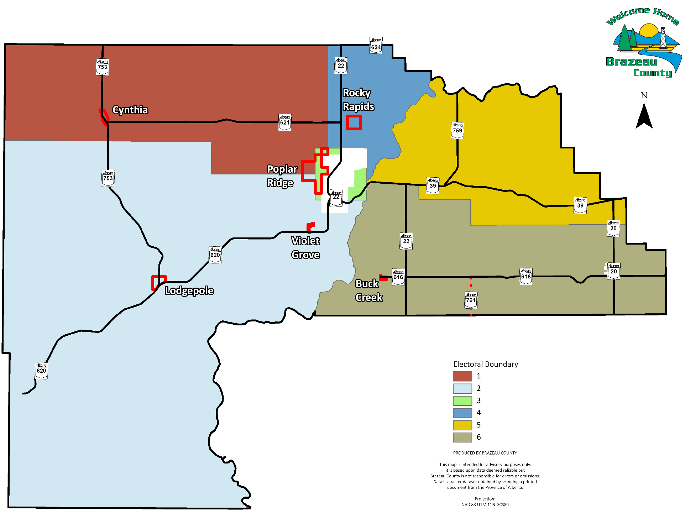
Brazeau County

Slide 3
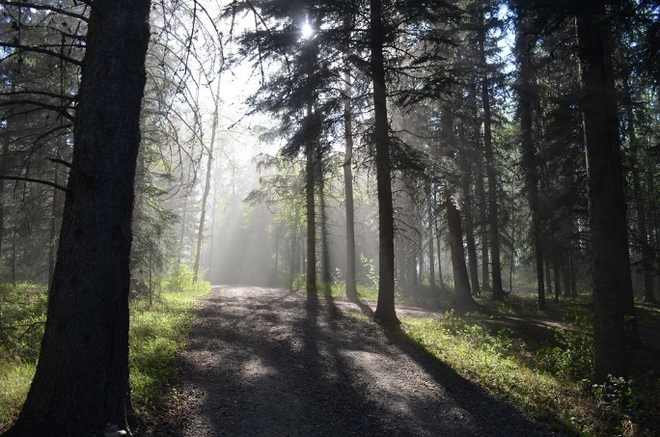
Agenda
Overview of Brazeau County
Tangible Capital Assets (TCA) v Asset Management (AM)
Current Progress with AM
Summary of Challenges
Innovative Processes and Overcoming Challenges
Lessons Learned/Advice to Others
Questions
Presenters Contact Details

Slide 4
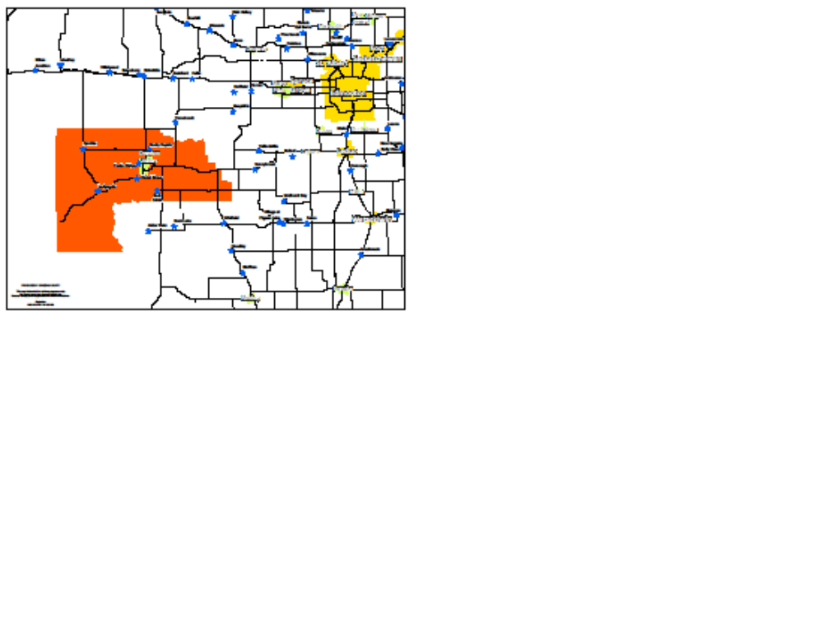
Overview of Brazeau County
Located ~125 km West of
Edmonton
Total land area – 3,005 km²
Population – 7,771 (2016 Census)
Seven Hamlets & shares assets with the Town of Drayton Valley

Slide 5

Overview of Brazeau County
Water and wastewater assets:
13 County owned gravel pit
Road assets: ~ 1,000+ km (paved 155 km, gravel 880 km and cold mix 5 km)
Sewage Lagoons – 7 Sewer Trunks – 34.88 km Solar Aquatic System (SAS) Plant – 1 | Water Distribution Lines – 13.42 km Water Treatment Plants – 2 Waste Transfer Facilities – 8

Slide 6
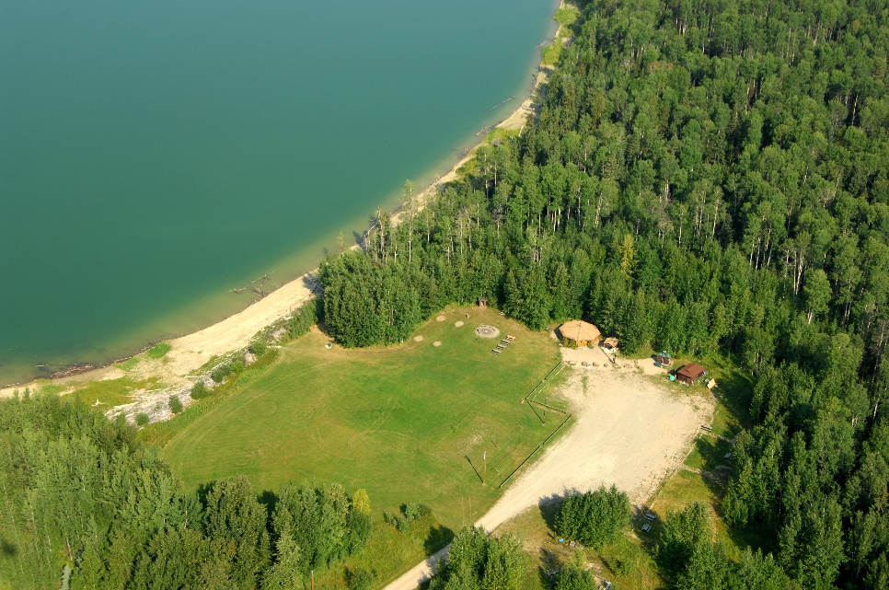
Overview of Brazeau County
Other assets include:
Average age of assets ~ 30+ years
Community Halls Parks and Camp Grounds Communications Towers

Slide 7
TCA vs. Asset Management
PSAB TCA
Inventory
Valuation
Amortize
Financial Statement
Manage contributions, disposal, write downs etc.….
Asset Management
Inventory
Valuation
Condition Assessment
Manage
Assets
Manage additions, rehabilitation, replacements, removals etc.…

Slide 8
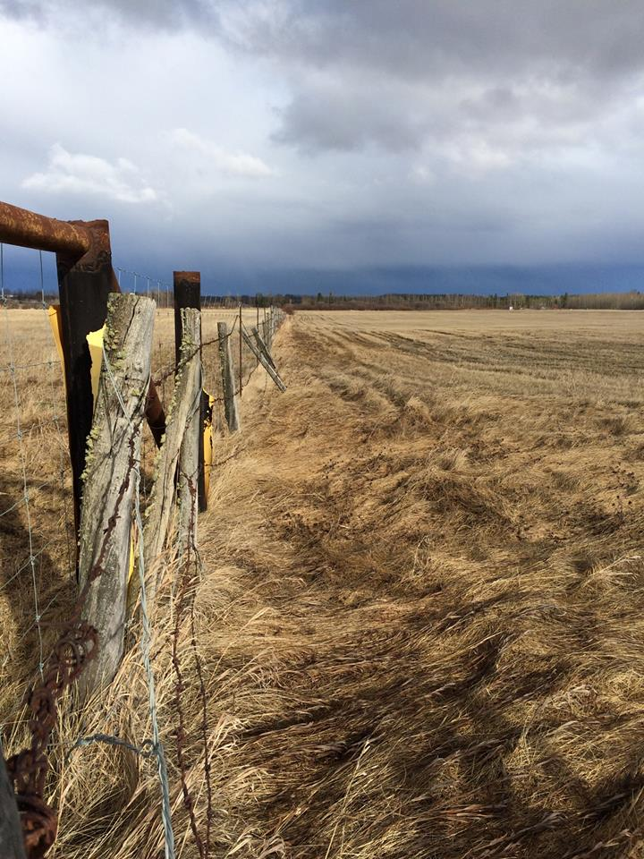
Current Progress with AM
Senior Management during 2016 initiated the elements of an AM policy
Kick-started
inter-departmental
discussions
Outreach initiatives –
other municipalities

Slide 9
Current Progress with AM
Conference calls and meetings:
  Day visit to City of Lethbridge to meet AM team. Following guides were helpful for Brazeau County:
    Develop an AM team
    Decision making for working with existing AM infrastructure
    Start with condition rating for various assets
    Harness facilitated field data collection
    Training for operational staff
    5-year plan that entails incorporation of the above
Communicated with the City of Cold Lake regarding their AM practices

Slide 10
Current Progress with AM
Obtained AM toolkit from Alberta Municipal Affairs webpage and worked with the template to extrapolate data to formulate an AM strategy
Used current TCA to support AM strategy
Researched and reviewed draft AM policies, framework and plans from other Municipalities

Slide 11

Current Progress with AM
Council commits to apply for AM grants with following directives:
  Municipal financial commitment
  AM Grant application commitment
Application to participate in Climate and Asset Management Network (CAMN) program

Slide 12

Current Progress with AM
Brazeau County formalized a team to establish AM framework with following roles:
  Public Works Engineer
  Administrator
  Finance Director
  Sustainability Coordinator
  Land Use Planner

Slide 13

Current Progress with AM
Brazeau County’s upcoming AM achievement aspirations:
  August 2018, seek Council buy-in AM policy
  AM Policy Development
  AM Governance Framework
  Data Gathering
  Condition Assessment

Slide 14

Summary of Challenges
  Dealing with the “unknown” – existing infrastructure
  Finding asset details and maintenance records
  Meeting the present need with existing infrastructure
  Integration of current software i.e. Worktech, ArcGIS, MS Diamond, Questica, etc.
  Education: Council and Staff

Slide 15

Innovative Processes & Overcoming Challenges
Dealing with the “unknown” – existing infrastructure:
  Start with identifying the knowns i.e. AM registry of existing infrastructure
  Upon completion of inventory of existing infrastructure, a dedicated technician will identify asset details
Finding asset details and the maintenance records:
  Build an AM registry and add details such as missing data and maintenance records
  Interviewing Municipal staff for historical repairs
  Create maintenance archive and integrate with AM framework

Slide 16

Innovative Processes & Overcoming Challenges
Meeting present need with existing infrastructure:
  Life cycle and condition assessments are conducted and registered
  As identified on asset registry and upgrade as required
Integration of current software i.e. Worktech, ArcGIS, MS Diamond, Questica, etc.
  Identify asset details from AM toolkit
  Complete GIS template with asset details and link with work order history on Worktech
Education: Council and Staff
  Training through seminars and/or workshops

Slide 17
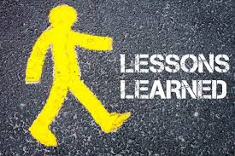
Lessons Learned/Advice to Others
Political buy-in is paramount
Dependent on municipality dedicate AM specialist
Team to implement an AM system specific to Municipality
AM policy, framework, database and condition assessment prior to an AM plan
AM practices should be developed with community, sustainability and climate change in mind

Slide 18
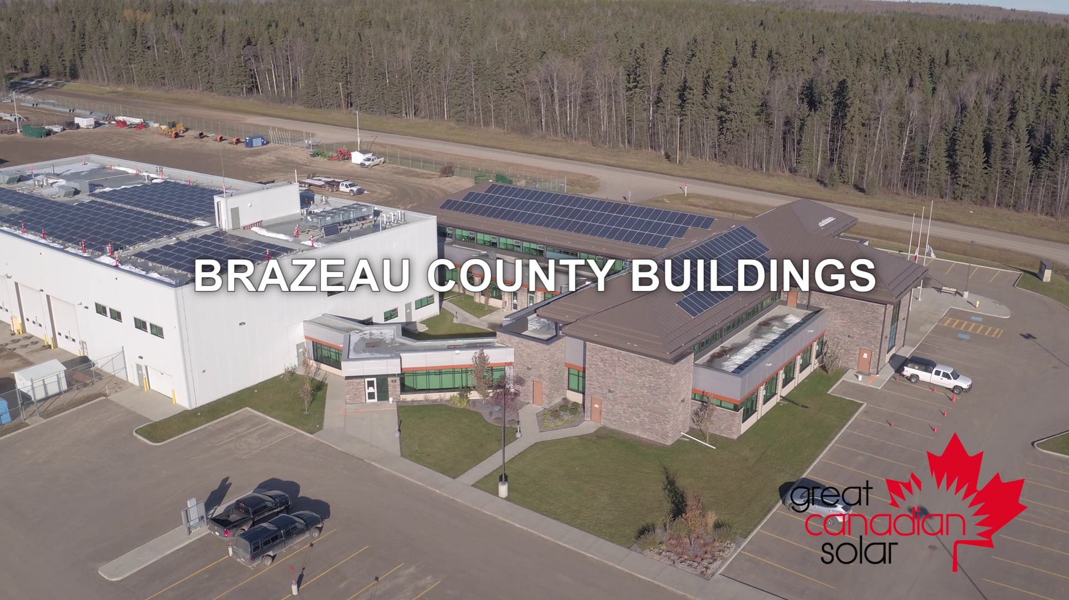
Brazeau County’s Solar Power Admin Building

Slide 19
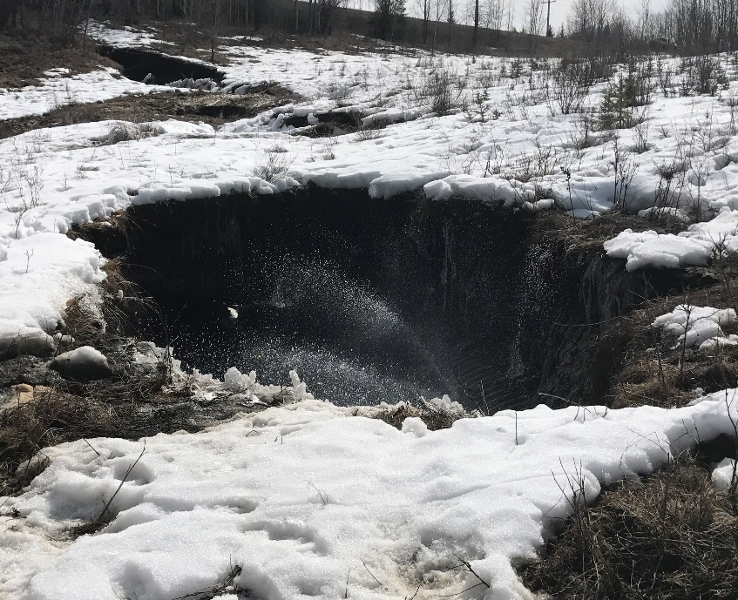
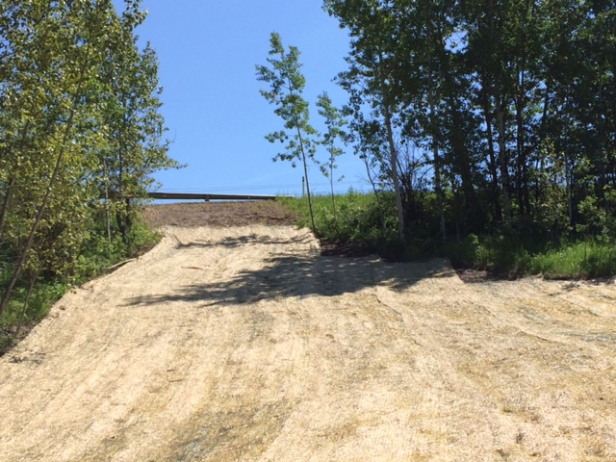
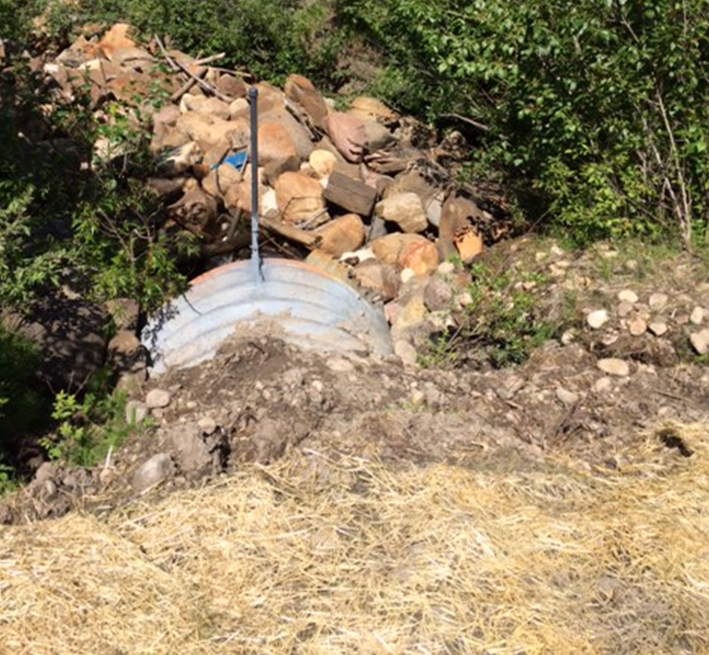
Example of Current Infrastructure

Slide 20
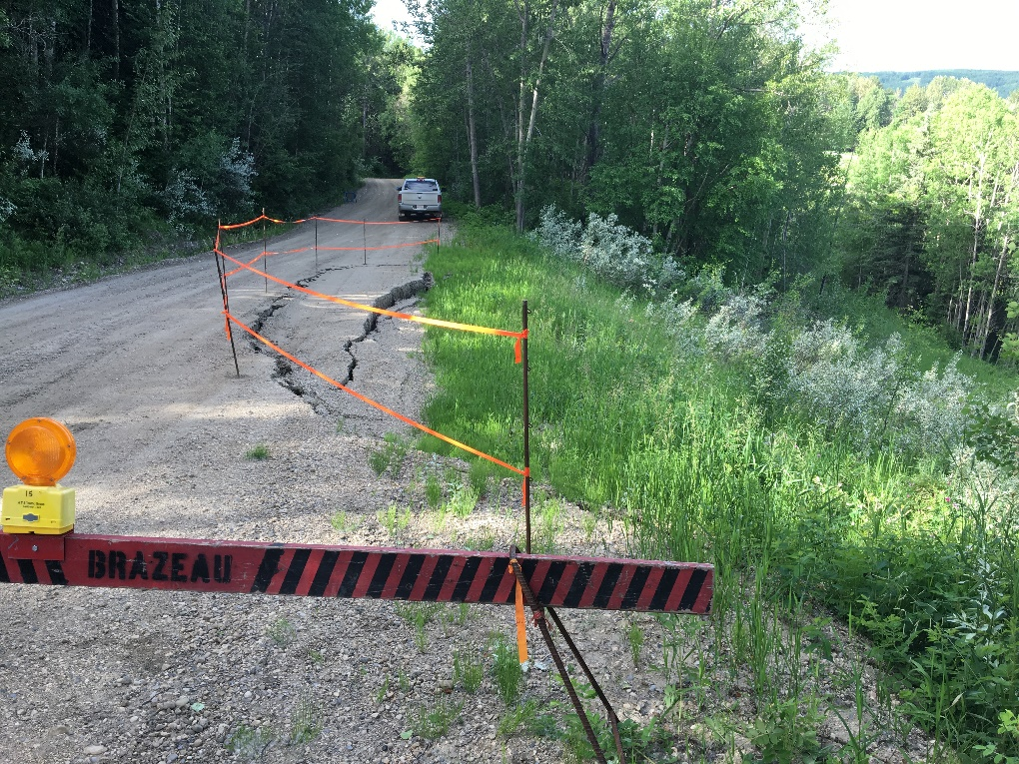
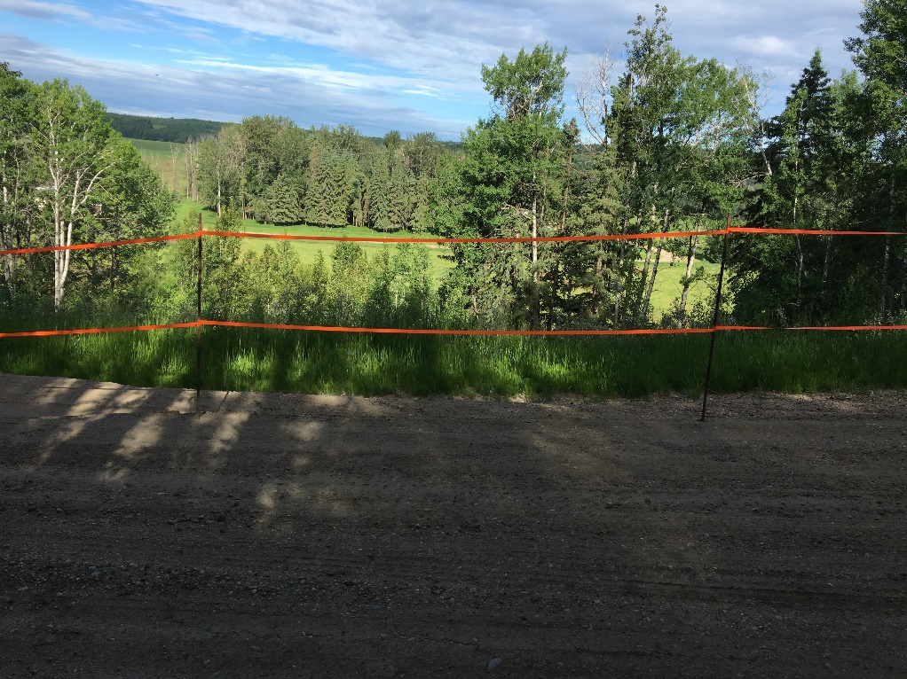
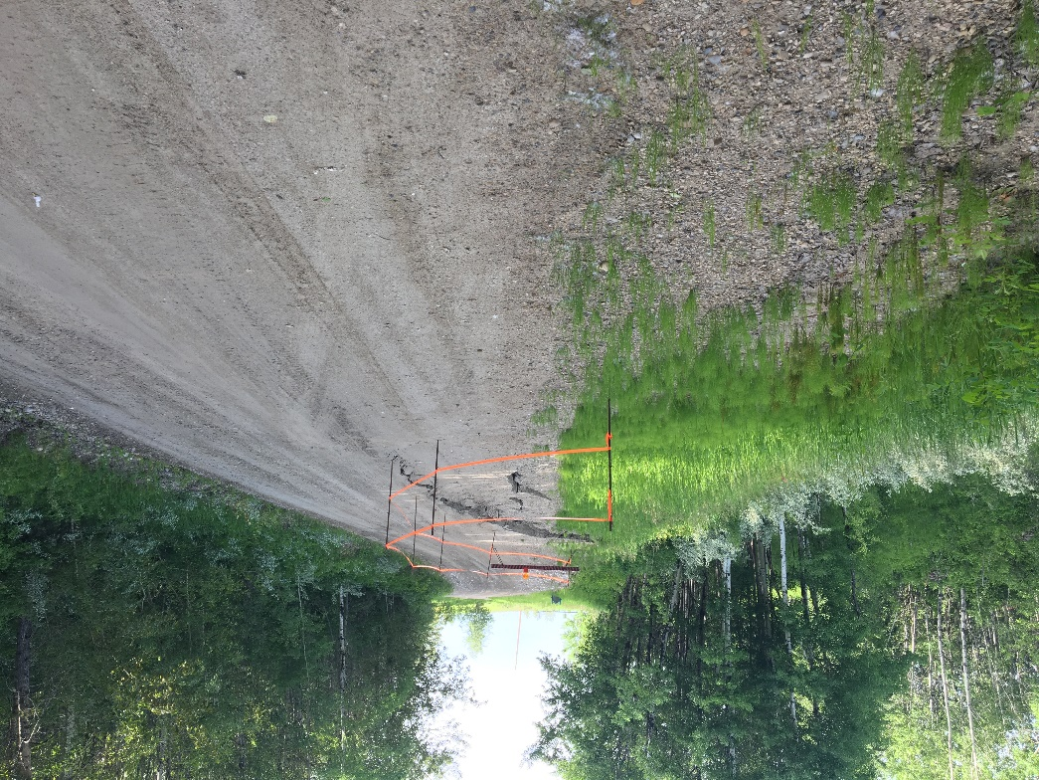

Slide 21

Questions?

Slide 22
Thank you for listening
Enquires:
bsakalley@brazeau.ab.ca
zkhokhar@brazeau.ab.ca

