Slide 1

Tech Talk
Wednesday February 8, 2018
Presented on June 27, 2017 to:

Slide 2
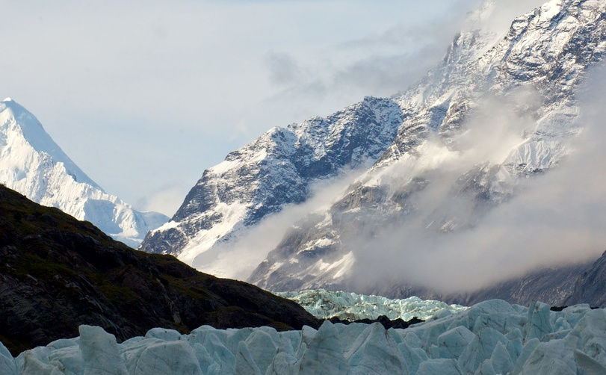
Risk Management:
Precursor to Effective Management Decision Making

Slide 3
Risk Assessment Process
&
Risk Management Elements

Slide 4
Risk Assessment Process
Risk Identification
Frequency Analysis
Consequence Analysis
Risk Evaluation
Risk Reduction
Risk
Acceptable
NO
YES
End

Slide 5



Risk Management Elements
Identify | Analysis and Precursor to Decisions | Plan and Manage | Control
Define the risk(s) Organizational Knowledge Group Brainstorming Experience from past Communication with stakeholders, suppliers, related functional areas | Bow Tie Ishikawa Fish Bone diagram Heat Matrix Bayesian Network Modelling | Stakeholder engagement Communication plans Training Resistance management Mitigation measures | Monitor performance metrics Leading and lagging indicators Adjust program as needed

Slide 6
Bow Tie
* Courtesy Government of Canada

Slide 7
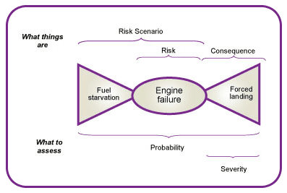
Bow Tie
The risk is preceded by a cause, and followed by a consequence.
Risk is the knot of the bow tie and the cause(s) and consequence(s) are the “wings”
* Courtesy Government of Canada

Slide 8
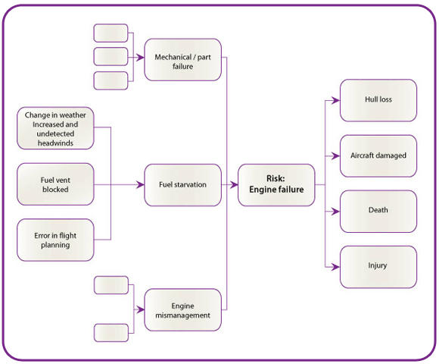
Bow Tie - Adjusting for complexity
First identify possible scenarios. Consider human, natural, economic and technical causes.
Identify consequences once scenarios are built. Consider property, health, finance, liability, people, environment, stakeholder/customer/public confidence
* Courtesy Government of Canada

Slide 9
Ishikawa Fish Bone Diagram

Slide 10
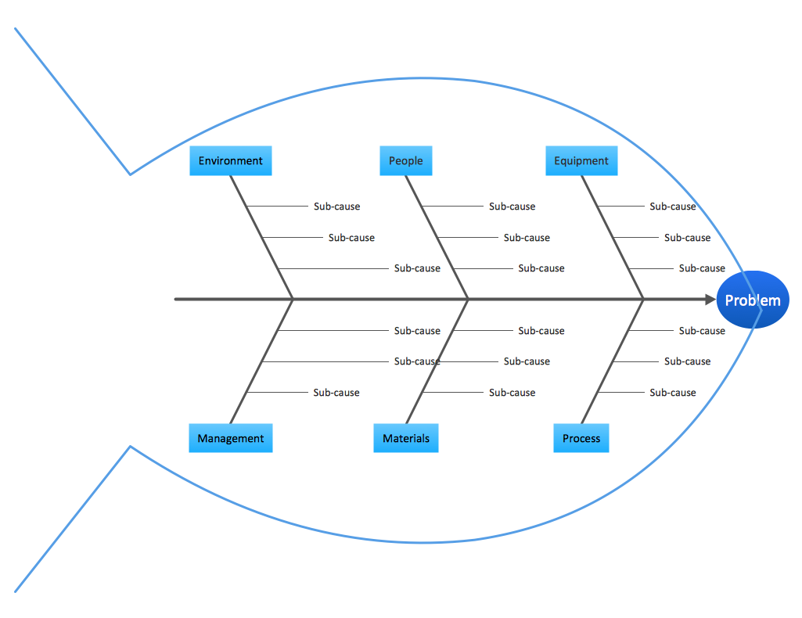
Ishikawa Fish Bone Diagram
To break down (in successive layers of detail) root causes that potentially contribute to a particular effect. Suggest using when:
Analyzing and finding the root cause of a complicated problem
When there are many possible causes for a problem
Measurement
Problem

Slide 11
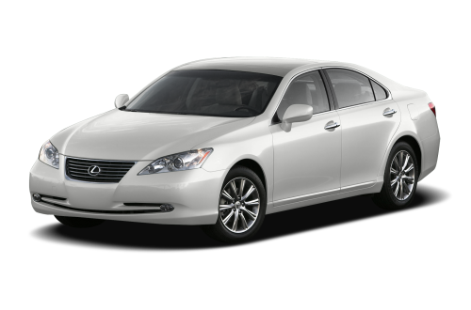
Ishikawa Fish Bone Diagram
2007 Lexus ES350

Slide 12
Ishikawa Diagram Example
- Toyota Unintended Acceleration Investigation

Slide 13
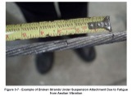



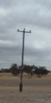
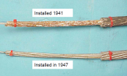
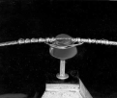

Bare Overhead Conductors:
Failure due to Conductor Break
- Line to Line
- Line to Ground
- Double/Multiple Line to Ground
Conductor uplift leading to fatigue failure of conductor binding wire (MD V 1.01)
Unassisted Failure
(~360 reported per year)
Aeolian Vibration (MD V 1.02)
Fatigue Break
Damage from Clashing (MD V 1.03)
Reciprocal Loading
Abrasion Wear
Vibration (Wind)
Fatigue
Exceeding Rating
Fretting
Extended Dormancy
Tensile Break
Service Overloading
Assisted Failure
(frequency tbd)
Crop Dusting
Mechanical Degradation
Ocean
Corrosion Centre Span
Industrial
Atmospheric
Corrosion
(PD C 1.01)
Corrosion at Fittings
Corrosion Throughout
Physical Degradation
Galvanic
Dampener
Annealing (PDA 1.01)
Pole
Associated
Asset
Failure
Cross Arm
Design Specification doesn’t meet duty
Joints
Leading Indicators not Effective
Requirement Specification
is Incorrect or Incomplete
Insulator
Fault Repaired with Substitute Parts
Design
Design Change Management
Inspection Regime is Inadequate (PE I 1.01)
Vehicle Striking Conductor
Laboratory Assessment QA Inadequate (PE I 1.02)
Security Lapse
& Third Party Damage
Vandalism
Inspection Performed Incorrectly
Procedural
Errors
Theft
Inspection Frequency too Long
Objects thrown over the conductor wires
Vegetation Management Inadequate
Installation Damage
Workmanship Mistakes
Inadequate Training
Unqualified Operator
Stay released from ground, not properly installed/compacted
Click and expand images for more detail
Unassisted prioritised causes are identified (AA x.xx) and described further in attached slides
Substitute Parts not Replaced
Instructions Wrong/Not Followed

Slide 14
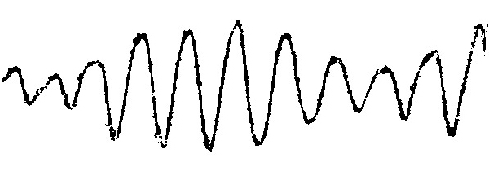

Mitigating Risk - Aeolian Vibration Wear
Vibration Recorded on 1272 kcmil
45/7 ACSR Conductor (11 Hertz)
* Courtesy Western Power

Slide 15
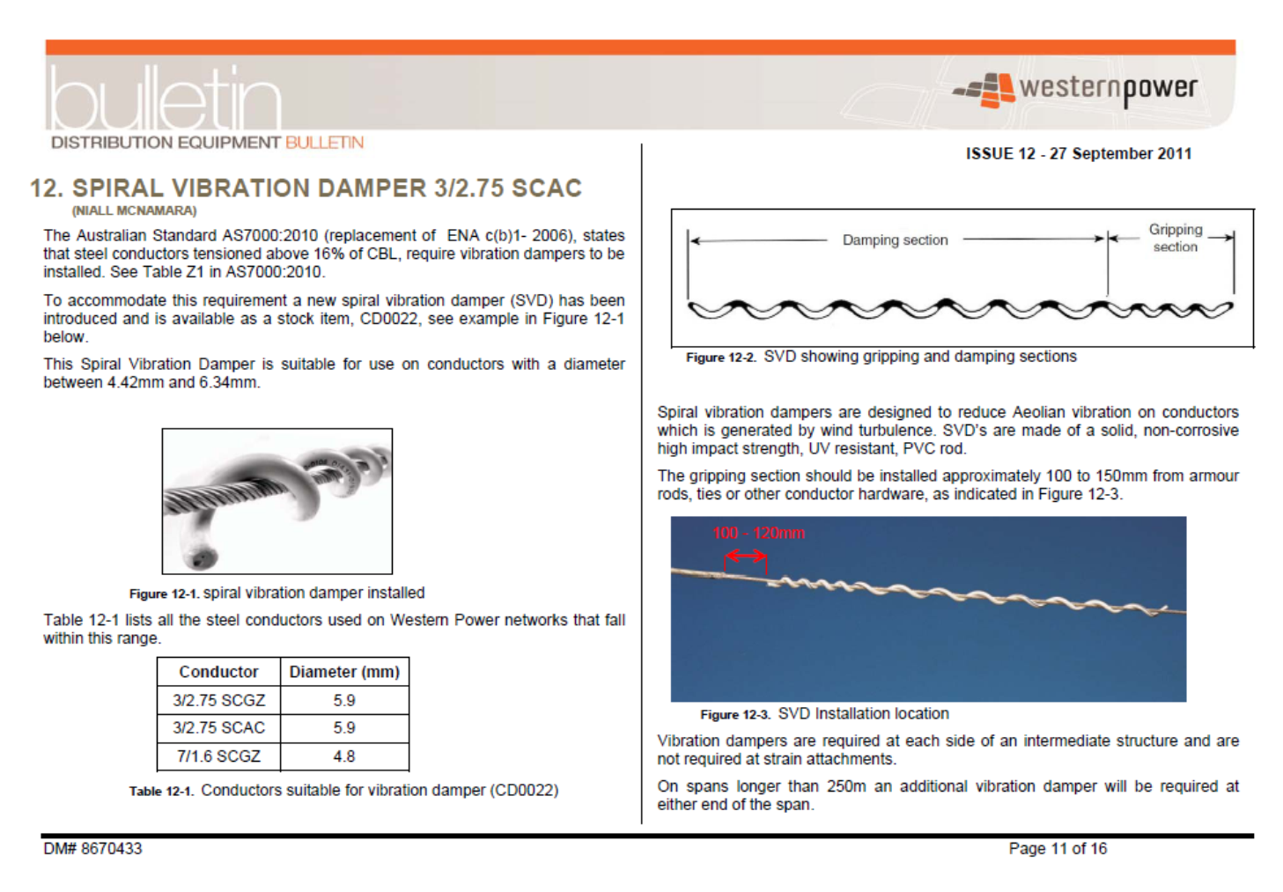
Spiral Vibration Damper
The Spiral Vibration Damper is an “impact” type damper made of a rugged non-metallic material that has a tight helix on one end that grips the conductor or wire. The remaining helixes have an inner diameter that is larger than the conductor or wire, such that they impact during Aeolian vibration activity. The impact pulses from the damper disrupt and negate the motion produced by the wind.

Slide 16
Heat Maps

Slide 17
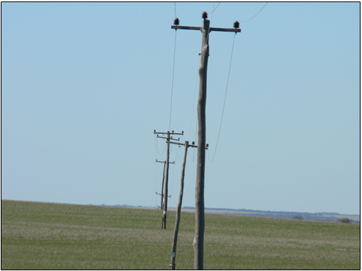
Heat Maps – Dalwallinu Example

Slide 18
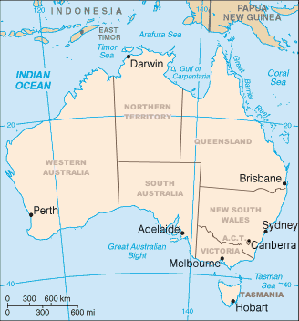

Quiz: Where is Dalwallinu?
Dalwallinu

Slide 19
Risk Identification
The risk identified is:
• public safety, sections of the power lines have come to the end of their useful life;
• risk of fire resulting from asset failure;
• risk of network outages;
• poor customer service outcomes.

Slide 20
Risk is
multi-dimensional

Slide 22
Bayesian Modelling
Not saying this is for everyone.

Slide 23
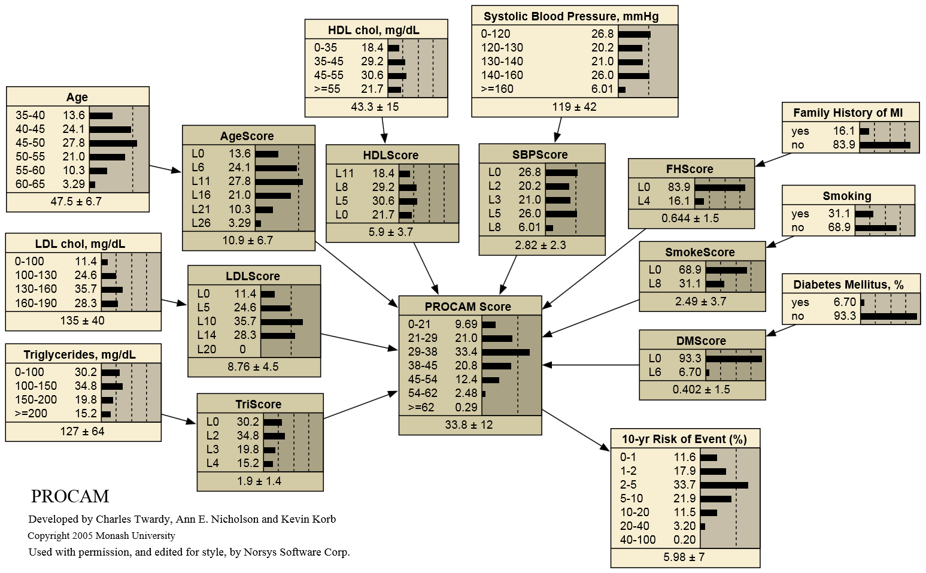
Myocardial Infarction and Acute Coronary Bayesian Network
Bayesian Network
Probability Distribution and Interdependent Conditions

Slide 24
Bayesian Network to Predict Vulnerability to Sea-Level Rise
Structure of the Bayesian network used for the study:
Climate Change
* Courtesy U.S. Department of the Interior
U.S. Geological Survey

Slide 25
Variables Used in the Bayesian network
Bayesian Network to Predict Vulnerability to Sea-Level Rise
* Courtesy U.S. Department of the Interior
U.S. Geological Survey

Slide 26
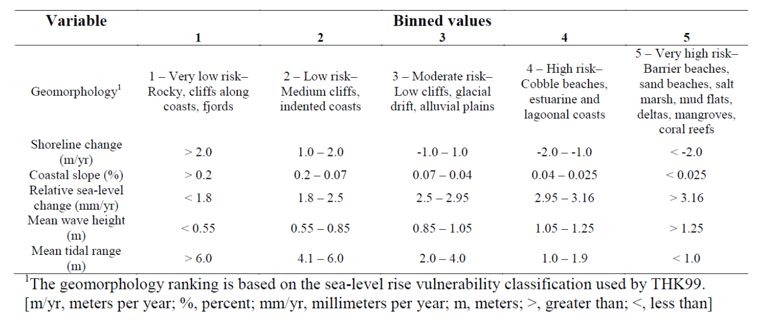
Variables are Inserted into the Model
* Courtesy U.S. Department of the Interior
U.S. Geological Survey

Slide 27
Sample Results
Bayesian Network to Predict Vulnerability to Sea-Level Rise
Probability of shoreline change less than -1 m/yr (erosion) calculated using the Bayesian network. The probabilities are color coded and labeled with terms developed by the Intergovernmental Panel on Climate Change.
* Courtesy U.S. Department of the Interior
U.S. Geological Survey

Slide 28
Summary
Risk Assessment Process
Risk Management Elements
Bow Tie
Ishikawa Fish Bone Diagram
Heat Matrix
Bayesian Network Modelling

Slide 29

Thank-You.
Questions?

