Slide 1
RMA/AUMA/IAMA Asset Management Cohorts
February 12, 2020

Slide 2
Project Purpose
Funded through FCM MAMP program
Build asset management capacity through group learning
Progress on FCM MAMP Asset Management Readiness Scale
Develop tangible outcomes
AM policy
AM strategy
AM team terms of reference
Support collaboration among participants beyond the cohort

Slide 3
Cohort Characteristics
Two cohorts
Cohort 1 – 12 municipalities
Cohort 2 – 13 municipalities
Different types and sizes
Different levels of AM progress, but all early in process
Within a three-hour drive
All formalized commitment to participation

Slide 4
Cohort Process
One to three staff per municipality
Three in-person workshops
Ongoing touchpoints
Focus on policy, strategy and building AM capacity
Utilized templates
Built group learning/mentorship into process

Slide 5
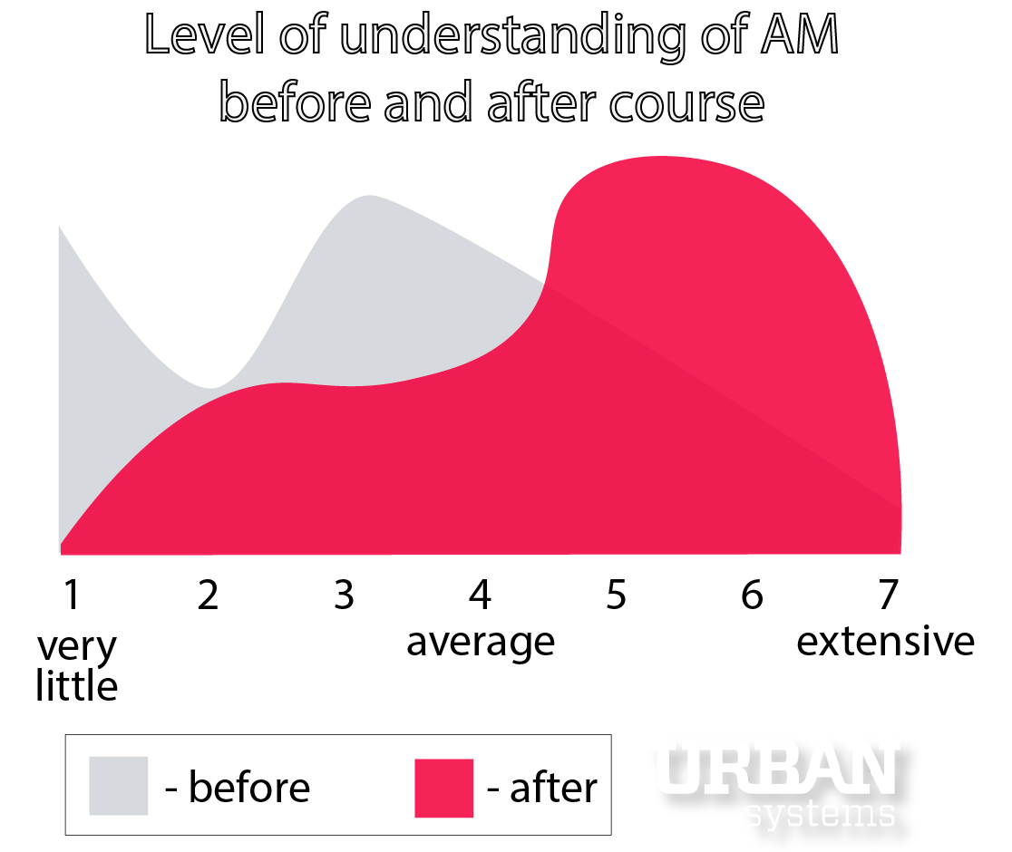

Slide 7
Delivery partnership

Slide 8
Partnership

Slide 9
“Enhance the well-being of Alberta communities through leadership in asset management” (IAMA) “Strong, vibrant and resilient rural communities” (RMA) “AUMA is a change agent that enables municipalities to be a fully engaged order of government with the capacity to build thriving communities” (AUMA)

Slide 10
Partner roles
AUMA/RMA
Administer cohorts
Reporting to FCM
Grant management
Consultant management
Scheduling and logistics
IAMA
Provide subject matter expertise
Review materials
Support cohort discussion
Provide post-cohort learning opportunities

Slide 11
Looking forward

Slide 12
More funding!
RMA, AUMA and IAMA applied for more MAMP capacity-building funding in 2019
Application was successful
Funding will allow the associations to build on the success of the 2019 cohorts

Slide 13
2020-2021 Delivery
Three additional introductory cohorts in different areas of province
Development and delivery of cohort 2.0 to a combination of municipalities that have already completed the introductory cohort
Associations are currently working on designing the cohort recruitment process and securing a consultant to deliver the cohorts.
The cohorts are likely to begin in spring 2020

