Slide 1
Sidewalk and Paved Trail Assets Condition Rating
Ryan Yuha - Camrose, Gary St. Michel – Tetra Tech
IAMA
February 2020

Slide 2
Contents
Sidewalk and Paved Trail Assessment
  Definitions
  Field investigation / data collection
Cross-Asset Comparative Level of Service Condition Index
  Asset Damage Index
Dashboard / GIS for Trail Management

Slide 3
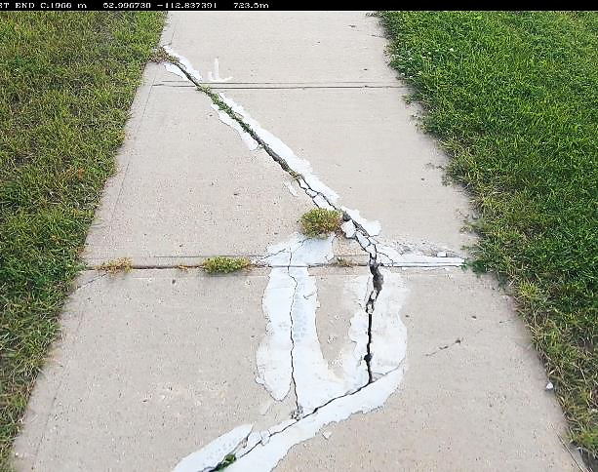
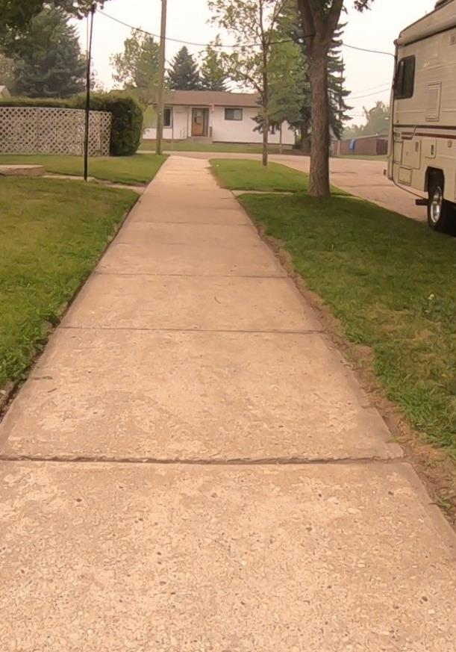
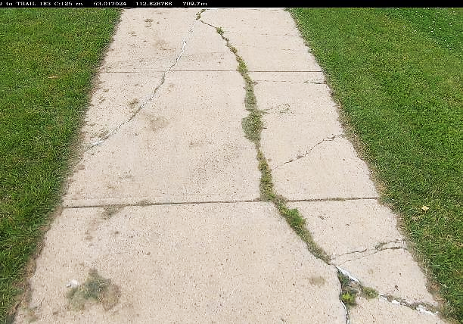
Sidewalk and Paved Trail Assessment
Sidewalks
  Roadway adjacent pedestrian facility
  May be separated from the road by a strip of grass trees or other vegetation
  Accommodate users of all ages and abilities
  Need to accommodate wheeled transportation

Slide 4
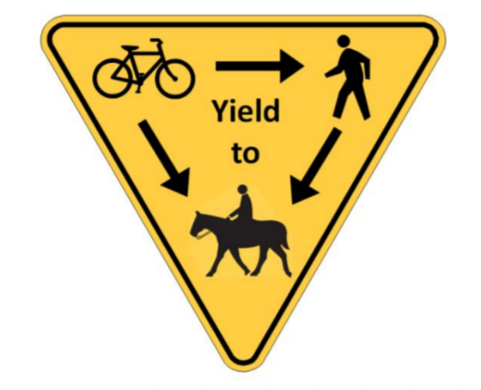
Sidewalk and Paved Trail Assessment
Paved Trails
  Also known as:
    Multi-Use Paths (MUPs)
    Shared Use Paths
    Active Transportation (AT) Paths
  Accommodate all sidewalk users and more
    Bicycles
    Inline skaters
    Equestrians?

Slide 5
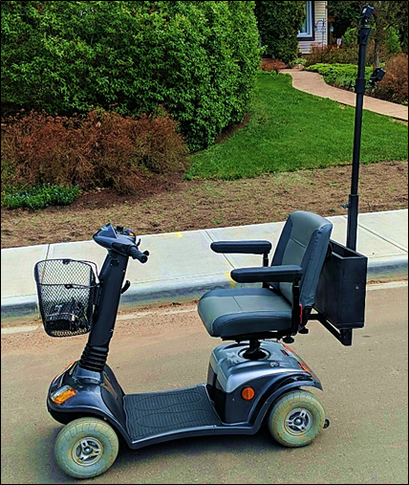
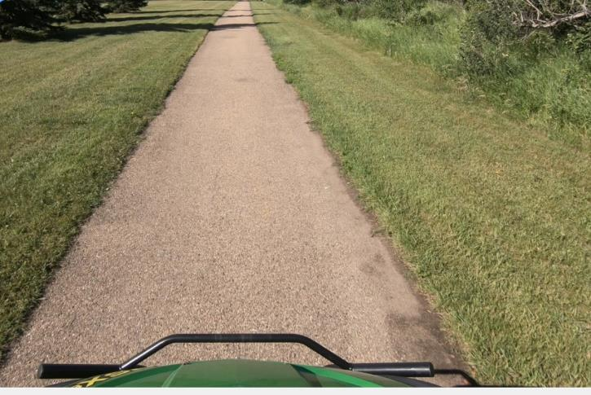
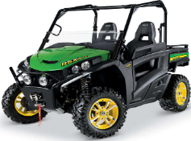
Field Investigation
GPS enabled Video camera mounted to a data collection platform, type should be consistent with facility use and user expectations
    An ATV Gator – similar to that used by City maintenance crews
    Bicycle may be suitable in some areas
    Personal mobility scooter

Slide 6
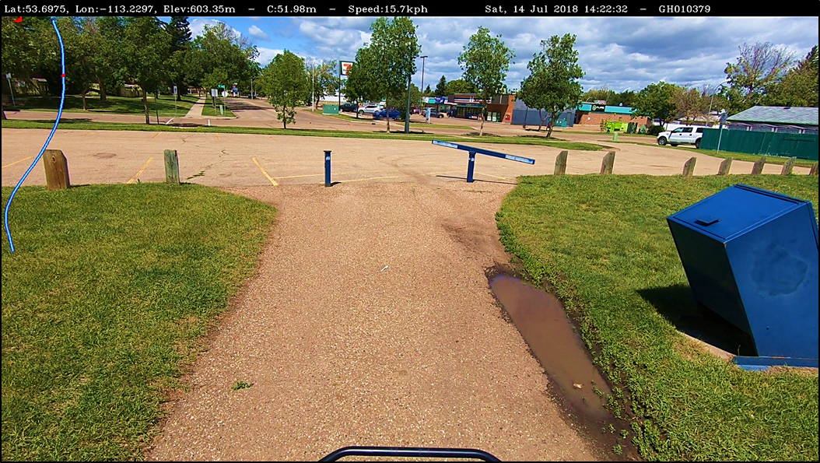
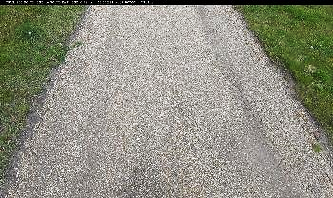
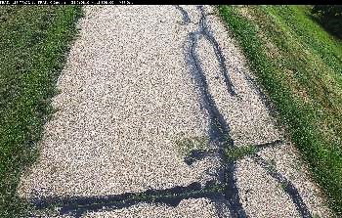
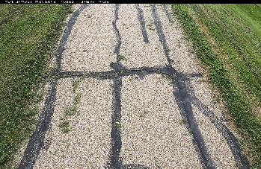
Field Investigation
Images are extracted from the video at 4 m intervals
  Imprinted with GPS location, date, and pictorial of the alignment
Location on
Trail Section

Slide 7
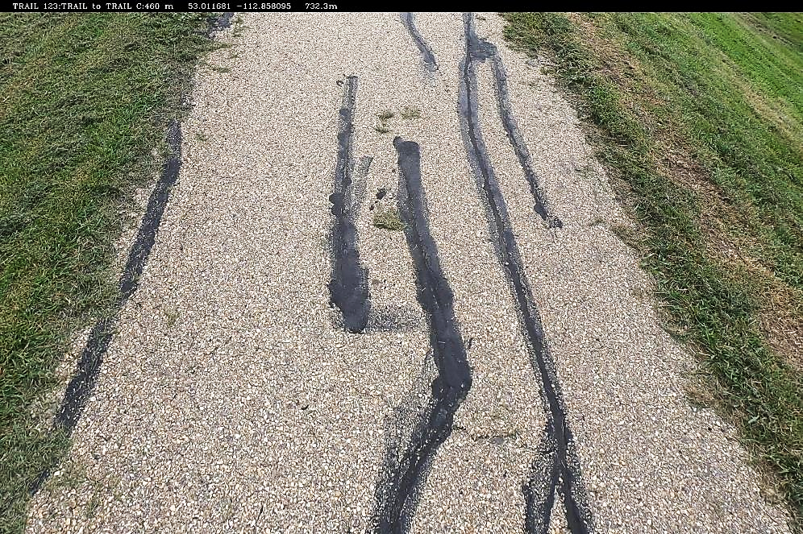
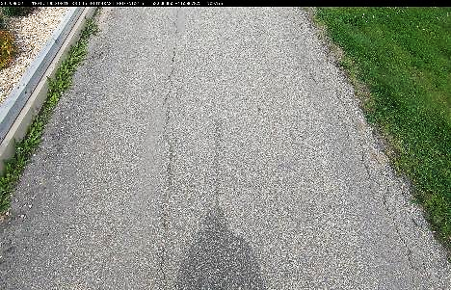
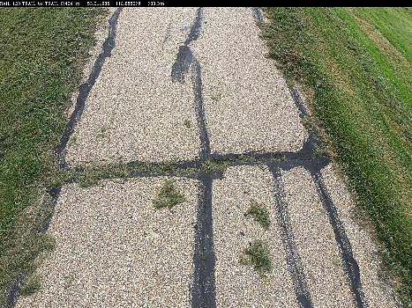
Field Investigation
Images provide a record of the survey, and
Define the Sample Units for condition rating

Slide 8
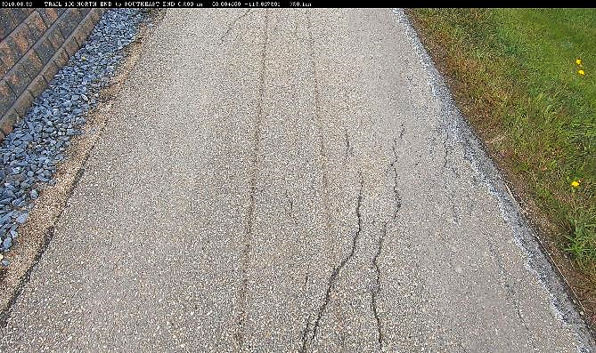
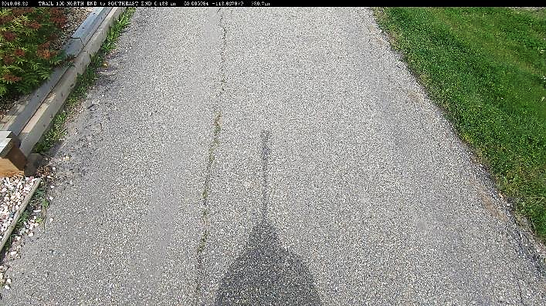
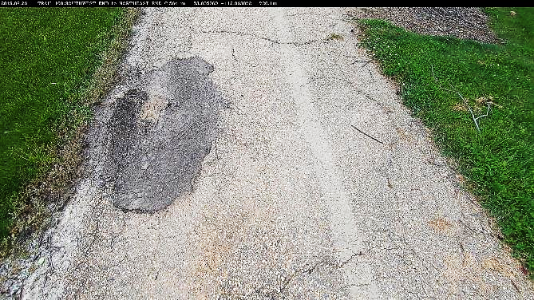
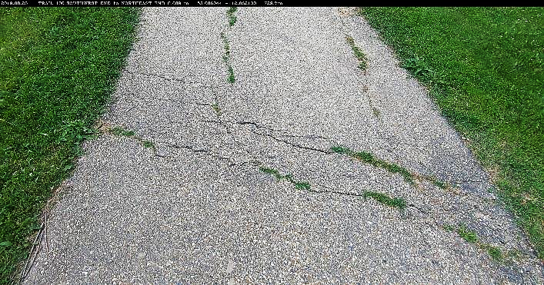
Field Investigation
Asphalt Trail samples

Slide 9
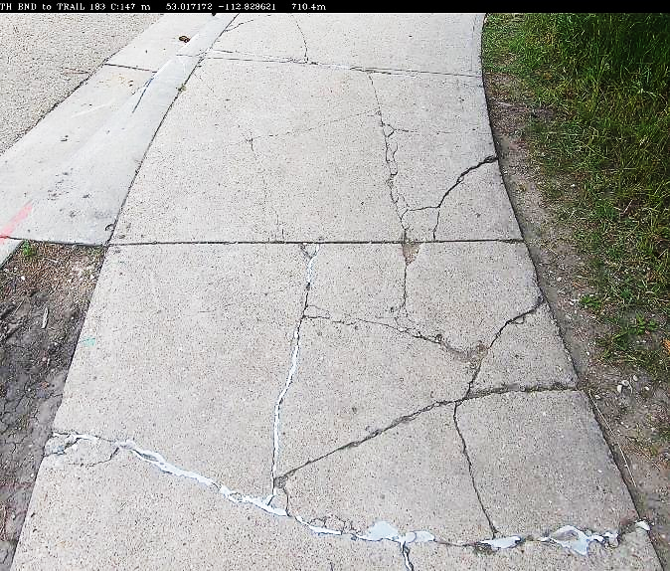
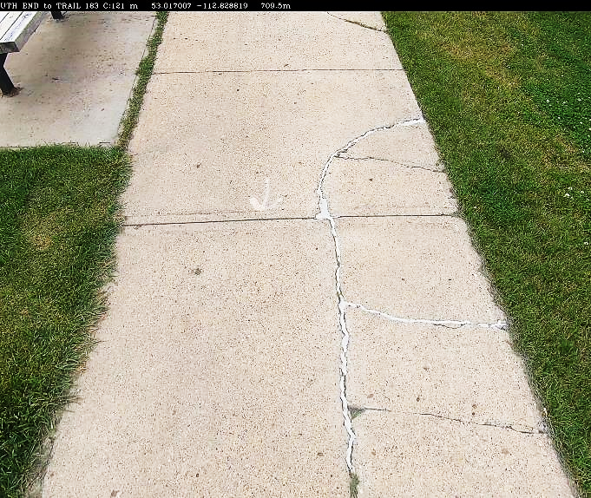
Sidewalk and Paved Trail Assessment
Image quality has been excellent and it is easy to see defects

Slide 10
Condition Rating
Condition rating based on “Development of Cross-Asset Comparative LOS Condition Index” by St. Michel, G., Reggin, A., and Rafiei, K., 2017, Transportation Association of Canada Conference, St. John’s, NL.
The rating is based on the works that could be done, defined as:
ASSET CONDITION | DESCRIPTION
Excellent | Asset appears in new condition with no visible distresses
Good | Asset appears relatively aged and has no visible distresses
Fair | The distress is visible but in the rater’s opinion, the distress does not affect the function of the asset and no repair can, (or needs), to be done (e.g. a just visible crack).
Poor | The distress has progressed to the point where a maintenance repair, could be readily and cost effectively applied to maintain the serviceability of the asset.
Very Poor | The Sample unit has deteriorated to the point where, maintenance repairs will be insufficient to economically re-establish proper function of the asset. All samples with Hazards are identified as Very Poor.
https://www.tac-atc.ca/sites/default/files/conf_papers/stmichelg_development_of_cross-asset_comparative_los_condition_index.pdf

Slide 11
Condition Rating
To assist the rater, an initial review is completed to determine typical distresses and maintenance/rehabilitation work.

Slide 12
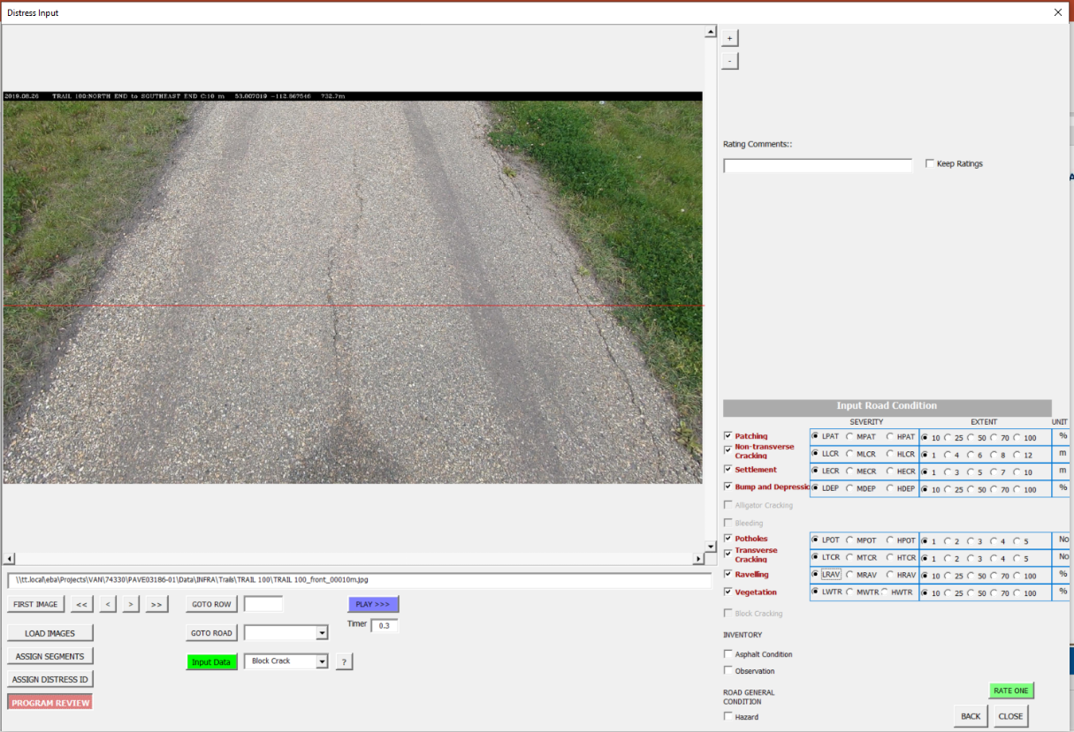
Condition Rating
A data entry and rating form is used to rate each sample

Slide 13
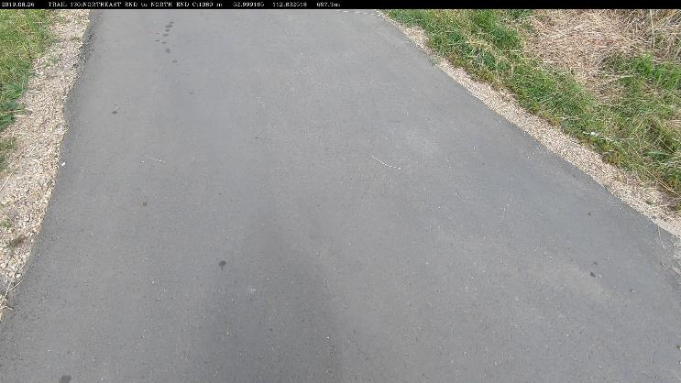
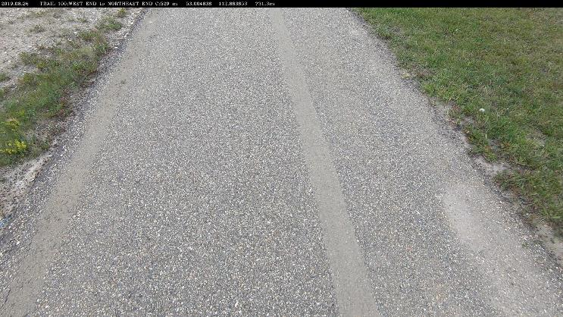
Condition Rating
V Good AC
Good AC

Slide 14
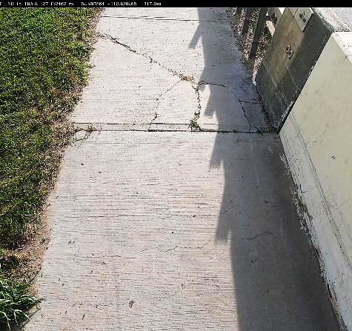
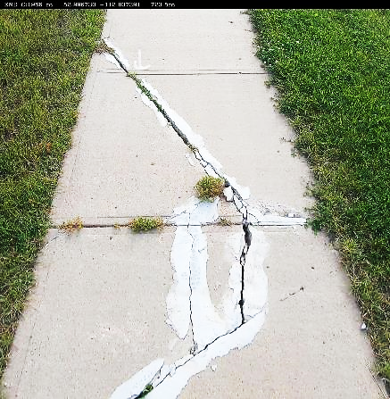
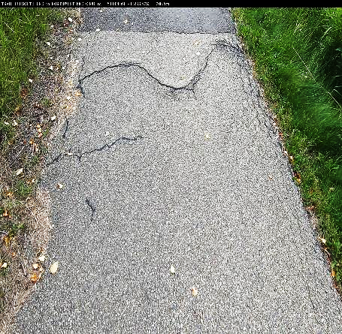
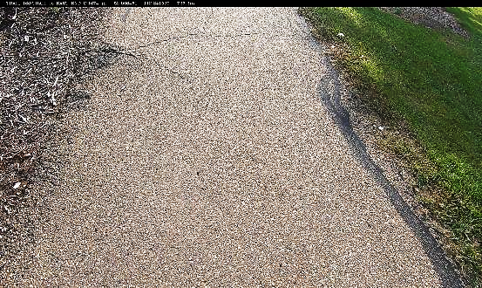
Condition Rating
Recorded data is associated with each image that can always be reviewed
Fault
Fair Conc
Hazard
Fault
Poor Conc
Hazard
MSETCRCK
Fair AC
Hazard
Roots
Poor AC

Slide 15
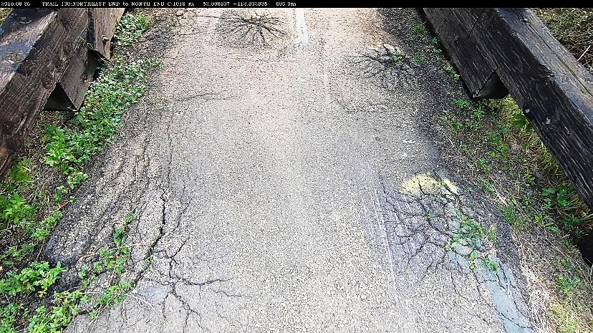
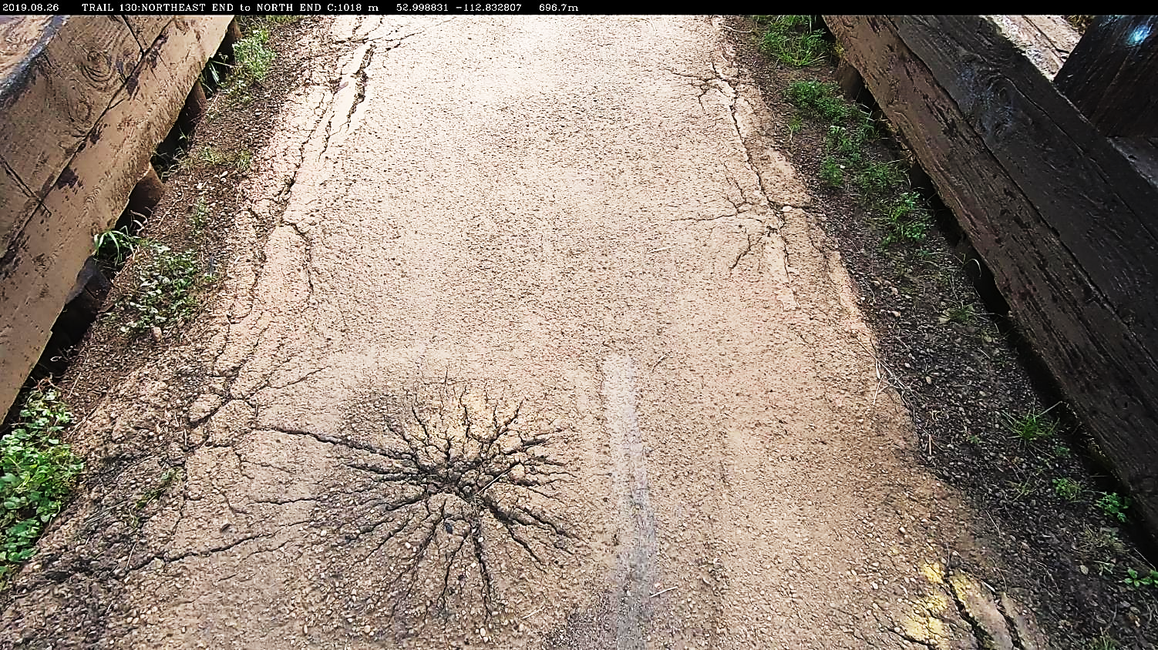
Condition Rating
Hazard
Roots
Very Poor AC

Slide 16
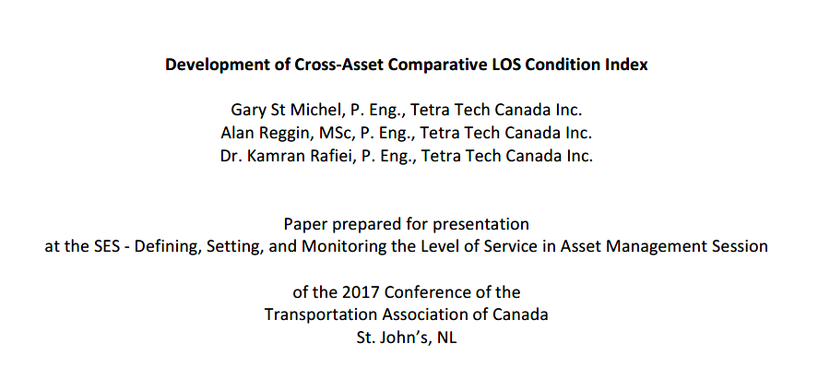
Development of Cross-Asset Comparative LOS Condition Index
Recently developed, damage based, level of service index
Conveys not only condition, but also severity and density of distress through a single index:
  The ADI – Asset Damage Index
https://www.tac-atc.ca/sites/default/files/conf_papers/stmichelg_development_of_cross-asset_comparative_los_condition_index.pdf

Slide 17
Development of Cross-Asset Comparative LOS Condition Index
The ADI – Asset Damage Index
  ADI is a compilation of sample unit ratings across sections of the network (e.g. block to block for sidewalks, logical portions of trails with similar age or condition).
  For the ADI, the sections are known as the ‘Asset’
  Directly informs the Asset Manager as to which sectional treatment category is suggested.

Slide 18
Development of Cross-Asset Comparative LOS Condition Index
The ADI – Asset Damage Index
  Structured to result a number from 10 to 0 that corresponds to the sections’ inspection / maintenance / rehab / replacement activity
ADI RANGE | DISTRESS | ACTIVITY
9 ≤ ADI ≤ 10 | No Distress | Do-Nil
8 ≤ ADI < 9 | Some Distress Exists | Field Inspection
5 ≤ ADI < 8 | Some Maintenance Repairs Suggested | Develop Maintenance Program
2 ≤ ADI < 5 | Less than 30% of Sample Units need Replacement and/or greater than 30 % of Samples need Maintenance Repair | Develop Rehabilitation Program
0 ≤ ADI < 2 | More than 30% of Sample Units need Replacement and/or greater than 60 % of Sample Units need Maintenance Repair | Develop Replacement Program

Slide 19
Development of Cross-Asset Comparative LOS Condition Index
The ADI – Asset Damage Index – Calculation
Deduct Values
All sample units in an asset section are assigned a deduct value based on their current condition.
ASSET CONDITION | SAMPLE UNIT DEDUCT VALUE | DESCRIPTION
Excellent | 0 | The Sample Unit is assigned a deduct value of Zero.
Good | 1 | The Sample Unit is assigned a deduct value of One.
Fair | 2 | The Sample Unit is assigned a deduct value of Two.
Poor | 5 | The Sample Unit is assigned a deduct value of Five.
Very Poor | 10 | The Sample Unit needs to be replaced. The Sample Unit is assigned a Deduct Value of Ten.

Slide 20
Development of Cross-Asset Comparative LOS Condition Index
The ADI – Asset Damage Index – Calculation
Density
Density of sample units in each category. The sum of all densities in a section is always 100.
Density | SAMPLE UNIT DEDUCT VALUE | DESCRIPTION
D₀ | 0 | Density of sample units in excellent condition
D₁ | 1 | Density of sample units in good condition
D₂ | 2 | Density of sample units in fair condition
D₅ | 5 | Density of sample units in poor condition
D₁₀ | 10 | Density of sample units in very poor condition

Slide 21
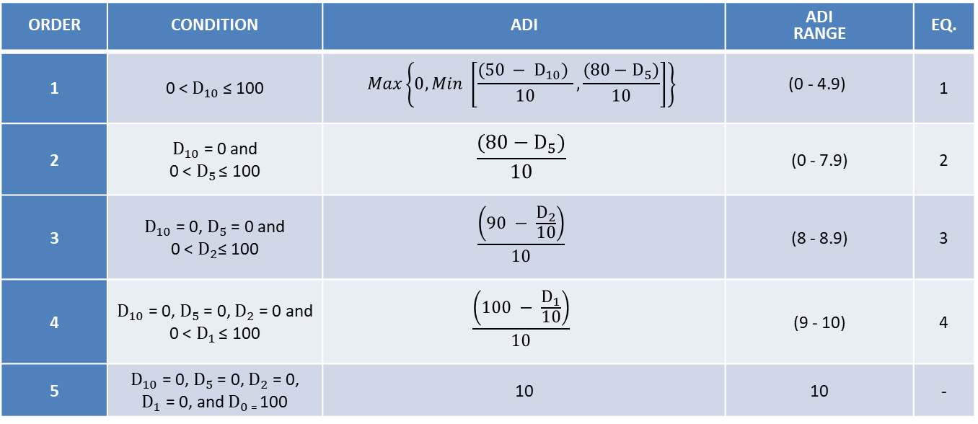
Development of Cross-Asset Comparative LOS Condition Index
The ADI – Asset Damage Index – Calculation
Calculate ADI from Density
Use the first equation where the condition is met. If the equation results in less than 0, report 0. ADI is rounded to one decimal place.
ORDER | CONDITION | ADI | ADI RANGE | EQ.
1 | 0 <$D_{10}$ ≤ 100 | $$Max\left\{0,Min \left[\frac{(50 − D_{10}) }{10}, \frac{(80−D_{5})}{10}\right]\right\}$$ | $$\text{(0 − }\text{4}\text{.9)}$$ | 1
2 | $D_{10}$ = 0 and 0 < $D_{5}$ ≤ 100 | $$\frac{(80−D_{5})}{10}$$ | (0 - 7.9) | 2
3 | $D_{10}$ = 0, $D_{5}$ = 0 and 0 < $D_{2}$≤ 100 | $$\frac{\left(90 − \frac{D_{2}}{10}\right)}{10}$$ | (8 - 8.9) | 3
4 | $D_{10}$ = 0, $D_{5}$ = 0, $D_{2}$ = 0 and 0 < $D_{1}$ ≤ 100 | $$\frac{\left(100 − \frac{D_{1}}{10}\right)}{10}$$ | (9 - 10) | 4
5 | $D_{10}$ = 0, $D_{5}$ = 0, $D_{2}$ = 0, $D_{1}$ = 0, and $D_{0}$ ₌ 100 | 10 | 10 | -

Slide 22
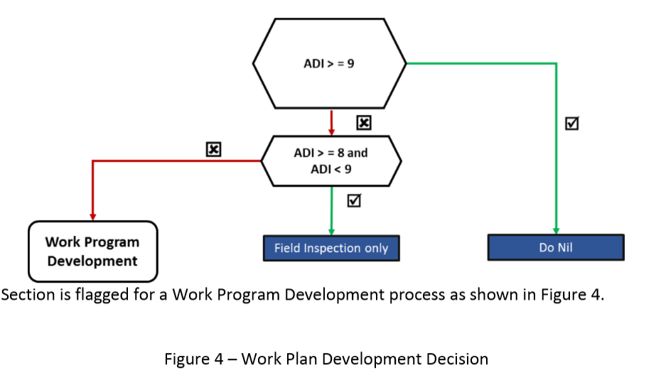
Work Plan Development Decision

Slide 23
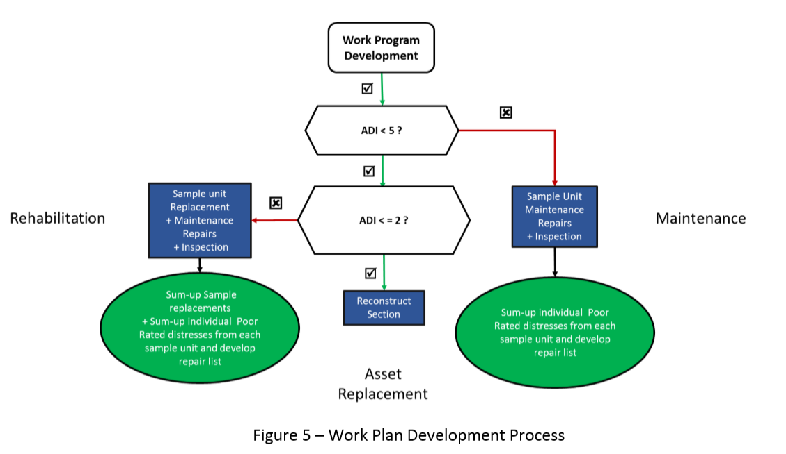
Work Plan Development Process

Slide 24
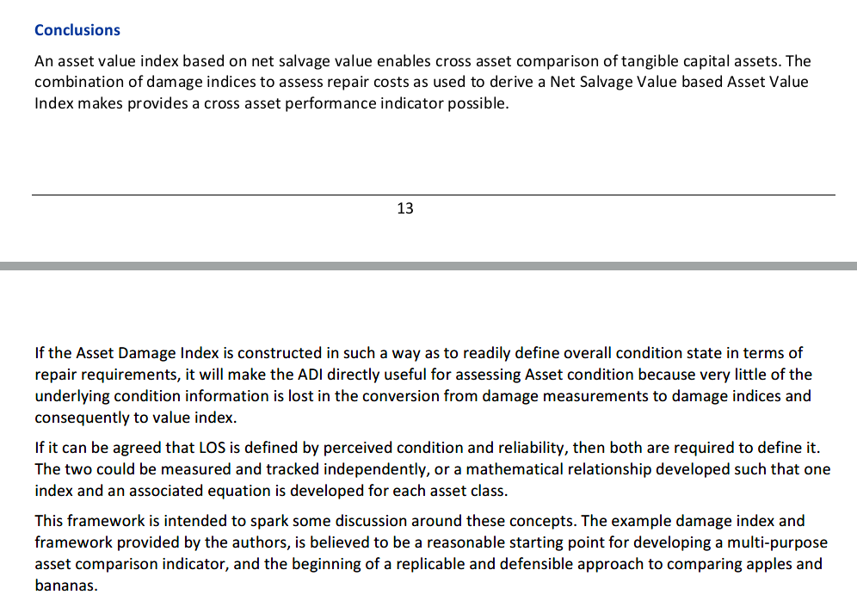
Development of Cross-Asset Comparative LOS Condition Index
From the paper:

Slide 25
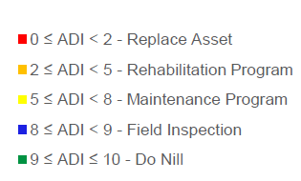
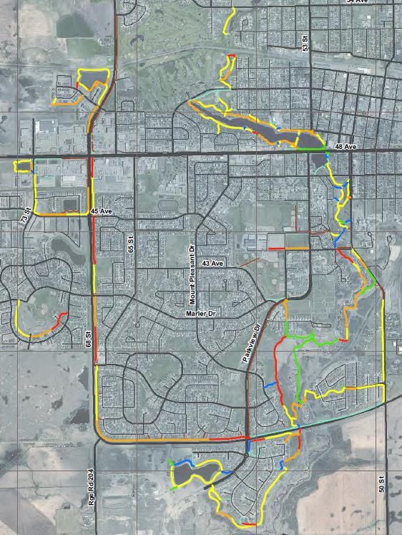
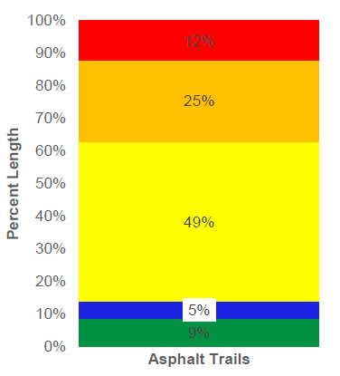
Development of Cross-Asset Comparative LOS Condition Index
Example Condition of a Asphalt Trails

Slide 26
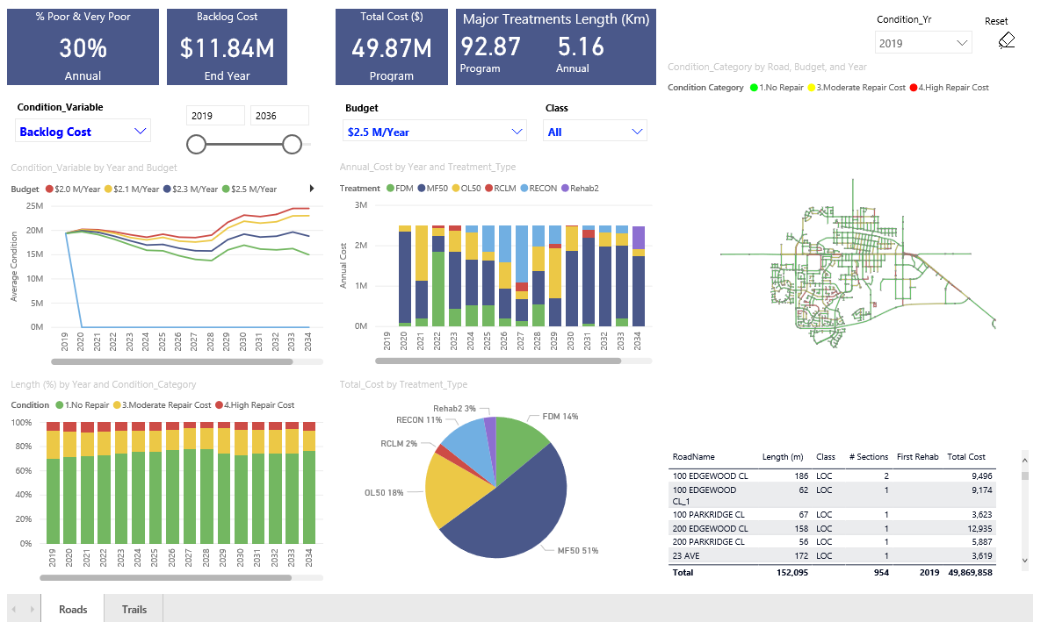
Dashboard
This is a municipal pavement management dashboard – hosted as the home page of SharePoint Online site

Slide 27
Dashboard
There is another Paved Trail dashboard

Slide 28
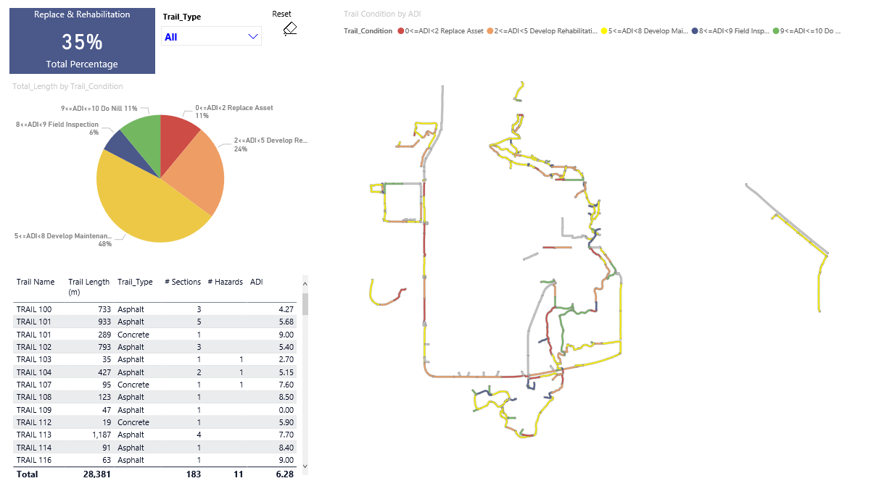
Dashboard
All visuals are linked. You can click to filter (slice and dice your data)

Slide 29
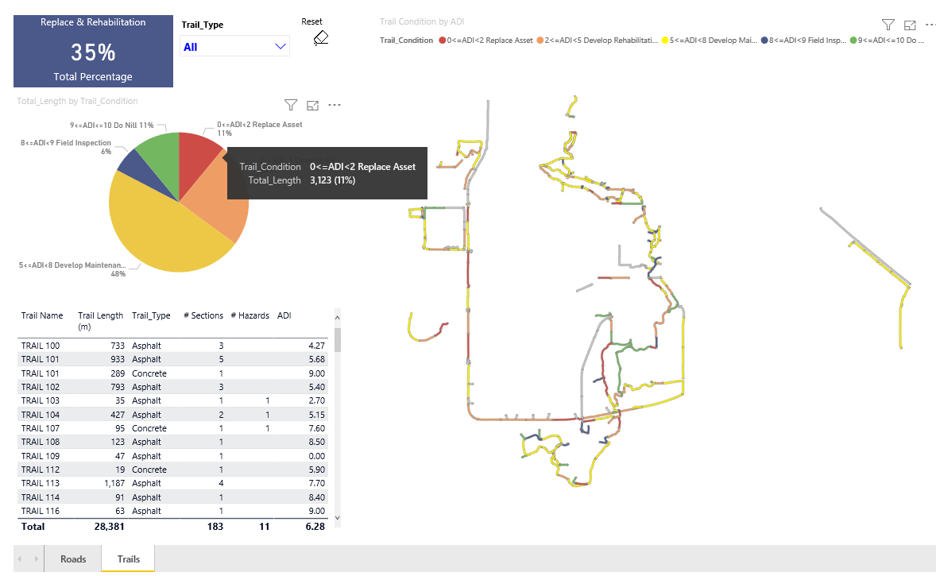
Dashboard
Click the wedge in the pie chart for Asset Distress Index <2

Slide 30
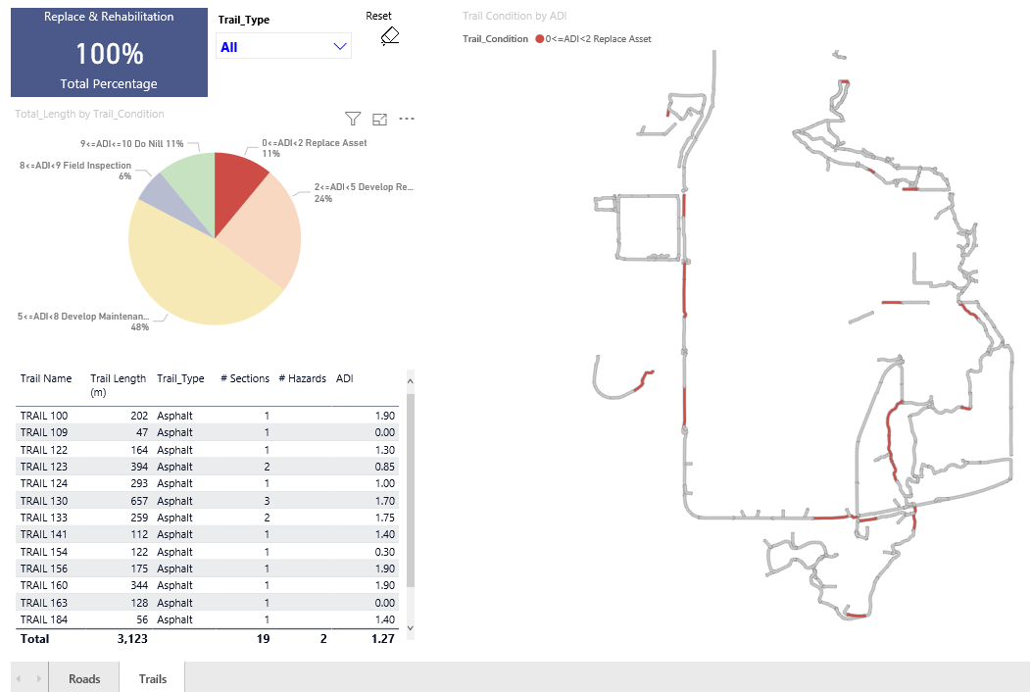
Dashboard
The map and length update to match the selection

Slide 31
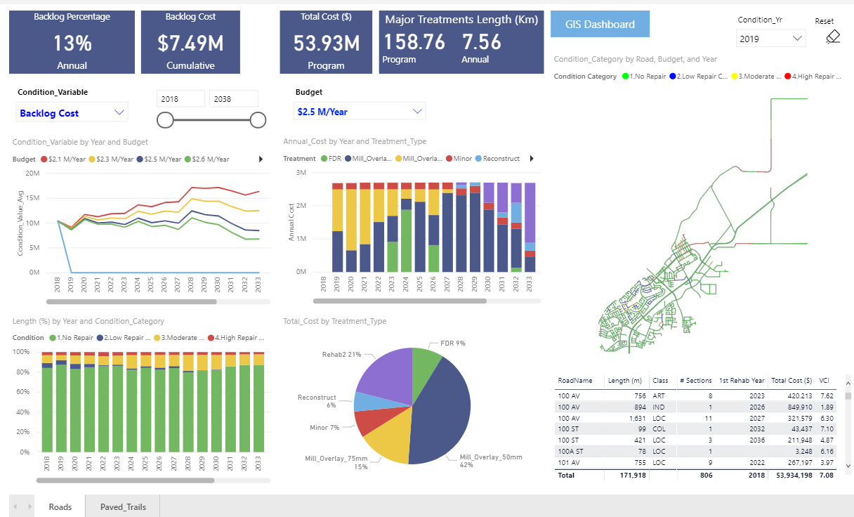
Dashboard
Links to other sites can be included

Slide 32
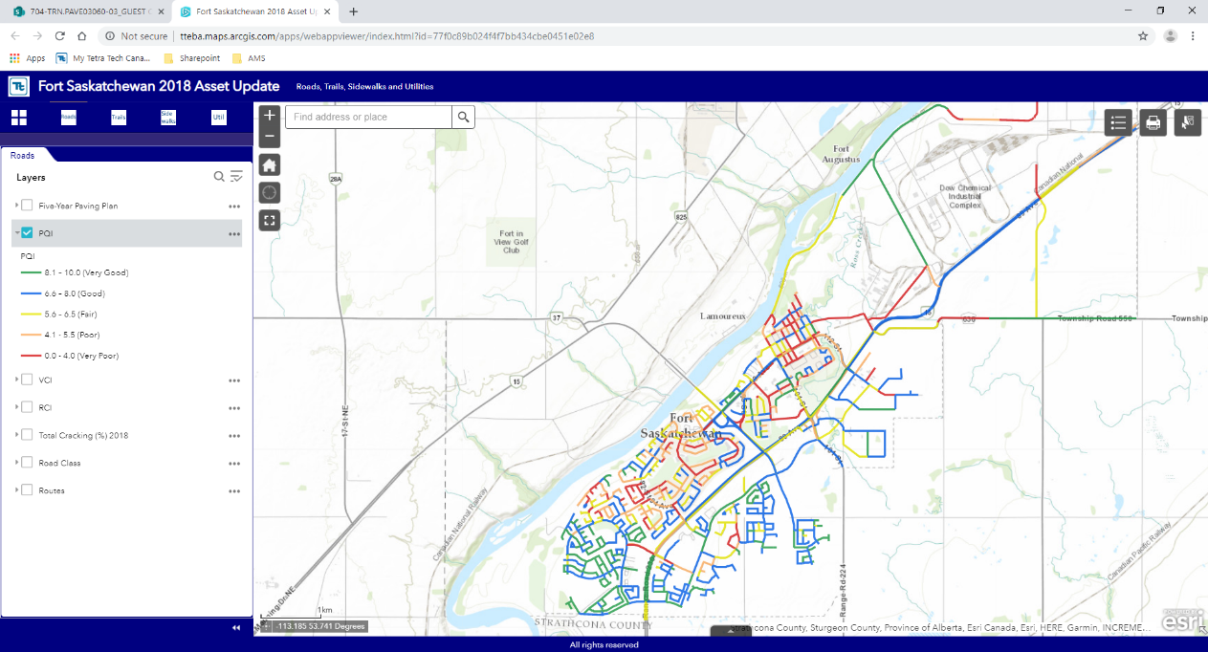
Dashboard
This a web-GIS
  More detailed data
  Separate tabs for Roads, Trails, Sidewalks, Utilities
  Does not have visuals of data or condition prediction

Slide 33
Thanks for your time

